Slide 1
3
NICE Dojo
Educational tools that provide access to product training

Slide 2
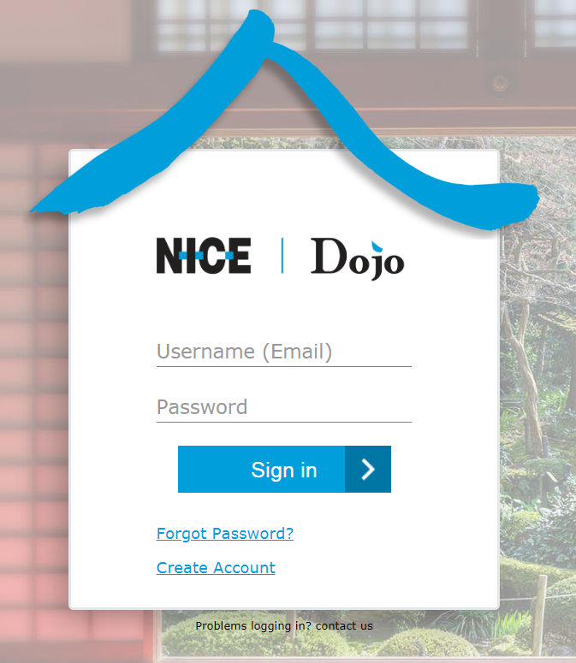
NICE Dojo
Unified learning platform for NICE inContact products and solutions
My Dojo – your personal space. It houses assignments and top picks just for you
Certification Center – Obtain and manage formal certification on our products
Join discussions in study groups and learning in our Communities
Get started here: Dojo

Slide 3
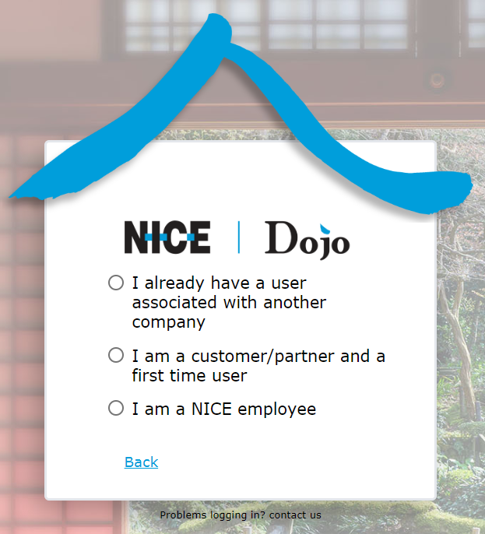
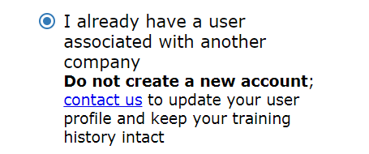
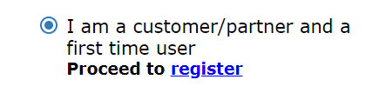
User Registration Experience

Slide 4
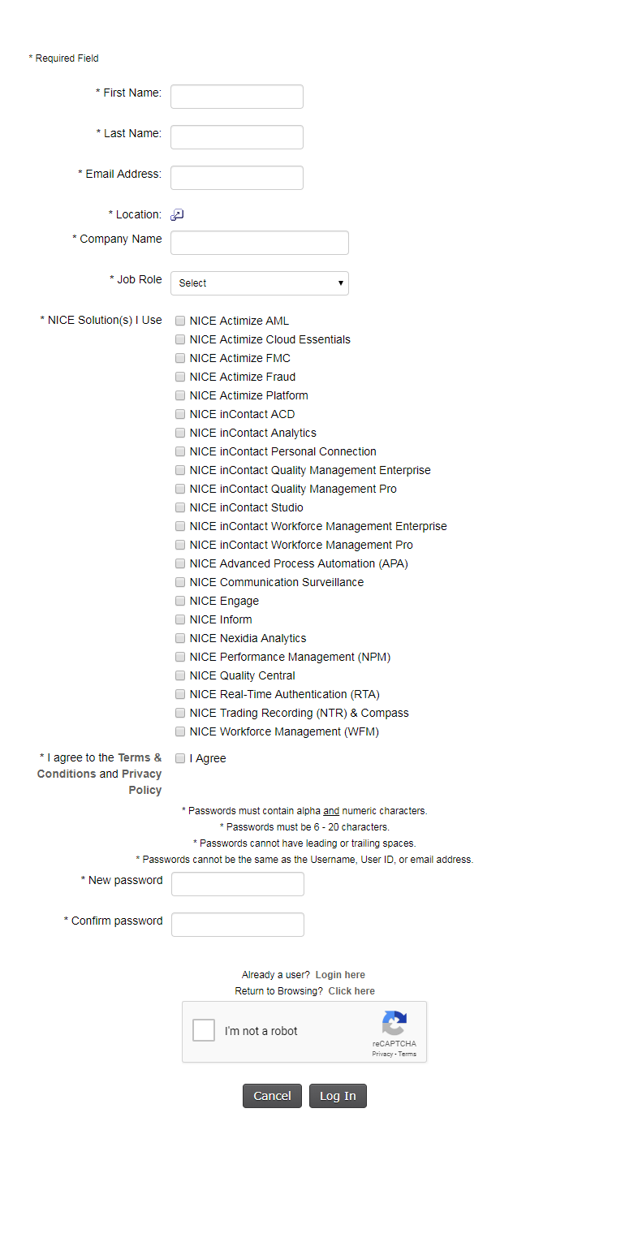
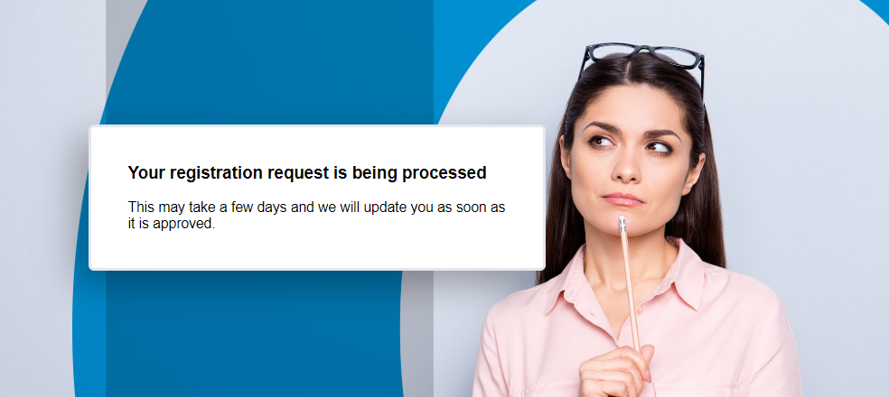
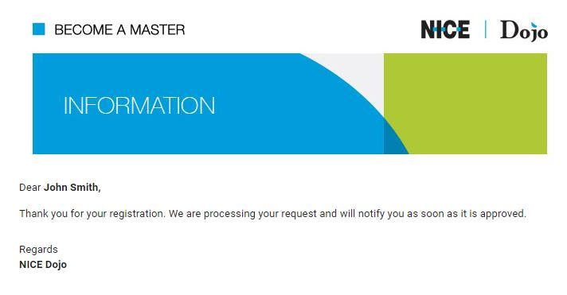
New User Registration Form
Notes:
Registration approval can take up to six hours. Once approved, you will receive a Welcome email that includes a log in link.
Your username is your email address, and your password is the one you entered in your registration form.

