Slide 1

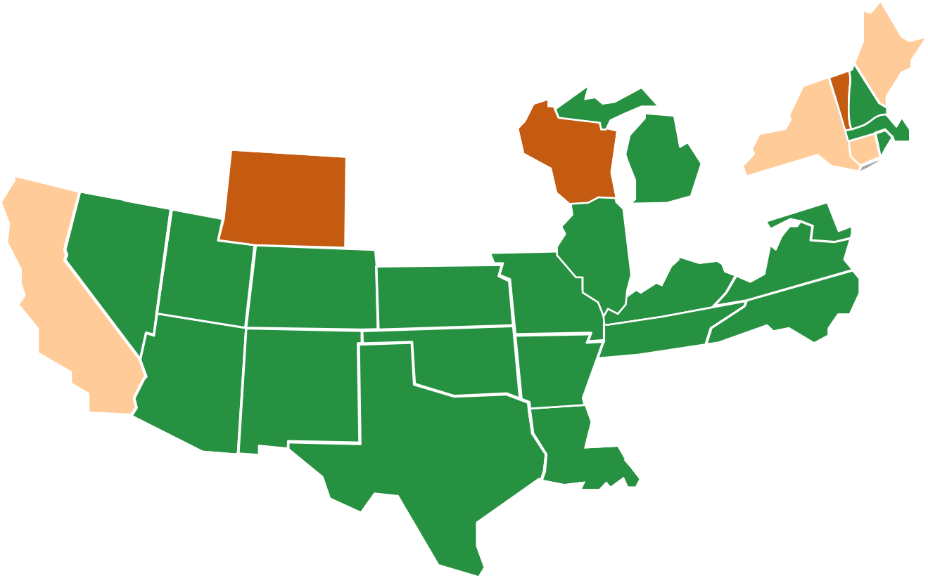
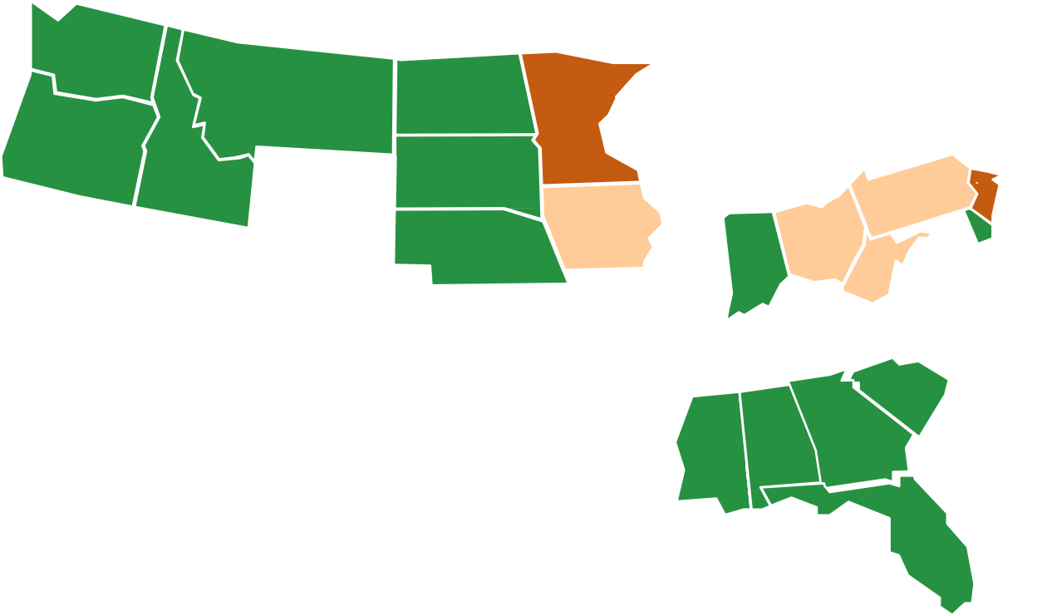
Program Terms $2,500($3,000) - $10,000
Microf believes that all consumers should have options when it comes to replacing their heating and cooling system. Our unique lease-purchase product (LTO+) has always been a great option for homeowners with damaged credit or for consumers looking for alternatives to traditional financing.
ME
LEASE TO OWN OPTION
VT
MN
NY
Microf offers monthly renewal payments based on 36, 48, 60, or 72 months to ownership (subject to underwriting approval)
Early Purchase Options Available
WI
CT
WY
PA
NJ
IA
OH
WV
CA
Microf owns the equipment until all payments necessary for lessee to acquire ownership have been made
Equipment permitted: Package System, Complete Split System, Mini Split, Boiler, Gas Furnace Only, and/or Condenser Only . No used Equipment.
36, 48, 60, and 72-months to own offered in these states. $0 cost to contractor. Min $2,500
Microf Lease to Own product not available in these states
NO CREDIT NEEDED!
NEXT DAY FUNDING!
Contractor Support:
855-498-8200
Customer Support:
855-642-7631
60 and 72-months to own not offered in these states (only 36 and 48 months to own). 5% contractor discount. Min $3,000
Capitalized Cost Reductions
(down payments) are not accepted in CA, IN and WV
www.Microf.com

