Slide 1


Information Technology
JIRA Project Tracking, Trouble Ticketing, IT Dev Team Communication and Process Tracking

Slide 2
EGIA Information Technology JIRA Project Tracking, Trouble Ticketing, IT Dev Team Communication and Process Tracking
EGIA IT JIRA
Project Tracking
Overall management of EGIA Information Technology Business Unit Project needs by area.
Trouble Tickets
Trouble ticketing, requests, MAC and Onboarding, Employee exit, Infrastructure and Security and Technology needs.
Dev Team Requests and Tracking
EGIA IT Dev Team requests, task assignment and communication.
Process Communication & Tracking Individual Process tracking and queues for Business Unit high profile and critical processes, (examples: Check Printing and rebate payment information updating).
EGIA IT
Help Desk
JIRA Projects and Trouble Tracking
Dev Communication
Process Tracking
Help Desk Call-in
1-(877) 260-6877
Help Desk Email Request
egiasupport@egia.org (support@egiaitteam.atlassian.net)
EGIA Portal Requests
https://egiaitteam.atlassian.net/servicedesk/customer/portals
Check Printing Process
https://egiaitteam.atlassian.net/jira/core/projects/CPP/board
Project Requests
tech@egia.org
Dev Team
egiadevteam2@egia.org

Slide 3
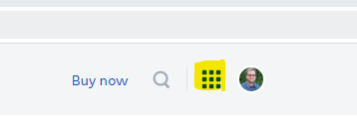
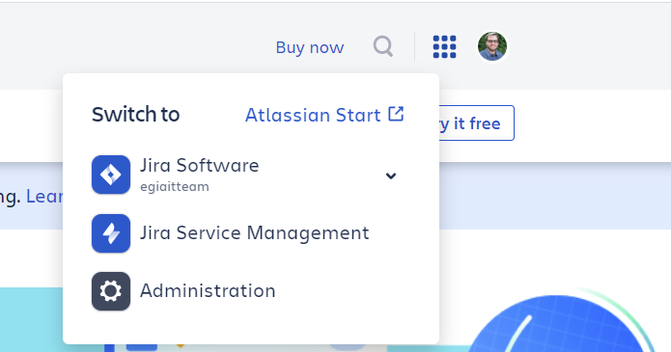
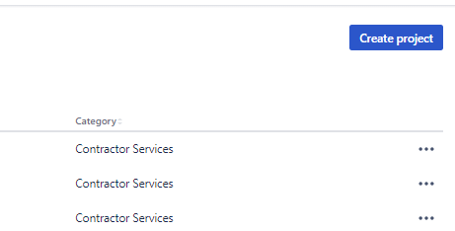
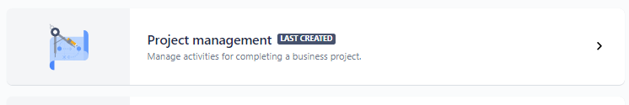
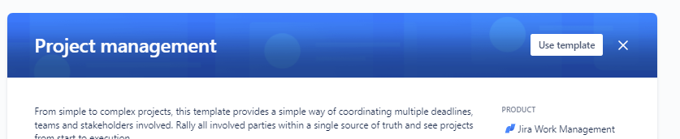
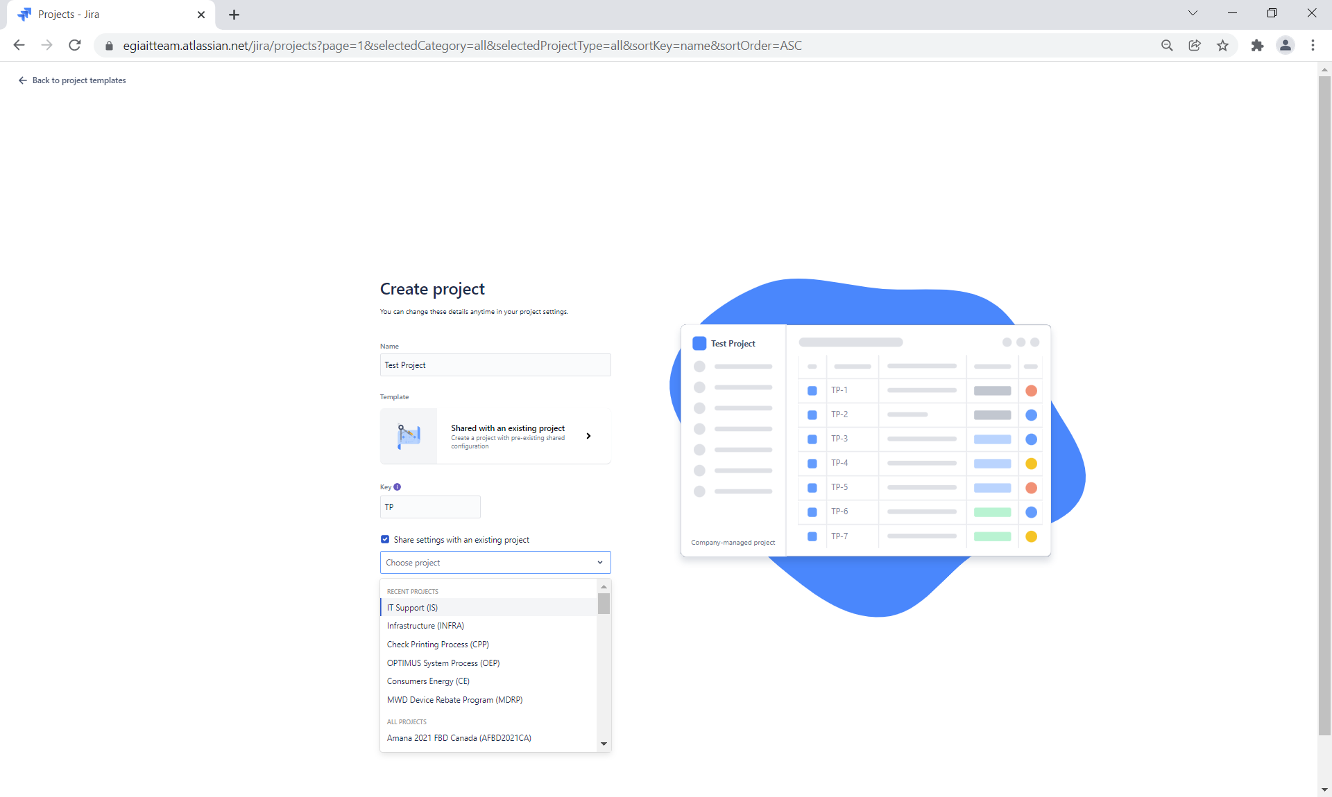
Project Tracking - Overall management of EGIA Information Technology Business Unit Project needs by area.
Jira Software Url: https://www.atlassian.com/software/jira Click on the boxes next to your account.
Choose Jira Software for egiaitteam
*Ensure that the filter is clear to see all projects.
Click the Create project button in the upper right-hand corner.
Choose Project Management & Use template
Title your project & choose a key
Check the share settings with an existing project button and then the project you would like to mimic.
Click Create project.

Slide 4
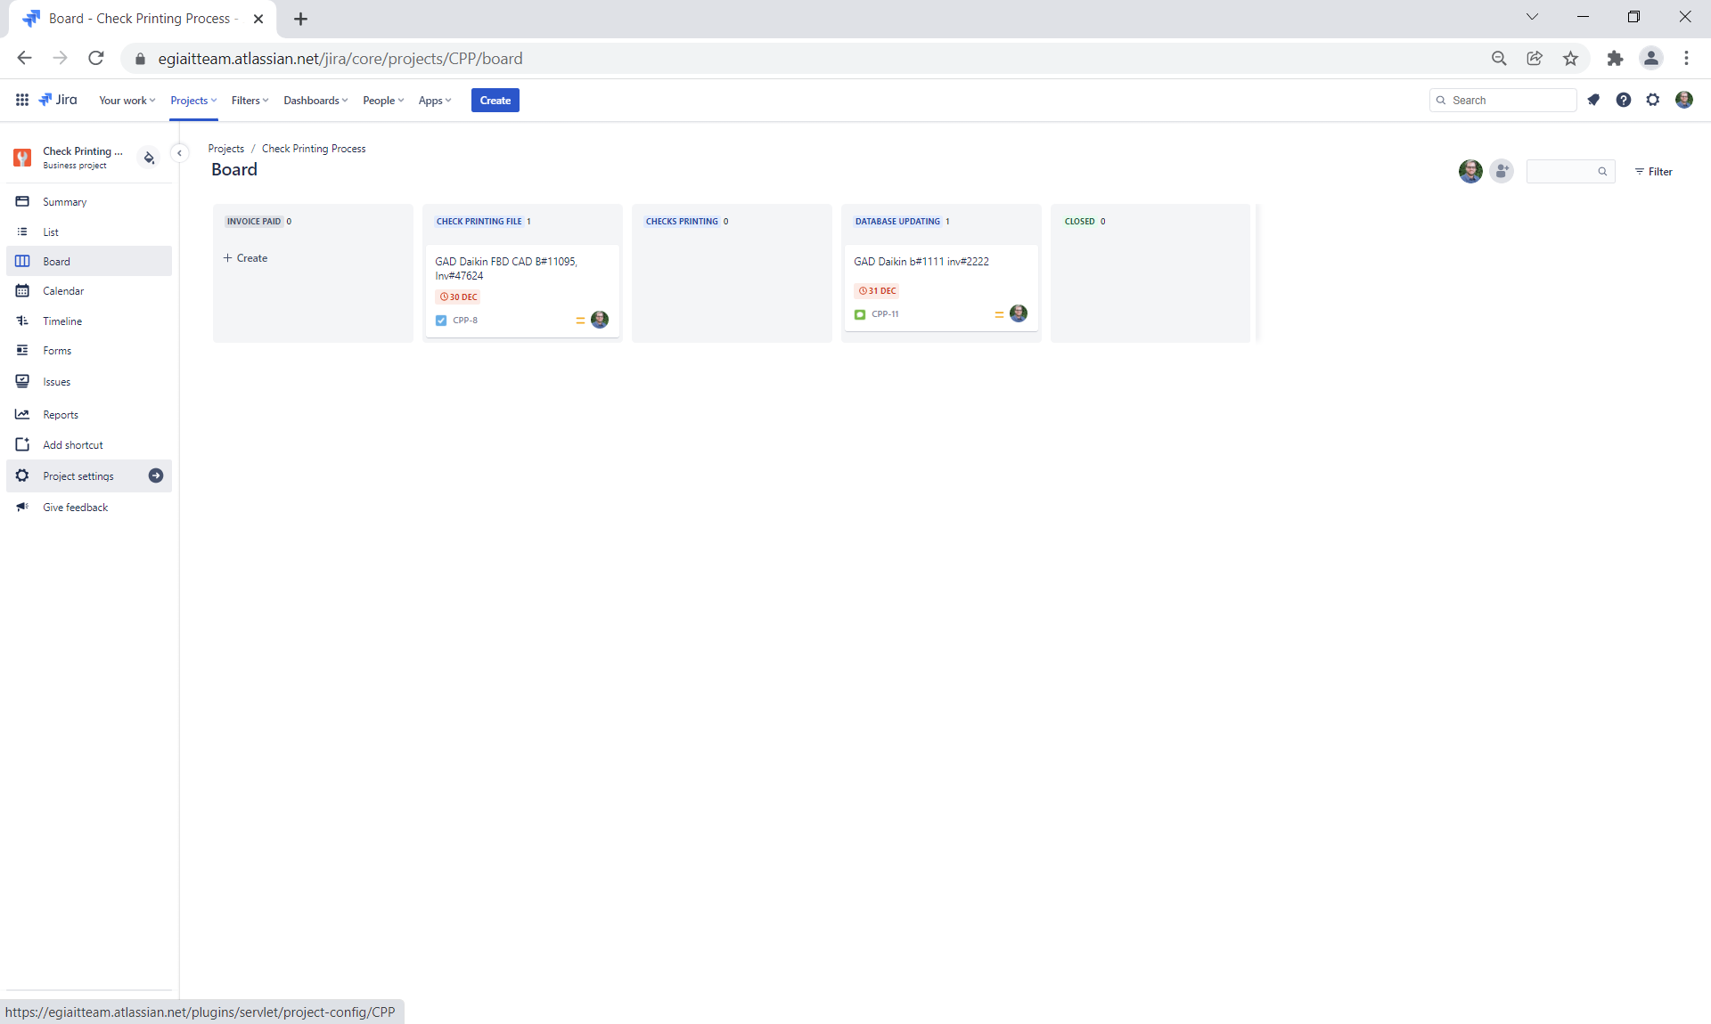
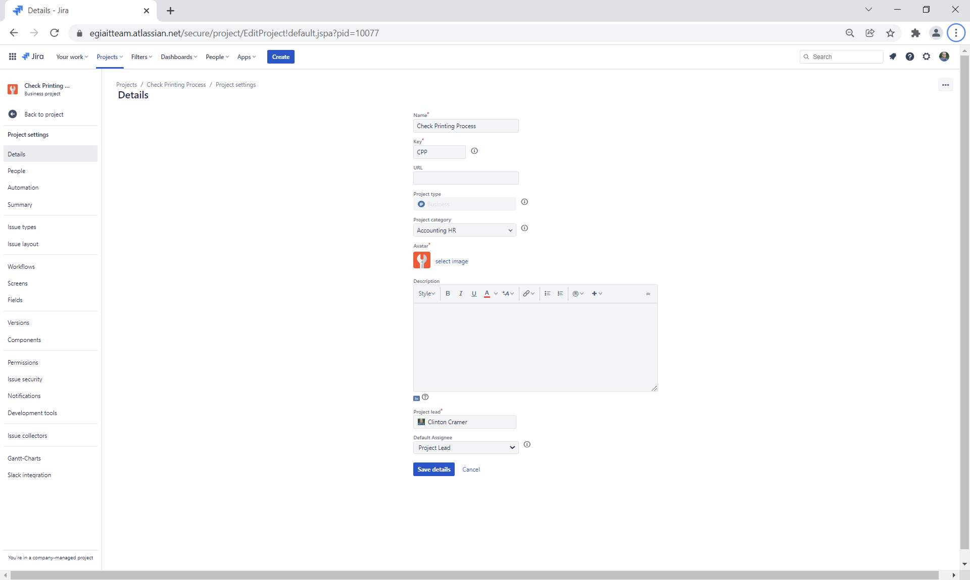
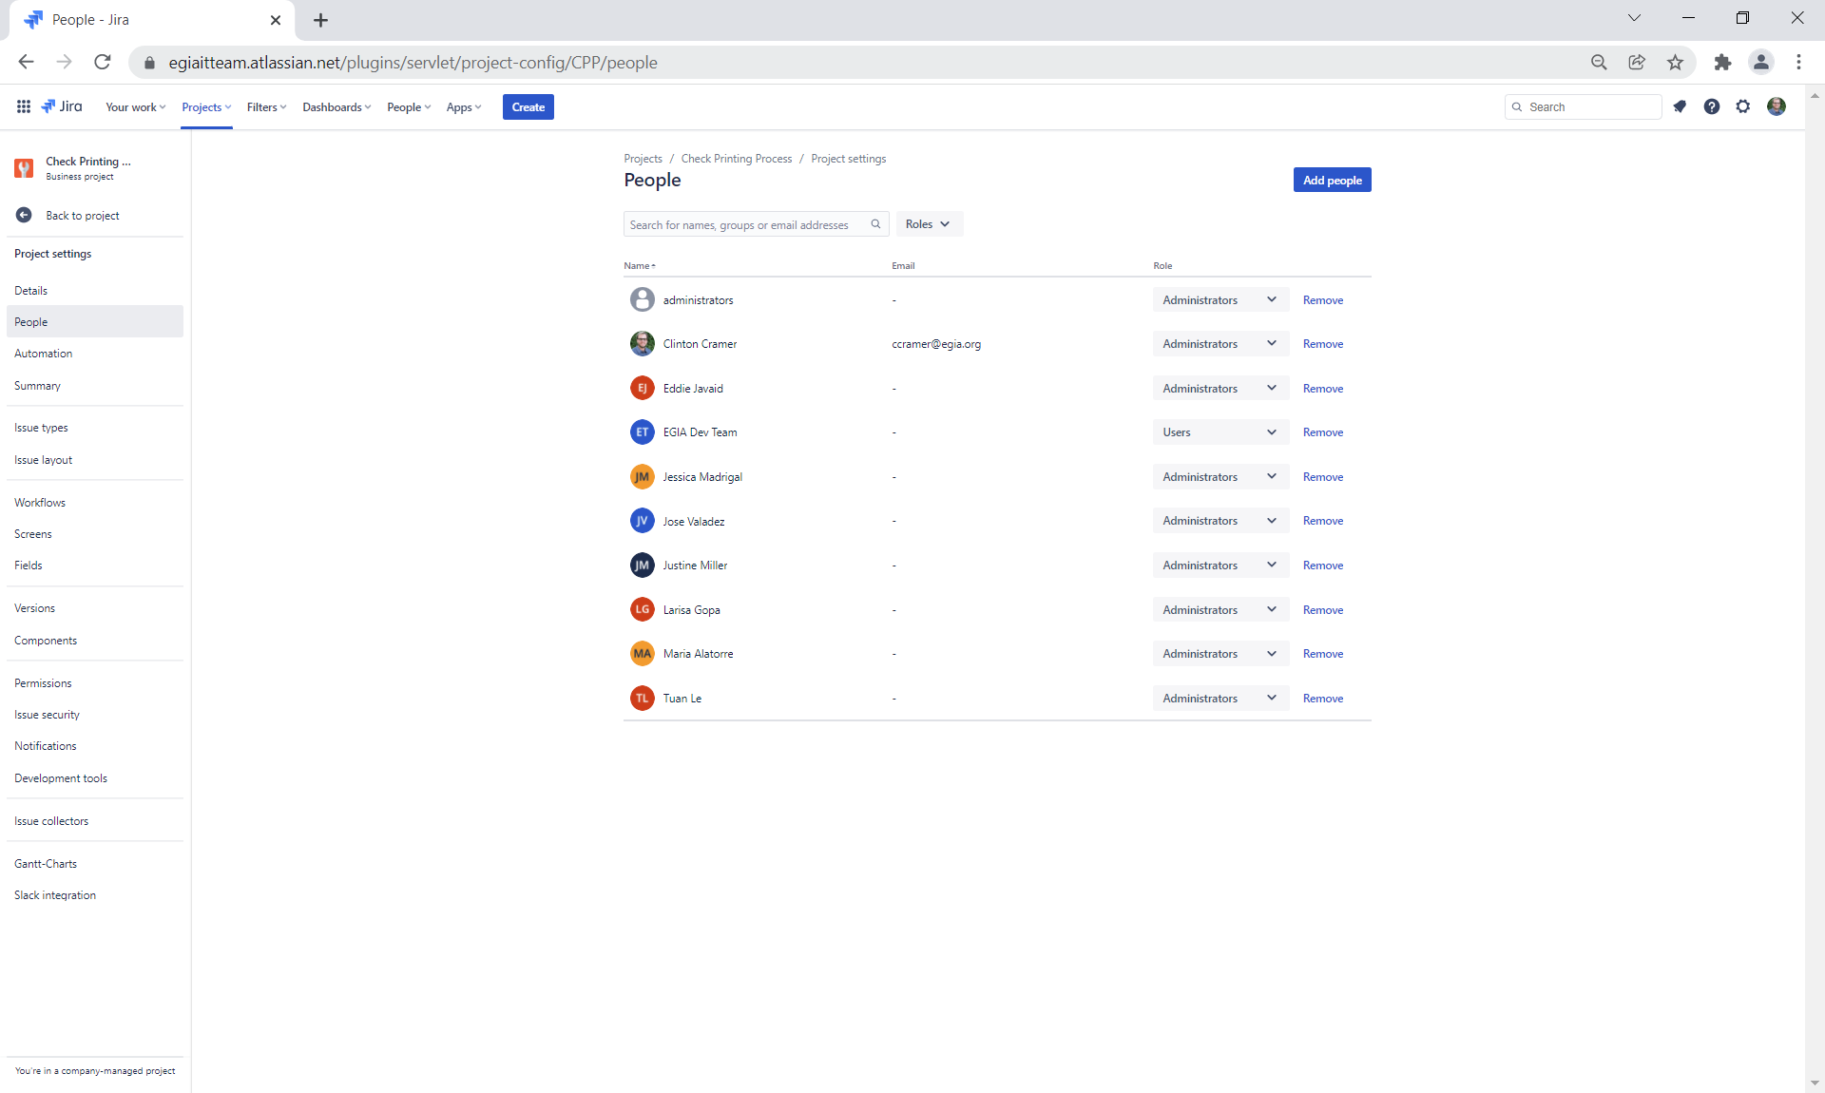
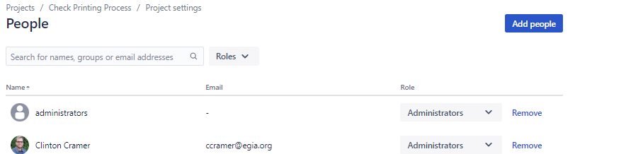
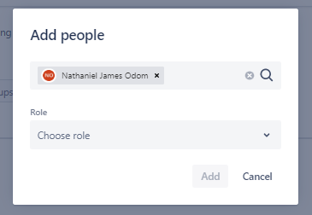
Project Tracking - Overall management of EGIA Information Technology Business Unit Project needs by area.
Navigate to Project settings:
On the Details screen, select Project category for the correct department and assign the lead
Save details
In the left-hand side menu list, select People
Click the Add people button, choose role and click Add (Note: You will have to add yourself or you will not be able to see the project)

Slide 5
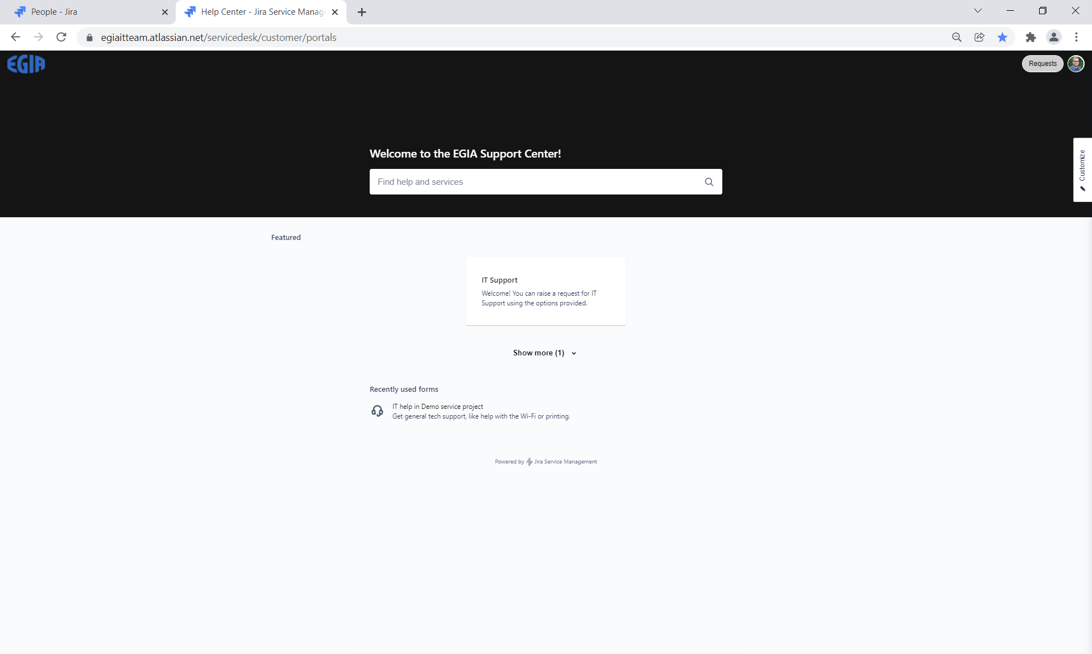
Trouble Tickets - Trouble ticketing, requests, MAC and Onboarding, Employee exit, Infrastructure and Security and Technology needs.
Preferred methods of submission:
Self-Help Desk portal request
https://egiaitteam.atlassian.net/servicedesk/customer/portals
IT Help Desk email requests
egiasupport@egia.org
Auto-creates service request ticket based on email received
Help Desk call-in
1-(877) 260-6877
Ticket created by help desk specialist
Email sent to tech@egia.org
Monitored by specialist for service request ticket creation

Slide 6
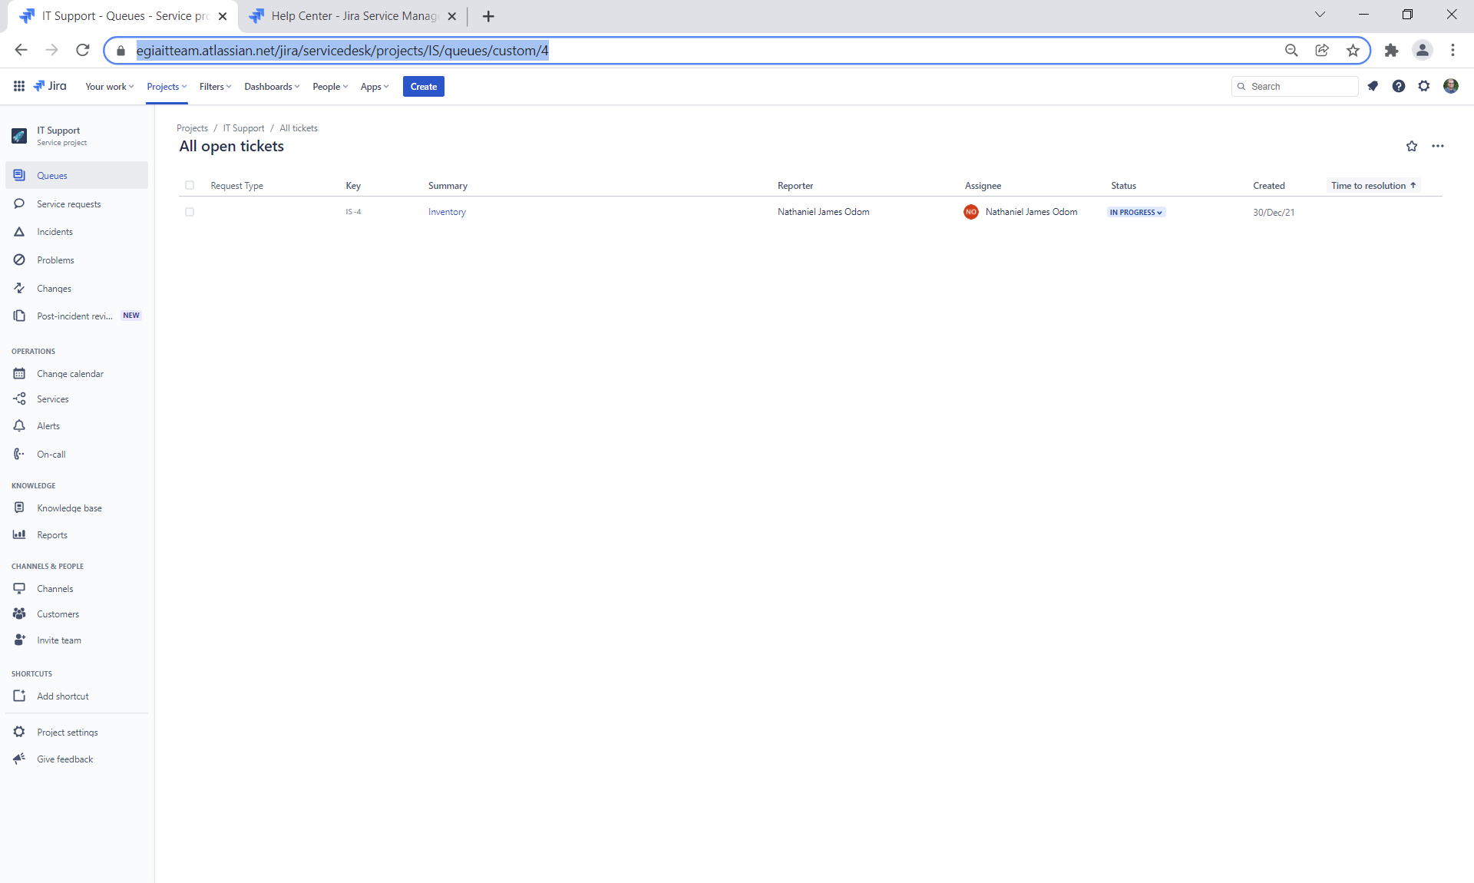
Trouble Tickets - Trouble ticketing, requests, MAC and Onboarding, Employee exit, Infrastructure and Security and Technology needs.
IT Support Help Desk Project:
https://egiaitteam.atlassian.net/jira/servicedesk/projects/IS/queues/custom/4

Slide 7
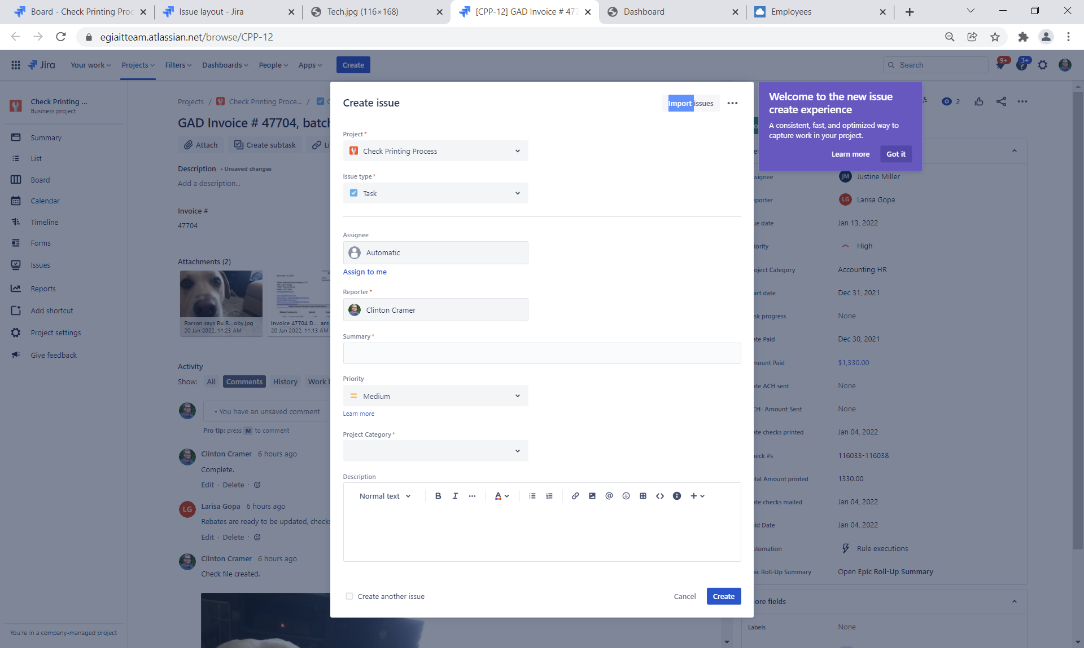
Process Tracking – Check Printing,
Check Printing Process:
Upon Invoice Payment receipt, Accounting (Larisa), will enter the initial task:
Issue type = task
Assignee should default to Larisa
Summary = Batch Title, Invoice Number, Batch Number
Project Category = Accounting HR
Description = Batch Title, Invoice Number, Batch Number Program Title
Click Create
When ready, Open task:
Attach a copy of the invoice
Date Paid = Invoice Paid Date
Amount Paid = Invoice Paid amount
If different from actual amount, add @Jessica note with details
Date ACH sent = Date of ACH setup and completion
ACH Amount Sent = Amount Sent via ACH
Comment = Ready for check file creation
Change to Check Printing File
Change Assignee to Dev (Clinton until approved to assign to Dev User)
Change status Check Printing
Set Due Date to 2 weeks out
Set Start Date to same day

Slide 8
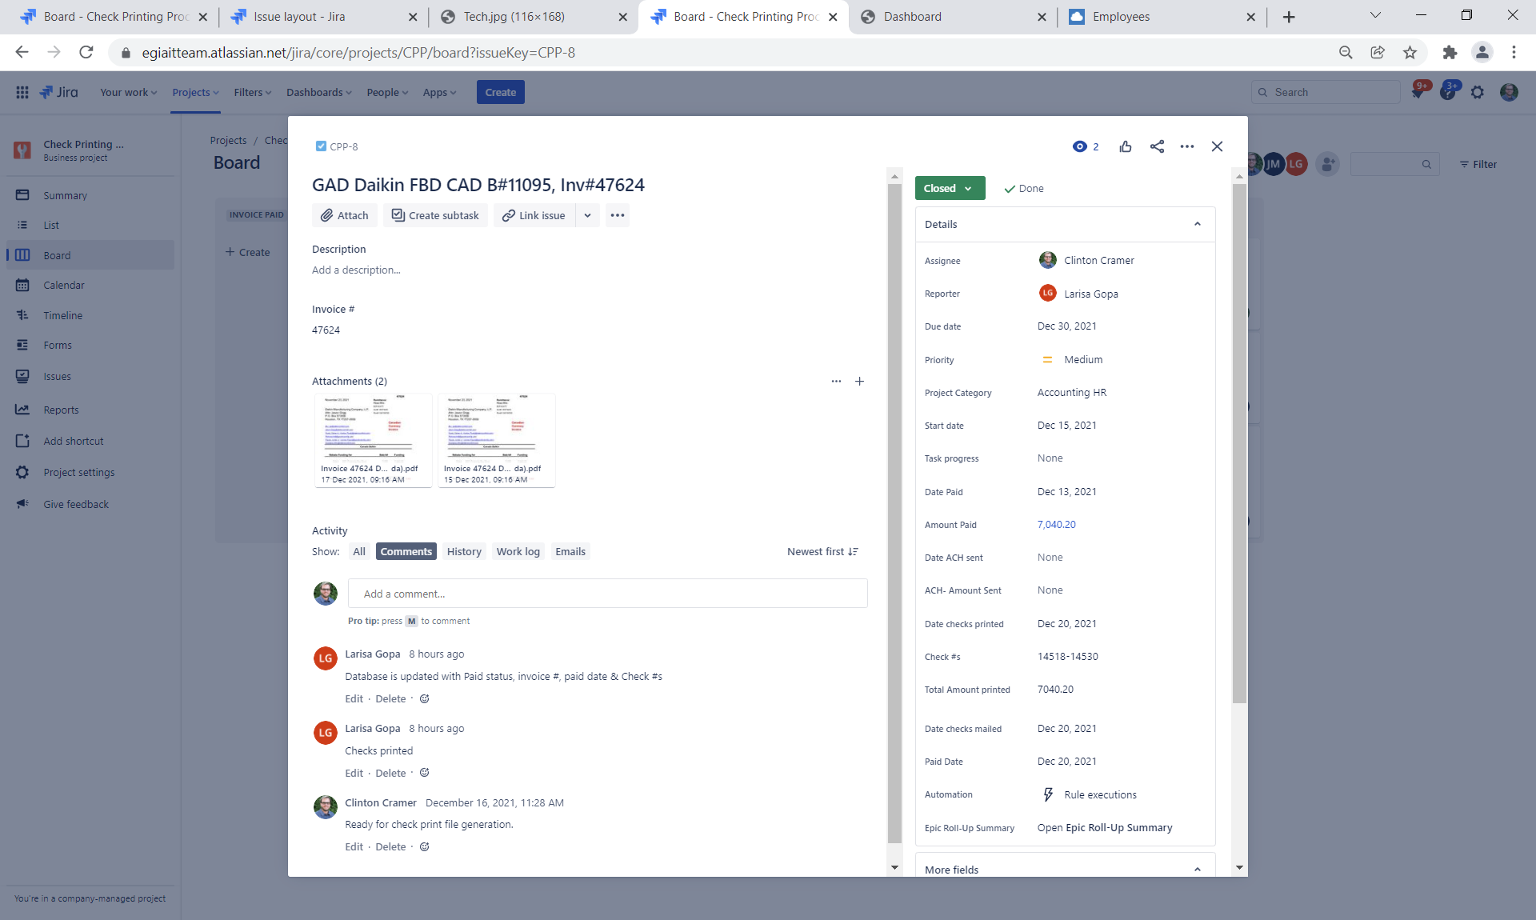
Process Tracking - Check Printing- Individual Process tracking and queues for Business Unit high profile and critical processes, (example: Check Printing and rebate payment information updating).
Check Printing Process (Cont):
Email notification received by Dev team from Jira
Dev team creates Check File
*Note – An email must come from the dev user ID email and the role must be set to ‘development’ in permissions at the Project Settings level for any project to be updated in this manner
Dev team, after completing their work, emails to egiadevteam2@egia.org with ticket ID in subject :
Comments:
Check File Created
Attach Check File Copy
Change status to Checks Printing
Change Assignee to Justine
Email notification received by Assignee (Justine):
Justine prints checks from attached file
Adds comment with:
Checks Printed
Date checks printed = check print date
Check #s = Range of Check numbers printed
Total Amount Printed = Monetary mount of check print
Date checks mailed = Same day as Date Checks Printed
Changes status to Database Updating
Changes Assignee to Dev
Email notification received by Dev team from Jira

Slide 9
Process Tracking Check Printing- Individual Process tracking and queues for Business Unit high profile and critical processes, (example: Check Printing and rebate payment information updating).
Check Printing Process (Cont):
Dev team, after completing their work, emails to egiadevteam2@egia.org with ticket ID in subject with verbiage:
Rebates updated with Paid Status, Invoice #, Paid Date, Check #s
Received email will:
Change Assignee to Justine
Add comment:
Database Updated
Change status to Closed with
Comment Done
Justine will review to ensure completion and change status to Reopened if incomplete

Slide 10
Different Options for IT Dev team and Customer
Option 1(Separate dev project for IT/Dev Comm)
Customer creates in project A
Tech Team creates in project IT dev and assigns the ticket to service account
Dev team receives the notification and works on it.
Dev team after completing their work emails to egiadevteam2@egia.org with ticket ID in subject.
Tech Team checks the comment and replies to the customer in Project A.
Cloned to Jira project IT DEV
Dev team works assign
Dev team emails to Jira
Tech Team replies to customer
Customer in Jira project A

Slide 11
Different Options for IT Dev team and Customer
Tech Team assigns the ticket
Dev team works assign
Dev team emails to Jira
Tech Team follows up with customer and closes it.
Customer in all Jira projects
Option 2 (Dev assigned and responds to email that updates any project)
Customer creates in project A-Z
Tech Team assigns the ticket to service account after checking the information from the customer.
The IT Dev team receives the notification and works on it.
IT Dev team after completing their work emails to egiadevteam2@egia.org with ticket ID in subject. (Dev team are trained with the templates for responses for different requests )
Tech Team follows up with customer and IT dev team. They also monitor the replies from the dev team.

Slide 12
Different Options for IT Dev team and Customer
Tech Team assigns the ticket to dev users directly
Dev team comments to Jira
Tech Team follows up with customer and closes it.
Customer in all Jira projects
Option 3 Direct customer Interaction with IT team in Jira (Dev only communicate)
Customer creates in project A-Z
Tech Team assigns the ticket to the dev team user after checking the information from the customer.
The IT Dev team members log's in to Jira and check the tickets assigned and work on it.
After completing work, the IT dev team changes the status and adds a comment in Jira. (Dev team are trained with the templates for responses for different requests )
Tech Team follows up with customer and IT dev team. They also monitor the replies from the dev team.

Slide 13
Future process tracking categories
IT Billing
QPLs
Asset Tracking
IT Quick Reference Documentation
Employee Directory
EGIA Program End dates and cycles

