Slide 1


Talkdesk
Implementation
Kickoff
11/24/2025

Slide 2
Introductions
Contract Review, Project Scope & High Level Plan
Implementation Overview
Next Steps
Best Practices and Resources

Slide 3


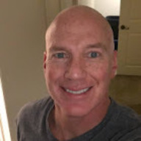

1. Introductions
Your Talkdesk Services Team - Who are we and how do we help you?
Samantha Sanchez
Project Manager
Complete ownership of the implementation
Aligns resources internally and externally
Identify & Mitigate risks
Budget Alignment
Danielle Abbott
Solutions Consultant
Consultation
Solution Configuration
Workflow Optimization
Technical Execution
Danny Orrick
Customer Success Manager
Account Ownership
Strategic Goal-Setting & Management
Industry Best Practices
Talkdesk Support
Product Support
Troubleshooting
Billing Support
Call Quality Analysis

Slide 4
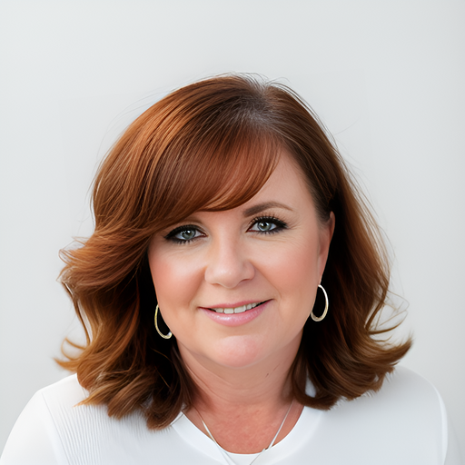
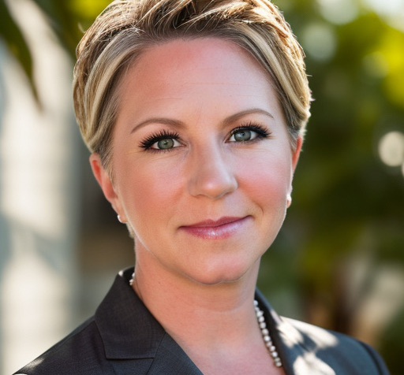
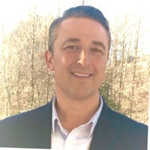
1. Introductions
Support and Escalation Path
Throughout the lifecycle of your project, there are many Talkdesk resources here to support you and your team. Our goal is for open communication, trust and transparency to ensure Talkdesk is meeting your expectations. Please reference this guide for partnership and escalation purposes when needed.
SAM SANCHEZ
Project Leader
1st point of escalation for any items related to the project. Your PM should always be informed of any concerns and will partner with you to resolve.
KIM WATERS
Manager of Professional Services
2nd Point of escalation, in the event you are seeking additional support for any items related to the project
ERICKA MADDEN
ericka.madden@talkdesk.com
NA Director of Professional Services
3rd point of escalation for additional support for any items related to the project
BRIAN STARCHER
brian.starcher@talkdesk.com
Sr. VP Professional Services
4th point of escalation for additional support for any items related to the project
ACCOUNT EXECUTIVE
1st point of escalation for any items related to billing, licenses or
Contracts
Can also be included in any additional support as needed.
Talkdesk Professional Services
Talkdesk Sales

Slide 5
1. Profile and Contacts
Clinton Cramer
Champion / Lead
Client Name
Project Manager
Client Name
Technical Resource
Client Name
Call Center Manager
Client Name
Telephony Expert
Here's what we know about
The Electric & Gas Industries Association (EGIA) is a nonprofit organization dedicated to contractors’ success and the advancement of the home services industry.​
EGIA serves a rapidly-growing network of HVAC, insulation, windows, solar and geothermal contractors, as well as regional distributors, product manufacturers and other trade allies, delivering unparalleled business solutions that include world-class business education & training, customer financing solutions, product & services discounts, groundbreaking industry trend research and more.​
EGIA is also a recognized leader in delivering sponsored demand management and resource efficiency services on behalf of electric, gas and water utilities and municipalities. EGIA services include financing; rebate program administration and rebate processing; contractor network management, training and certification; and sales channel development and support. EGIA has facilitated the financing of over 450,000 residential and business projects valued more than $8 billion, and administered over $1.5 billion in rebate payments.​
Credit: egia.org

Slide 6
2. Contract Overview
Talkdesk Contract Summary (Order Form & Statement of Work)
Professional Services: Partnering with you on scope and schedule to quickly realize Time to Value
Subscription Details
Edition | Talkdesk Elite License | Order Form subscription details include the date your Talkdesk licenses are officially active & invoicing begins.
Quantity | 55
Start Date | 10/31/2025
End Date | 02/27/2029
Professional Services
SOW Hours | 163 hours | Term of this SOW commences upon the Start Date and continues for the specified duration after the project kickoff. If the project timeline extends past this time frame, a written change order may be required.
SOW Term | 4 months
Fees and Payment Terms | T&M
Notes:
Professional Services Fees - Talkdesk will provide a Weekly Status Report of all hours comparing budgeted to logged

Slide 7
2. Project Scope & High-Level Plan
What Solutions are being deployed?
Services
Integrations
Additional Features
Agentic Autopilot (FAQ) (Voice or Chat)
Talkdesk for Salesforce
Talkdesk Preview Dialer
Workforce Management
Inbound Flow
Agent Count
Dedicated AI Specialist Team focused on driving increased
automation and AI adoption across operations.
55 Agents

Slide 8
2. Project Scope and High-Level Plan
Initial Questions
Are you looking for a phased approach or an all-in-one delivery?
What are the priorities you want to focus on first?
What are your overall goals with Talkdesk?
How hands on does your team want to be?
Are there any upcoming project timeline impediments like time off, other projects, change freezes, ect.?

Slide 9
2. Implementation Overview
Cadence of Implementation Activities
Multi-phase deployments
Launch phase 1
Launch phase 2
Kickoff
Project team
Project scope
Project plan
Meeting cadence
Executive communication
Network Testing
QoS
networktest.talkdesk.com
Firewall configuration
Network equipment evaluation
Advanced Configuration
Integrations
Automations
Workflows
Network set-up
Training
academy.talkdesk.com
Super-user training
Virtual classroom training
User adoption
Client excellence
Continued dedicated support
24x7 issue resolution
Regular check-ins
Strategic reviews
Partnership for growth
Discovery
Requirements
User stories
Business rules
Current setup
Reporting
Number purchasing
Configuration
Talkdesk setup
Studio flows
Greetings
Routing
Porting prep
Testing
User acceptance
Quality assurance
Fine-tune configuration
Deployment
Pre Go Live preparation
Command center stand-up and support
Go-live
Virtual walk-the-floor supporting agents
2x p/day Executive updates
Project lead
Lead solutions consultant
Solutions consultant(s)
Network engineer
Technical account manager
Customer success manager
Notes:
https://docs.google.com/presentation/d/11JQZUZTxC13NYMmeEOcXljD-6qT2M0_T2QMby_sqN0w/edit#slide=id.ga046ec113b_1_1745

Slide 10
3. Implementation Overview
Communication and Collaboration
Communication Approach:
Frequent and Candid Correspondences.
Transparency and Visibility.
High Touch, Consistent Project Collaboration.
Post Call Meeting Notes.
Weekly Project Status Reports.
Communication Plan:
Project Status Meetings - Weekly
Technical Meetings - ad-hoc
Executive Review Meetings - Monthly as applicable
This applies to both EGIA internal and Talkdesk communications!

Slide 11
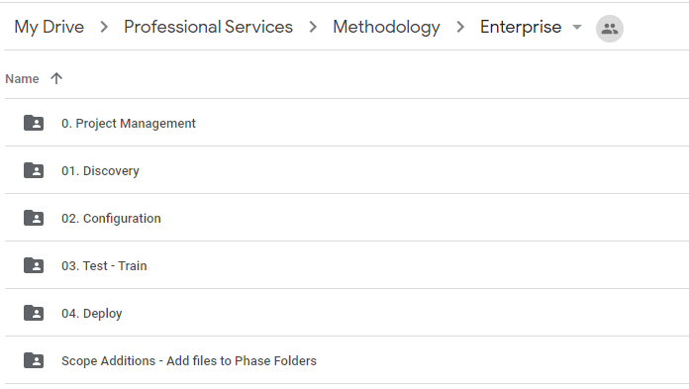
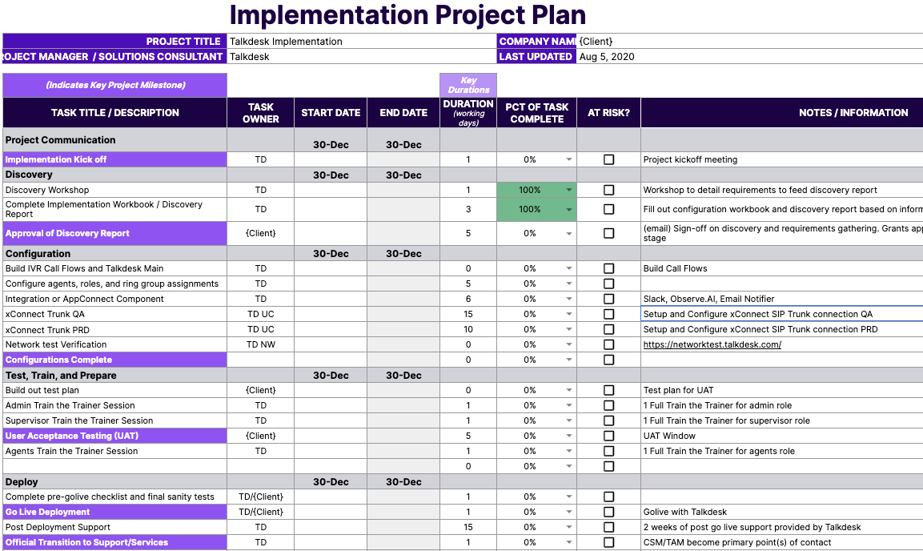
3. Implementation Overview
Project Folder & Plan
We’re here to guide you through the process, step-by-step!
See corresponding link to your new Talkdesk Implementation Folder!
Feel free to bookmark to begin for easy access.
Included in this folder is your Talkdesk Project Plan available to be referenced anytime showing deliverables and implementation schedule.

Slide 12
3. Implementation Overview CSAT Survey
Customer Satisfaction Survey - a perfect opportunity to provide us with valuable feedback on the implementation process as well as your assigned resource(s).
Short and Sweet - less than 5 minutes to complete!
Survey will be sent at the conclusion of the implementation.
Sent via Email with a URL link to the survey upon official Transition to Services for an overall review of the implementation.

Slide 13
4. Next Steps
A call to action!
Talkdesk
Share Project Documentation / Drive
Share Discovery Questionnaires/ Workbooks
Schedule Discovery Session - First week of December
Schedule Weekly Review Meetings - Following week
Client
Complete Talkdesk Academy product-related trainings
Begin filling out Discovery Questionnaires/ Workbooks

Slide 14
Questions?

Slide 15
Thank you!

