Slide 1



Implementation Kickoff
11/7/2024

Slide 2
Introductions
Implementation Overview, Contract & Scope Alignment
Agenda
Project Plan / Data Collection Workbook & Discovery Questionnaire
Communication Expectations
Next Steps & Takeaways

Slide 3

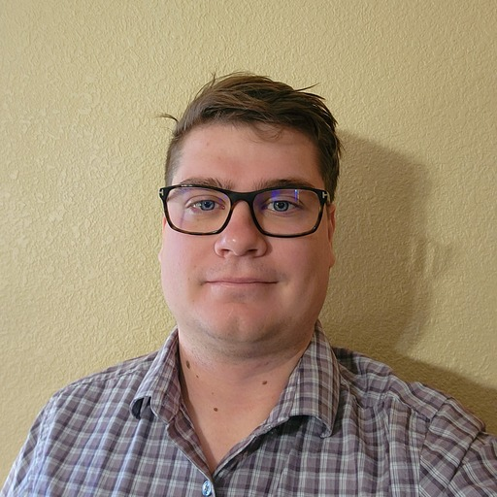
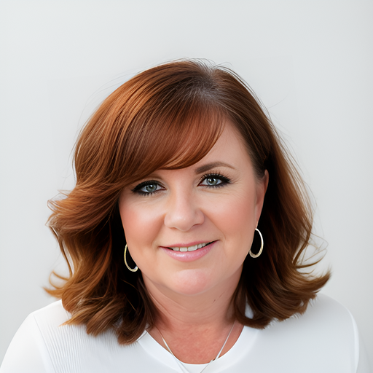
Introductions
Who are we and how do we help you?
Samantha Sanchez
Project Manager
Tristan Bateman
Sr Solutions Consultant
Kim Waters
Professional Services Manager
Complete ownership of the implementation
Aligns resources & budget
Identify & Mitigate risks
1st point of escalation support for any items related to the project
Consultation
Solution Discovery & Configuration
Workflow Optimization
Technical Execution
2nd point of escalation for additional support for any items related to the project

Slide 4
Here is what we know about
Clinton Cramer
Champion/Lead
<Name>
Project Manager
<Name>
Technical Resource
<Name>
Call Center Manager
<Name>
Telephony Expert
The Electric & Gas Industries Association (EGIA) is a nonprofit organization dedicated to contractors’ success and the advancement of the home services industry.
EGIA serves a rapidly-growing network of HVAC, insulation, windows, solar and geothermal contractors, as well as regional distributors, product manufacturers and other trade allies, delivering unparalleled business solutions that include world-class business education & training, customer financing solutions, product & services discounts, groundbreaking industry trend research and more.
EGIA is also a recognized leader in delivering sponsored demand management and resource efficiency services on behalf of electric, gas and water utilities and municipalities. EGIA services include financing; rebate program administration and rebate processing; contractor network management, training and certification; and sales channel development and support. EGIA has facilitated the financing of over 450,000 residential and business projects valued more than $8 billion, and administered over $1.5 billion in rebate payments.
Credit: egia.org

Slide 5
Implementation Overview
Cadence of Implementation Activities
Pre-kickoff deliverables
Ensure customer has access to
the following:
Discovery questionnaire
Support access article
Configuration
Talkdesk setup
IVR routing
Standard automations
Deployment
Go Live
Agents live on Talkdesk
Porting submitted
Kickoff & discovery
Project team & Scope
Requirements
Implementation workbook
Porting prep
Testing & training
Talkdesk Academy
QA
Go live checklist
Client excellence
Success & support
Office hours
Customer success
Account executive
Project Manager
PS program manager
Solutions consultant
Talkdesk support
Customer success
Notes:
https://docs.google.com/presentation/d/1MGgZJYGCY9D_Aa0MlOZVgpaGx2ySNM3y3kjG8qcblCQ/edit#slide=id.ga510835bc3_0_3035

Slide 6
Scope Alignment
What Solutions are being deployed?
Services
Integrations
Connectivity
Additional Features
Inbound/Outbound Voice
Talkdesk Phone
Standard Talkdesk Connections
Conversations
Proactive Notifications
Autopilot
Customer Experience Analytics
Inbound Flow
Agent Count
Numbers
Timelines | Expectations
1 Flow
Optimization
Continuity Settings
55 Agents
Port or Purchase?
Anticipated Go Live: 12/23/2024
Notes:
Are any Early Access Products in scope? If yes - these should be highlighted and discussed

Slide 7
Communication Expectations
Frequent and Candid Correspondences
Transparency and Visibility
High Touch, Consistent Project Collaboration
Post Call Meeting Notes
All Project Calls are Recorded (Screen/Audio)

Slide 8
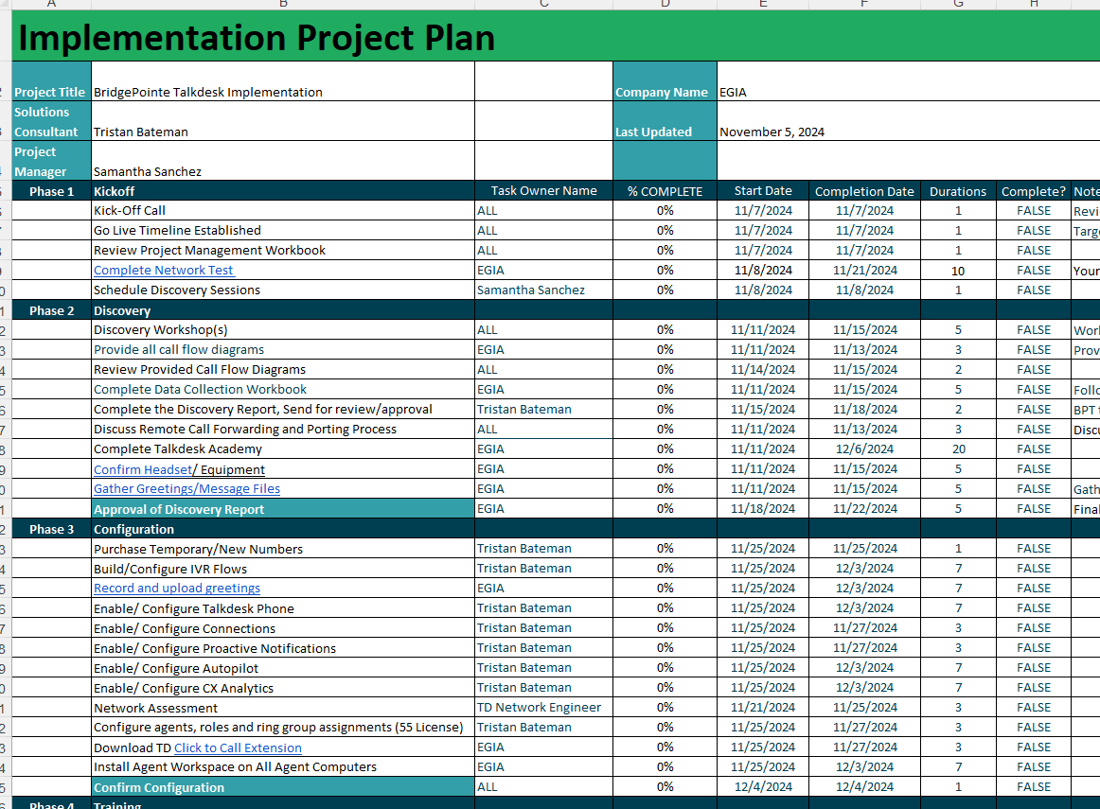
Implementation Checklist and Workbook
We’re here to guide you through the process, step-by-step!
See corresponding link to your new BPT Implementation Folder!
Feel free to bookmark to begin for easy access
Included in this folder is your provided all-in-one Data Collection Workbook available to be referenced anytime. This includes your personalized Project Plan, Discovery Questionnaire, and workbook deliverables to begin system configuration!

Slide 9
Discovery Considerations
What are the user stories across your different personas?
Audience
Agents
Managers
Admins
Call Experience
Agent Workflow
Reporting
Demo of configuration
Call Volume
Queues and Routing
KPIs
Integrations
Greetings
Skill Groups
Monitoring and Coaching
Automations
IVR
Coverage and Hours
Escalations
Porting Numbers

Slide 10
Next Steps
Talkdesk
Share Project Documentation
Share Data Collection WB (includes Discovery Questionnaire)
Schedule Discovery Session – Starting Next Week?
Schedule Weekly Review Meetings – Schedule After Discovery
Client
Complete the Talkdesk Academy eLearnings
Begin filling out Data Collection Workbook
Complete the Network Test Assessment

Slide 11
Operational Best Practices
Use Google Chrome
No Chrome Plug-ins
Enable Microphone
Use 3.5mm Audio
Always use the most recent version
Avoid plugins (AdBlocker)
and extensions
Allow microphones in your computer settings
Ensure headsets use 3.5mm jacks, and not USB
Ethernet Connection
Save Your CPU
Port or Purchase
Ensure Credit
Use a wired connection instead of a wi-fi connection where possible
Network-intensive applications can compete with your audio bandwidth
You can choose to port existing numbers or purchase new numbers
Make sure you have proof
of billing in your account
to continue service

Slide 12
Resources
Want to stay up-to-date on all the latest and greatest Talkdesk features? Subscribe to the Release Notes and automatically be informed!
Getting started with Talkdesk
Talkdesk Video Academy
Installing CX Cloud & Agent Workspace
Number Porting
Network Tests
Sharpen your skills here!
Porting process of US/Canadian Numbers to Talkdesk
Here’s how you can test
the quality of your network connection and interpret results.
Download CX Cloud on Mac or PC
System Requirements
& Network Settings
Integrations
Set Up Browser
Recommended Headsets
See all the Talkdesk Integrations
Setting up your Browser
to work with Talkdesk
What headsets are recommended?
To ensure a smooth experience, see the set of requirements for the use of our web application
Curious about events/issues on the platform? Status.Talkdesk.com

Slide 13
Questions?

Slide 14
Thank you!

