Slide 1
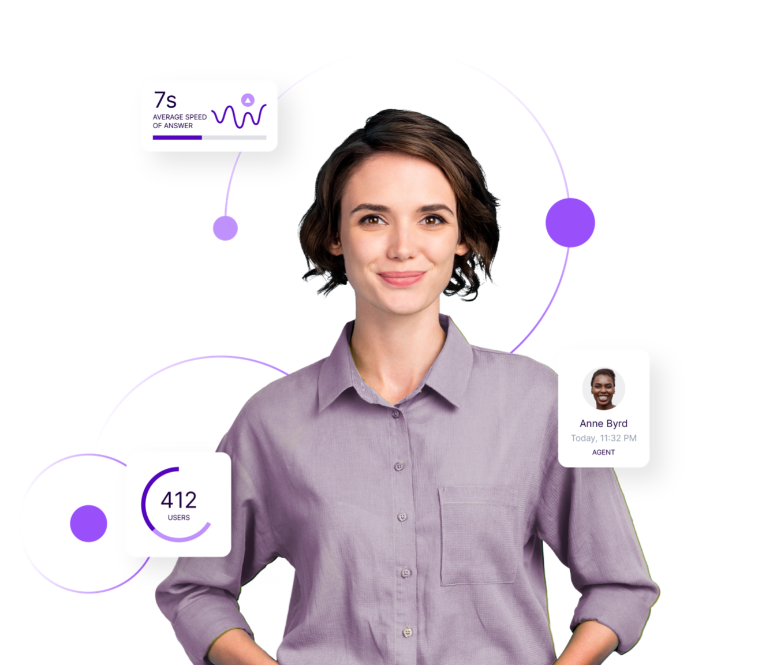
Mobile App - Configuration
October 2022

Slide 2
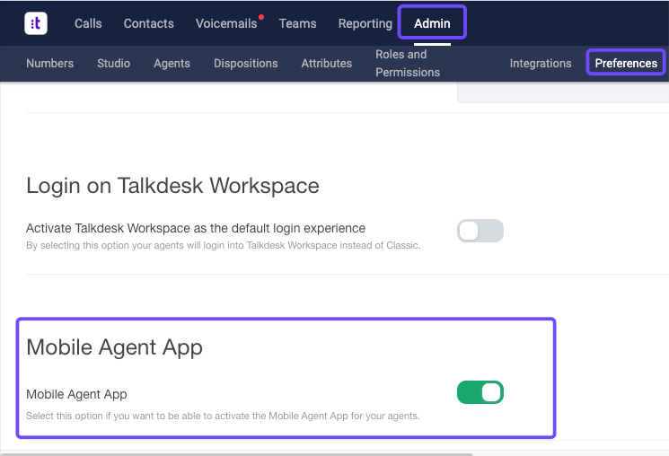
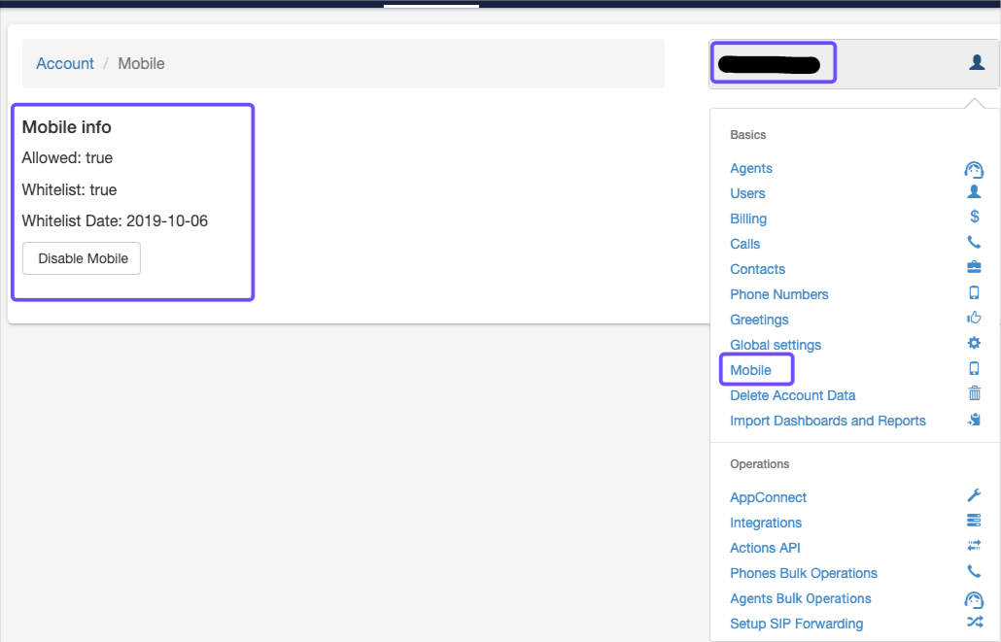
Configuration
To enable:
  Go to Talkdesk Admin Console. Admin > Preferences > Conversations Mobile App on/off
  If this does not show, please check the TD Support Dashboard and ensure this is enabled:
    Access the Support Dashboard Here
    Click on the account name > Mobile > Toggle Enable/Disable
    Download and Install the app from the app store

Slide 3
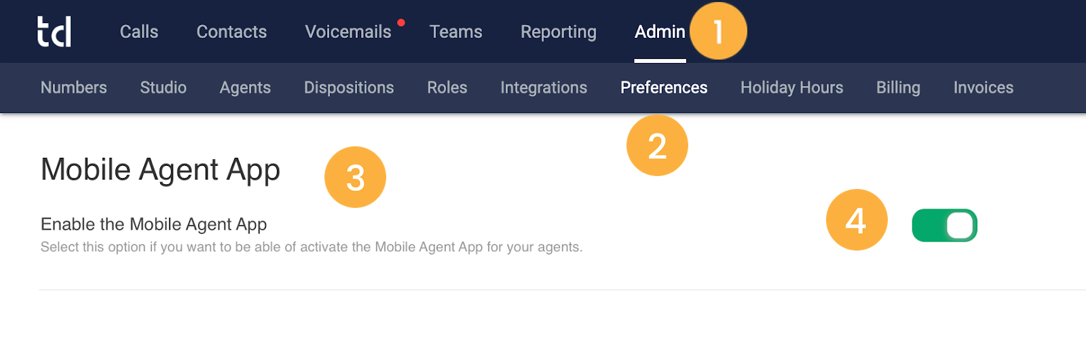
Managing Access
To customize the access to the Conversations Mobile App, please follow these steps:
1. Log in to your Talkdesk account and go to Admin [1].
2. Click on Preferences [2].
3. Scroll down to the “Conversations Mobile App” section [3].
4. Switch the toggle to the right (on) [4] to “Enable the Conversations Mobile App”.
After enabling access to the mobile app at an account level, you can limit access to a group of agents. This access can be granted/removed individually or in bulk.

Slide 4
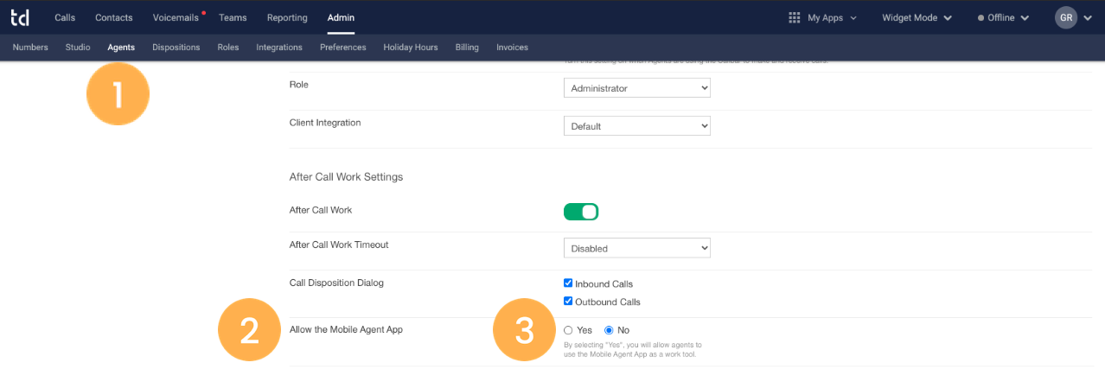
Setting Access
To perform this action individually, please follow these steps:
1. Go to the Agents [1] tab and select the agent whose access permissions you want to edit.
2. Scroll down until you see the “Allow the Conversations Mobile App” section [2].
3. Tick “Yes” to grant access or “No” to remove it [3].

Slide 5
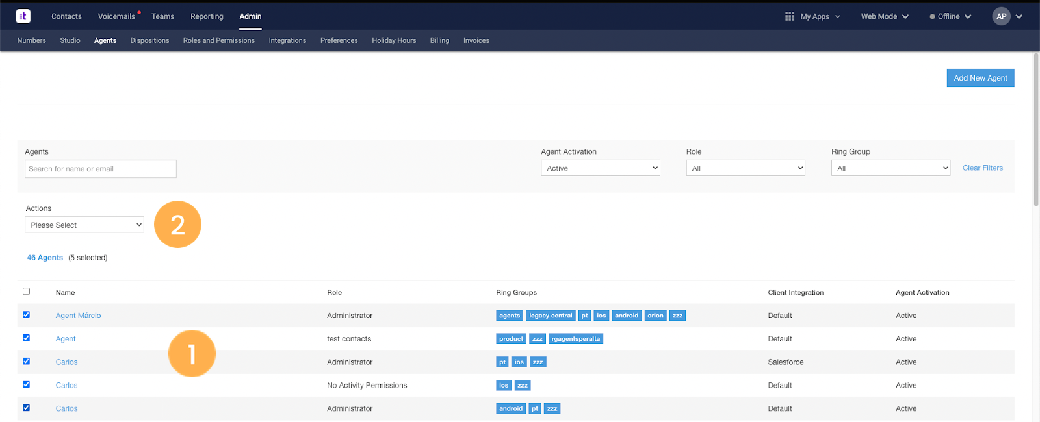
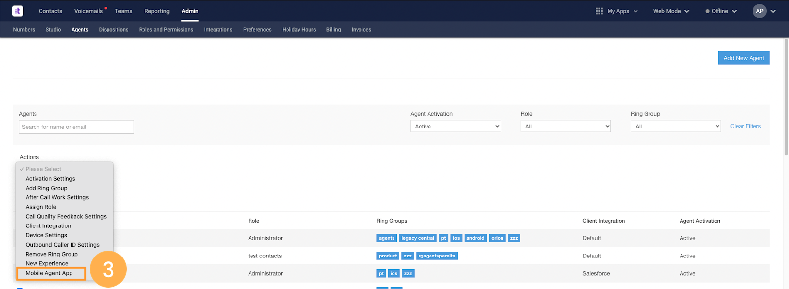
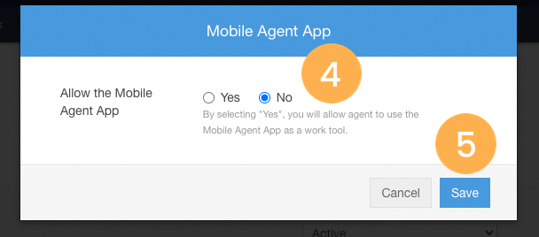
Setting Access
If you want to edit the access of multiple agents, on the Agents page, do the following:
1. Select the agents [1] whose access you want to review.
2. Click on the drop-down arrow [2] in the “Actions” menu.
3. Select Conversations Mobile App [3].
4. On the pop-up window that will appear, select “Yes” to confirm and give access to the selected agents. Alternatively, click “No” to remove the access [4].
5. When you’re done, choose Save [5].

Slide 6
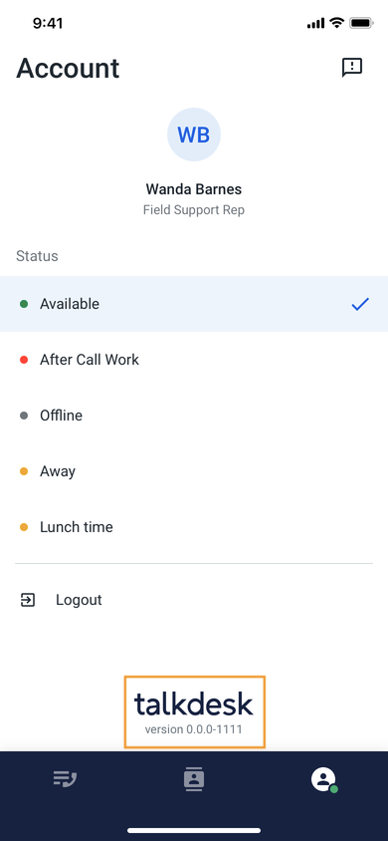
Configuration of SMS in the Mobile App
After we have made through the process of demoing the feature and have the OK from the customer, there are a few steps that Talkdesk needs to make to guarantee the feature becomes available in the App for that account.
Please contact your partner at Talkdesk to have SMS enabled.
Notes:
To know the app version you are using, check the “My Account” screen, at the bottom of the screen, under the Talkdesk icon.
Your device's time settings should match your local time to help prevent errors.

