Slide 1

Talkdesk
Admin Training

Slide 2
Welcome!
Welcome to Talkdesk! We are thrilled to have you as the newest member of our growing family.
With Talkdesk, you can customize your call center to fit any of your requirements - this guide will act as a general reference of important settings and preferences for you to consider. It will walk you through the setup process and link to more detailed documentation articles so you can dive a bit deeper when needed.
We really hope Talkdesk makes your job easier and that you love it as much as we do!

Slide 3

Best Practices and
Recommendations
Use Google Chrome
Always use the most
recent version
No Chrome Plug-ins
Avoid plugins (AdBlocker) and extensions
Enable Microphone
Allow microphones in your computer settings
Use 3.5 mm audio
Ensure headsets use 3.5mm jacks, and not USB
Save your CPU
Network-intensive applications can compete with your audio bandwidth
Port or Purchase
You can choose to port existing numbers or purchase new numbers
Ensure Credit
Make sure invoices are paid in a timely manner for your account
to continue service
Ethernet Connection
Use a wired connection
over wi-fi connection
where possible

Slide 4
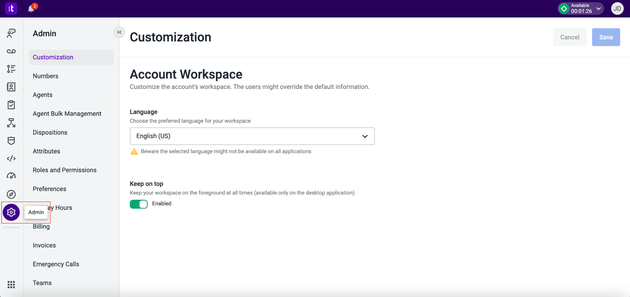
Talkdesk Admin
Upon logging in to your primary website [perpay.mytalkdesk.com], your session will open into Talkdesk Workspace. Several admin features are handled within the Admin app, while some other features may be handled in standalone applications.

Slide 5
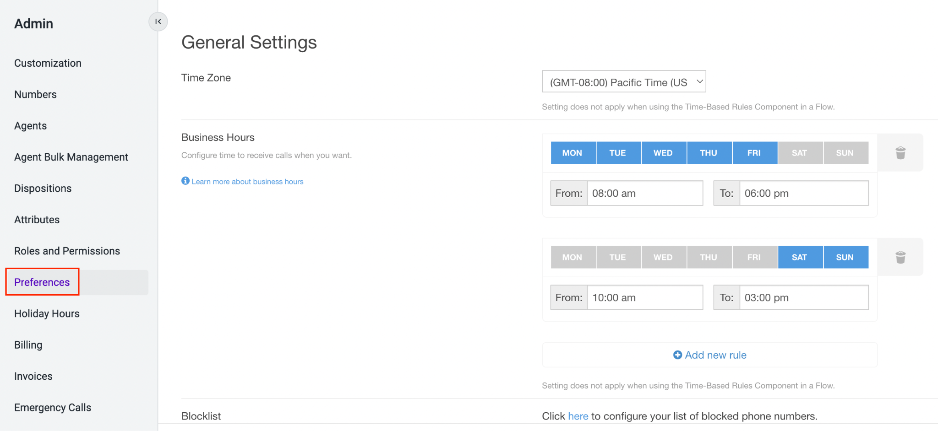
Preferences
The Preferences section will allow you to configure global settings that will apply across the entire account. Note that some settings can be overridden within a Studio flow, on an individual phone number basis or on an individual agent basis.

Slide 6
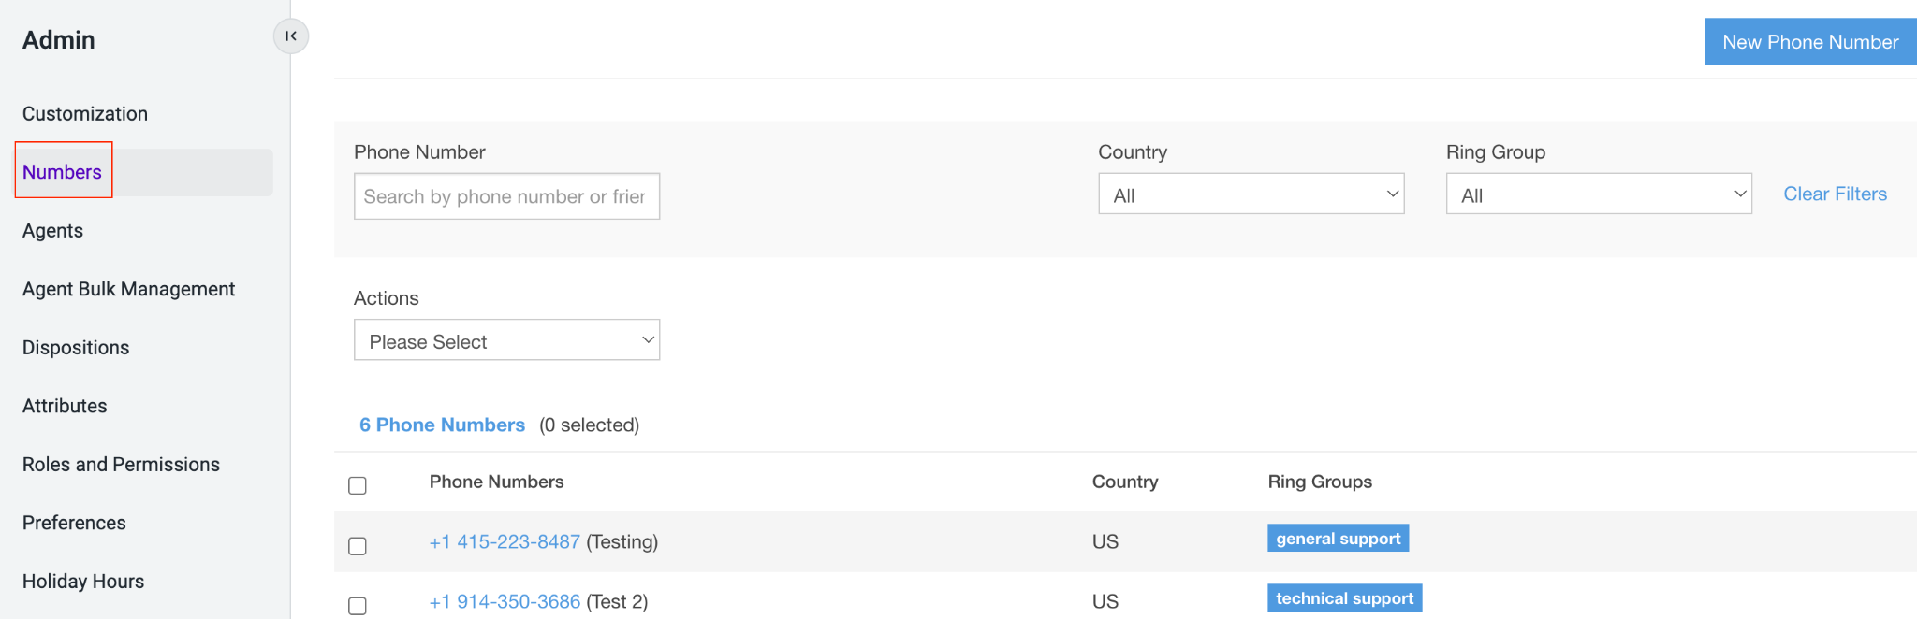
Numbers
Talkdesk offers phone numbers in a multitude of countries around the world. Depending on the country, Talkdesk can provide toll-free, local, or national numbers. Configuring a number will include assigning ring groups, and giving a friendly name. Additionally, ‘Custom Settings’ can be configured at the number level. If used, these custom settings will override some of your account level settings (under the Preferences tab).

Slide 7
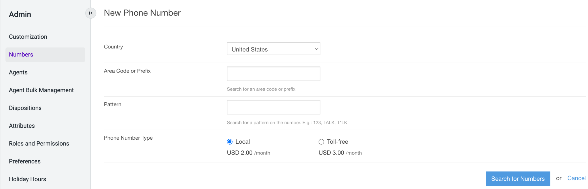
Purchasing a Number
US & Canada:
Navigate to Admin -> Numbers and click on New Phone Number
Select the desired country in the dropdown. If the option to enter an area code is available and you would like one, please enter it. You can also search for specific patterns in your number as well as the phone type. Please note that not all searches will yield results.
Rest of the World:
Due to international regulators, please contact Talkdesk Support team to understand which regulations are applicable to the country you wish to buy a number.

Slide 8
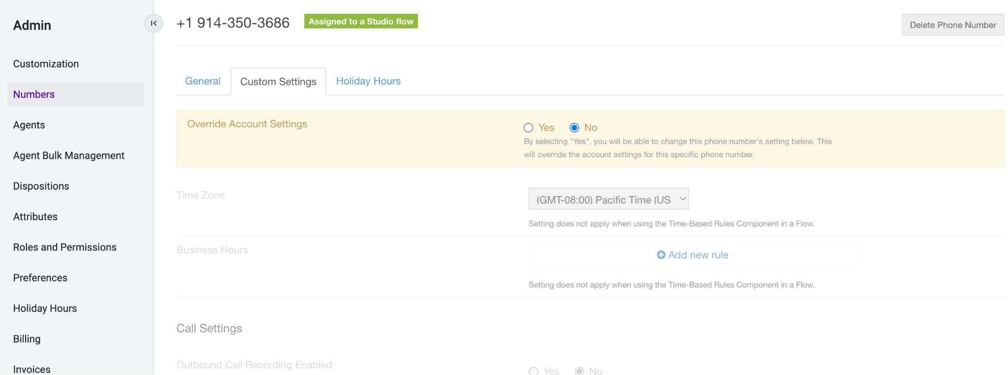
Numbers: Custom Settings
In Talkdesk, Individual numbers can have number specific settings that are different from global ‘Preferences’. ‘Custom Settings’ are primarily used for different time zones, business groups, stores or individuals that require specific configurations.
Select the ‘Custom Settings’ tab to override certain account settings for the specified number. Under ‘Override Account Settings,’ select yes, and make the appropriate changes. Upon completion, click ‘Save’ at the bottom of the screen.

Slide 9
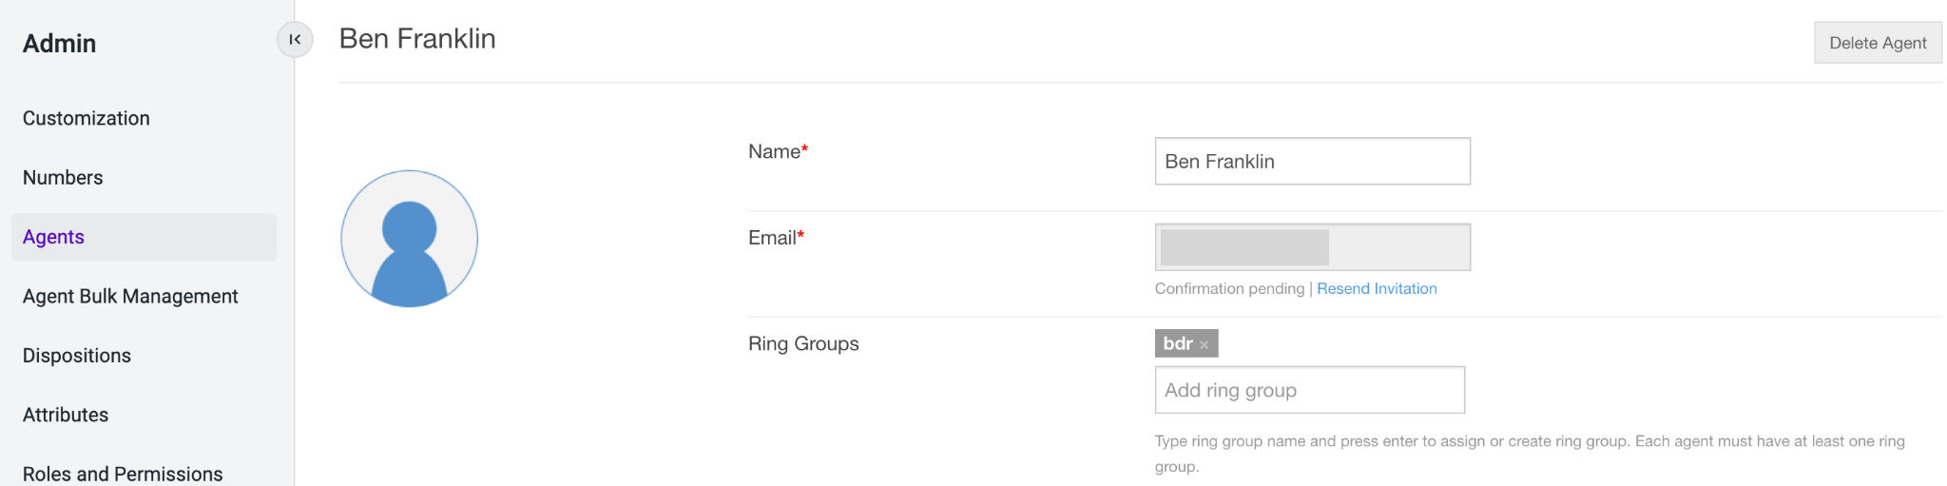
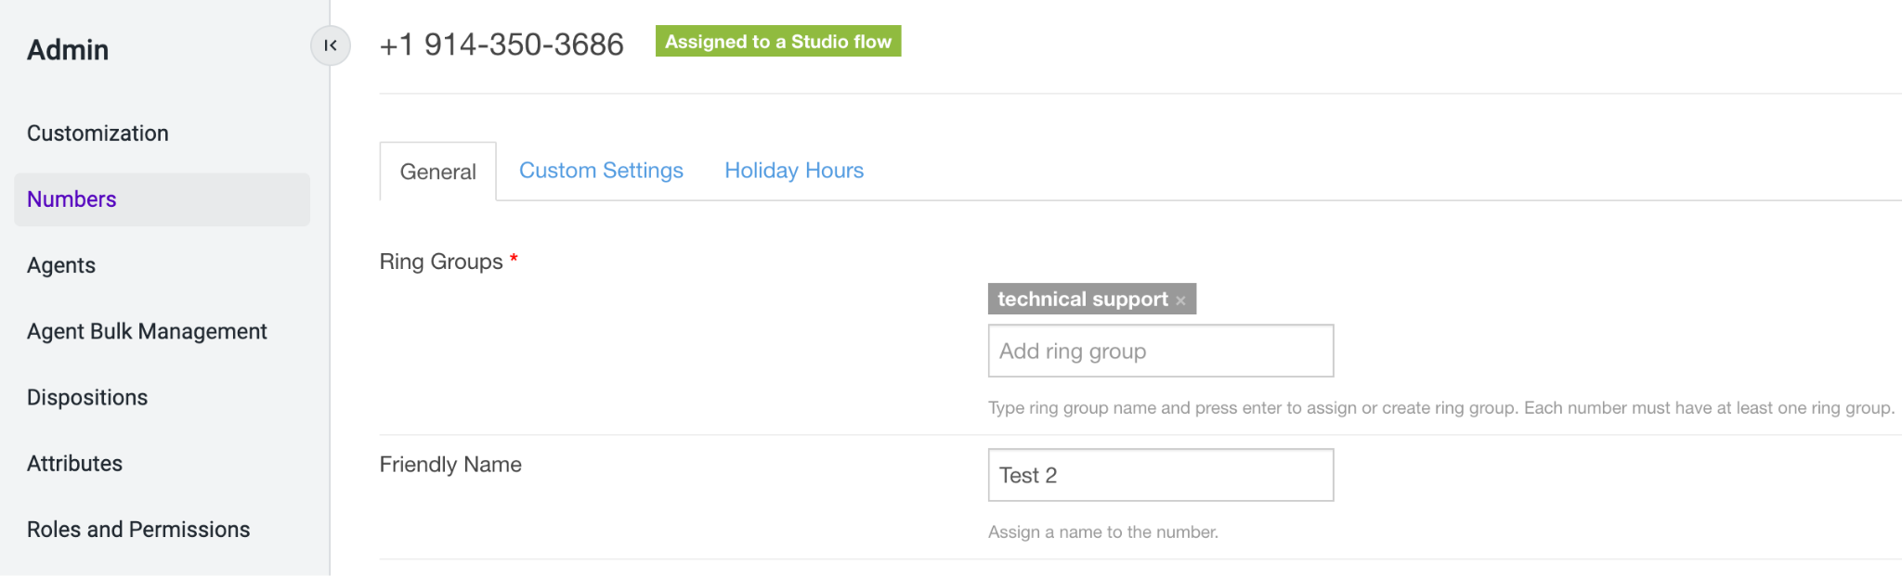
Ring Groups
Ring Groups allow you to direct incoming calls to groups of agents who are best suited to meet the caller’s needs. Ring groups can be organized based on specialized skills, product proficiency, language, geographic location, etc. You can direct calls to different ring groups through various routes in your Studio flows. Ring groups are also how agents become associated with phone numbers.
Ring Group - Agents
Create/add a ring group to the Agent profile by typing the desired group name in the Ring Groups box and hit ‘enter’. If a call reaches this ring group (through a Studio flow), this agent is eligible to answer that call. Every agent must belong to at least one ring group.
1
2. Ring Group - Phone Numbers
Create/add a ring group to a phone number by typing the desired group name in the Ring Groups box and hit ‘enter’. Any agents who share a ring group assigned to a phone number are able to use that number as an outbound caller ID. Every phone number must have at least one ring group.
2

Slide 10
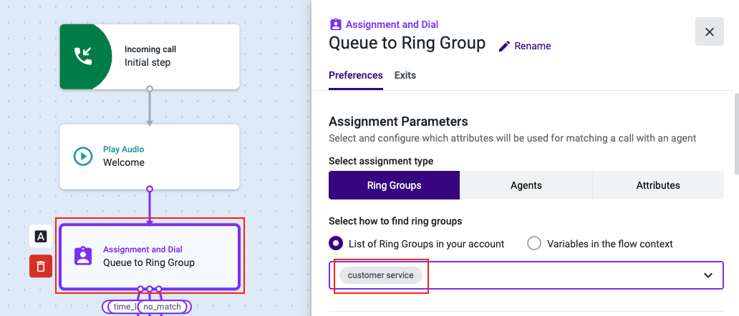
Ring Groups
3. Ring Group - Studio
Configure Studio flows to route to specific Ring Groups based on IVR selections or other desired routing logic
3

Slide 11
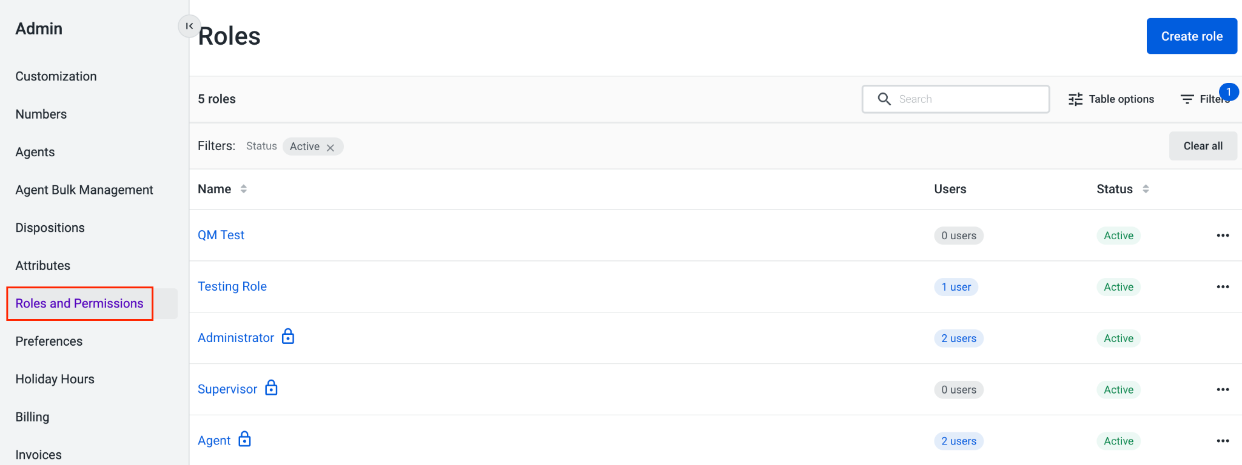
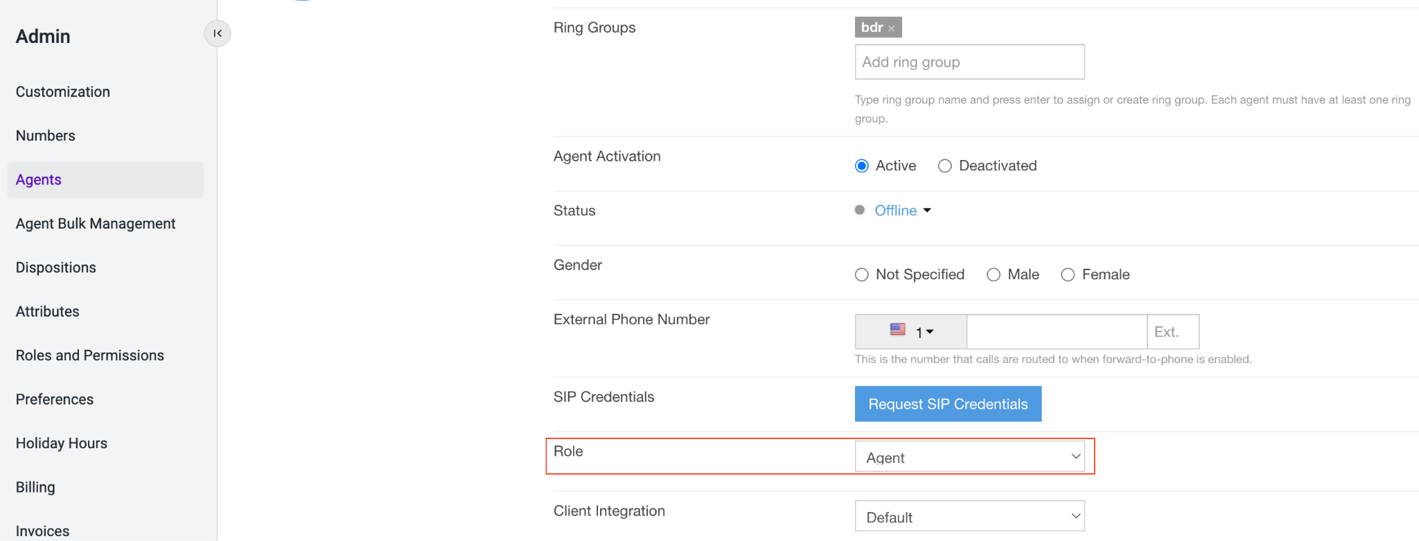
Roles and Permissions
Roles allow users access to specific functions within the Talkdesk application. Out of the box, Talkdesk provides 3 roles: Agent, Supervisor and Administrator. You can create custom roles and permission sets under Admin -> Roles and Permissions.
You can then specify the role for an agent by selecting the desired option for the ‘Role’ setting in the agent profile, which can be accessed in the ‘Agents’ tab of the ‘Admin’ section.

Slide 12
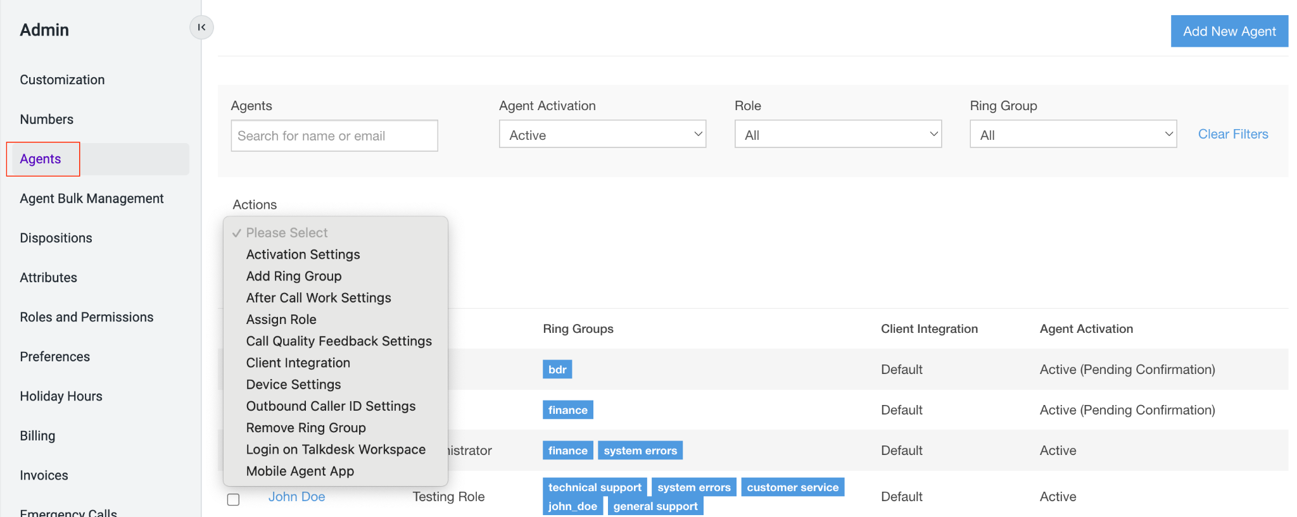
Agent Settings
There are a variety of options within agent settings that can be customized to fit your desired agent configurations. Some of the most critical components include Bulk Management, Ring Group Assignment, Role, and Outbound Caller ID.
Within Admin > Agents, you can manage agent settings in bulk or on an individual basis.
Click on an agent name to review/update their individual settings [1].
Use the filter options [2] to narrow down your list of agents if needed for bulk management. Check the names of agents to update in bulk, and click on the Actions dropdown [3] to select the appropriate settings to update.
2
3
1

Slide 13
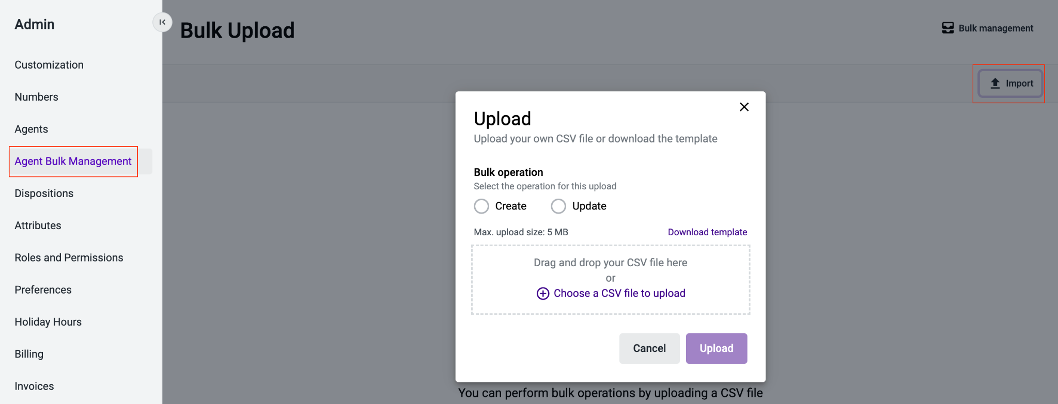
Agent Bulk Management
In addition to utilizing the bulk management feature within the Admin > Agents section for already created agents, Admins can use the Agent Bulk Management CSV import to create new users and/or update existing users. The import tool includes a template CSV file for you to update with your agents’ data and will create a log file with any errors for agents the system was not able to create successfully.

Slide 14
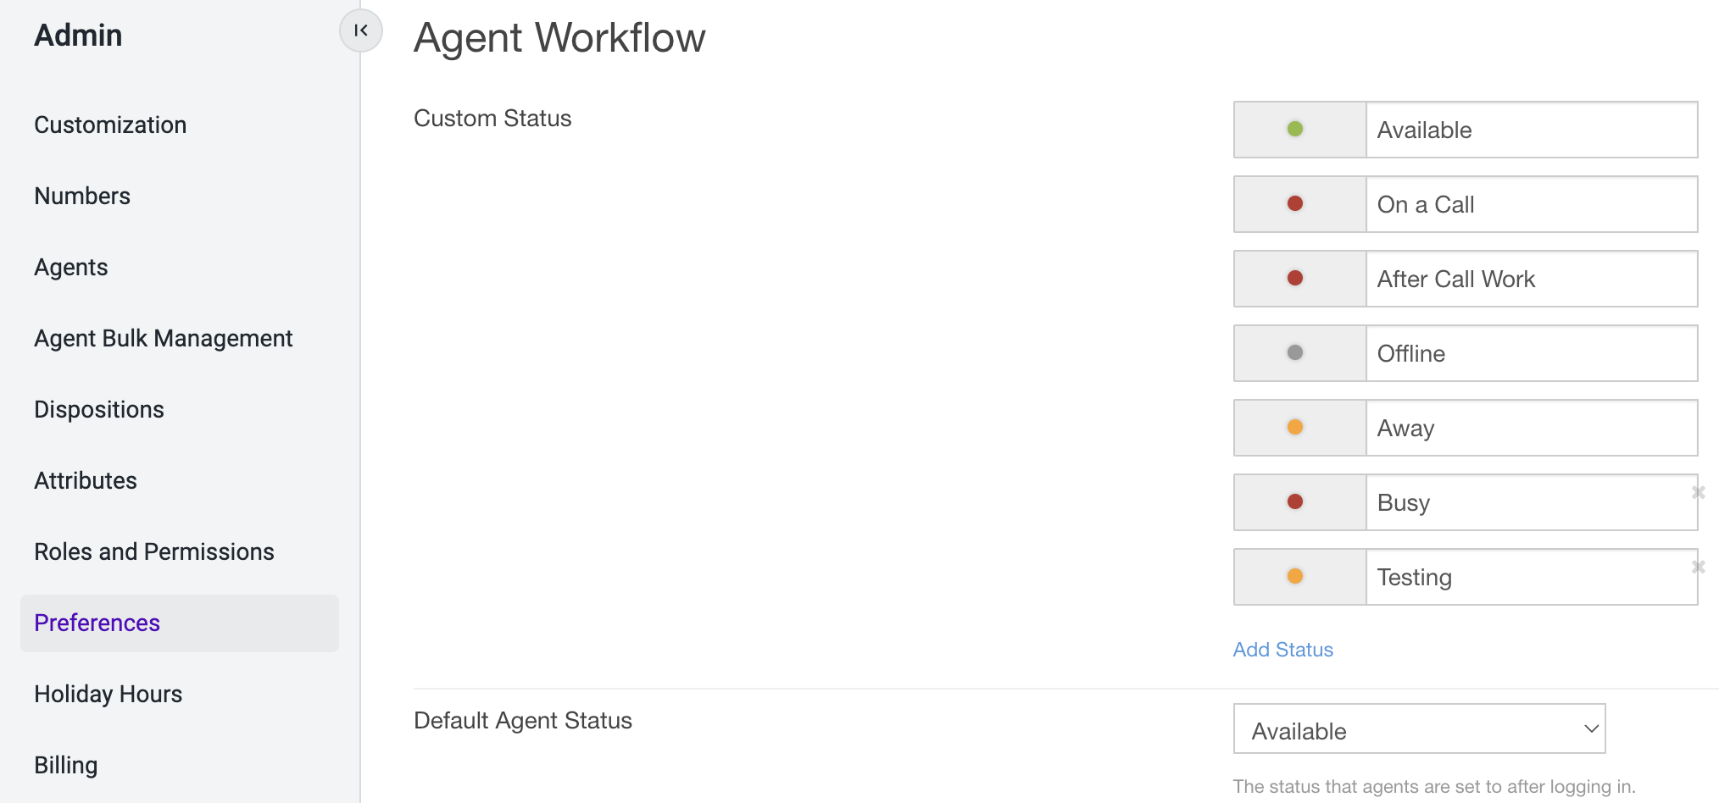
Agent Status
The agent status is used to determine whether an agent can make and receive calls. It has a direct impact on call routing and greetings played. Admins can select the desired default status upon users logging into Talkdesk. Default agent statuses include “Available,” “After Call Work,” “Away,” “Offline,” and “On a Call,” but these can be modified or additional red and yellow statuses can be included.
Agent Status Setup
Navigate to Admin -> Preferences and scroll down to the “Agent Workflow” section. Here, you will see a list of default custom statuses as well as the option to add more by clicking on “Add Status.”
To change the default status when an agent logs in to be something other than “Available,” scroll down to “Default Agent Status” and select your preferred status. Be sure to click Save at the bottom of the screen.
1
2

Slide 15
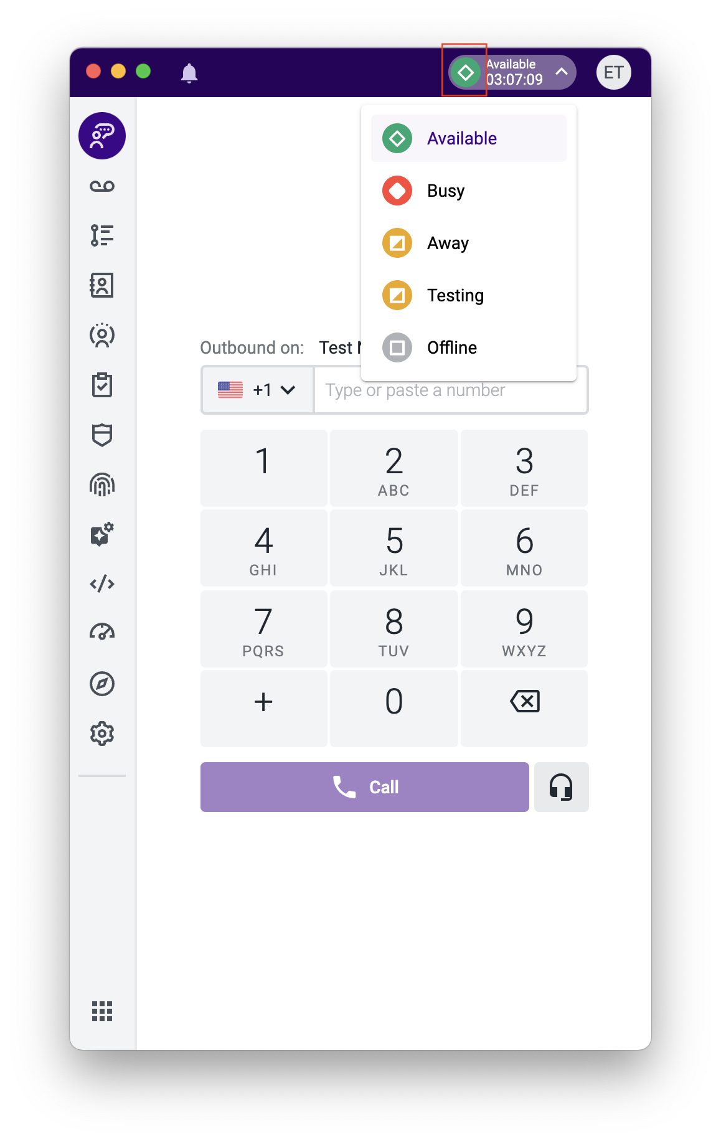
Agent Status
The agent status will be displayed in the Agent Workspace
Agent Status Types
GREEN: The agent is signed into Talkdesk and is available to take calls. There can only be one green status in the environment, and the default value is ‘Available’.
RED: The agent is signed into Talkdesk but is busy performing other tasks. If no other agents are available, any new call will wait in queue until an agent in red status becomes available. Two default red statuses:
On a Call: The agent is signed into Talkdesk and is on a call. This status is automatically changed when agents receive/make a call, and they are unable to receive calls.
After Call Work: When a call ends, the agent’s status can be configured to automatically change to “After Call Work” for a fixed period of time. The agent cannot receive calls.
YELLOW: The agent is signed into Talkdesk but is away from the computer and not eligible to take calls. It will still allow agents to receive call transfers though, should they wish to accept these.
GRAY: This status indicates that the agent is not signed into Talkdesk and is unable to receive calls. There can only be one gray status in the environment, and the default value is ‘Offline’.

Slide 16
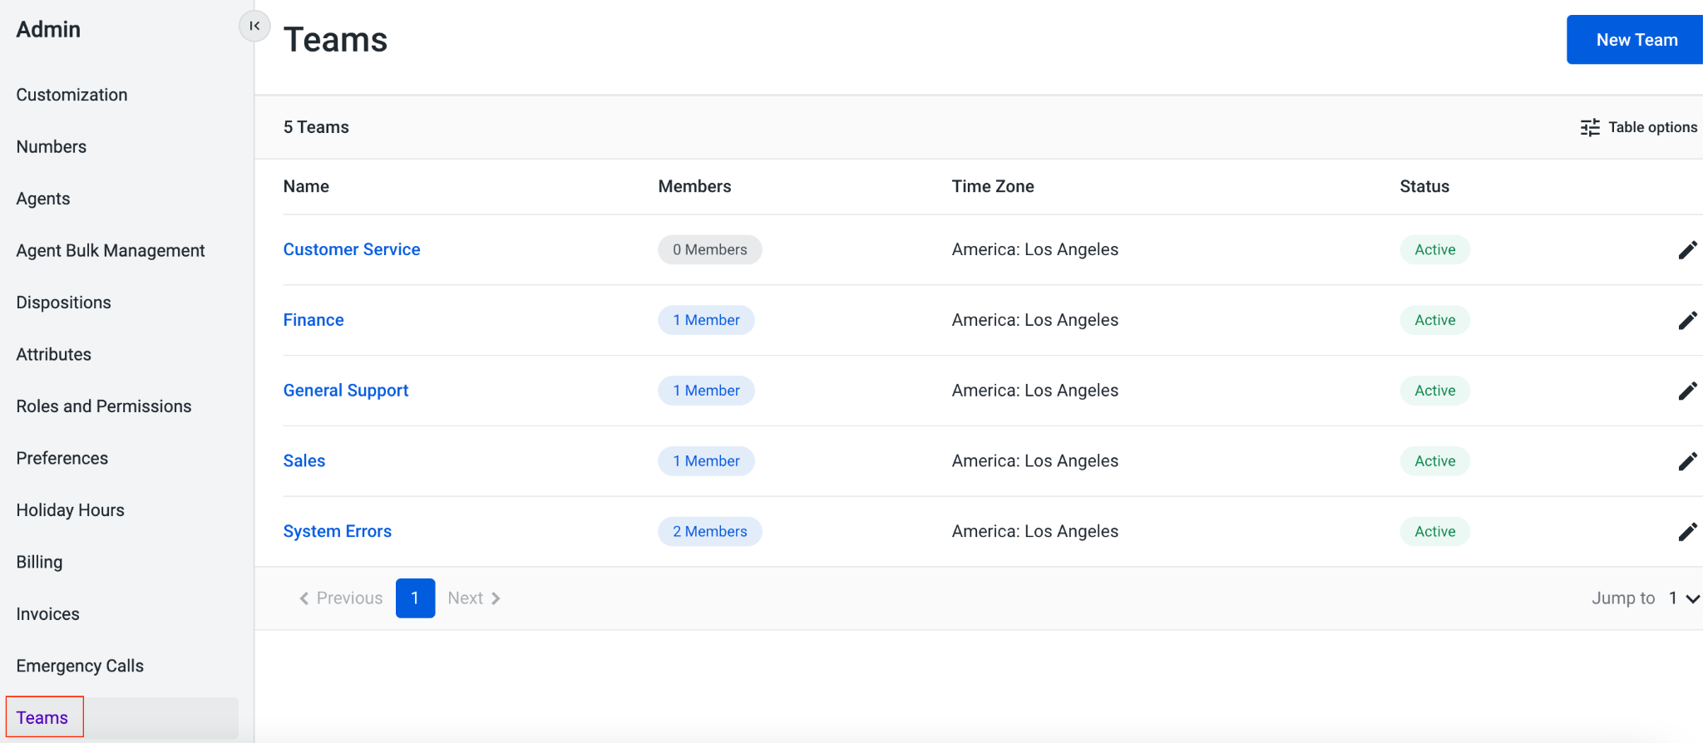
Teams
Teams can be used to group agents under a single department, skill, region, etc. A user can only be added to one Team, so these entities typically have a broader scope than ring groups. Some reports and Live Dashboard widgets allow for filtering on the Team level as well.
Admins can empower supervisors and managers to control the ring groups assigned to the agents within their own Team.

Slide 17
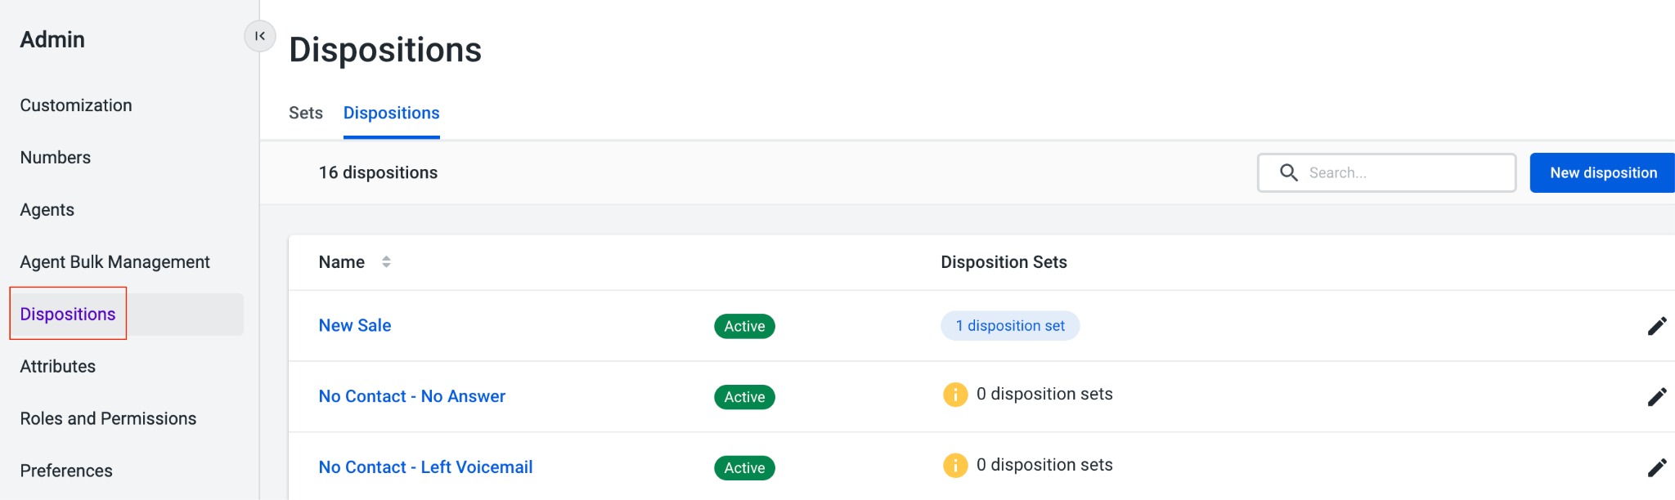
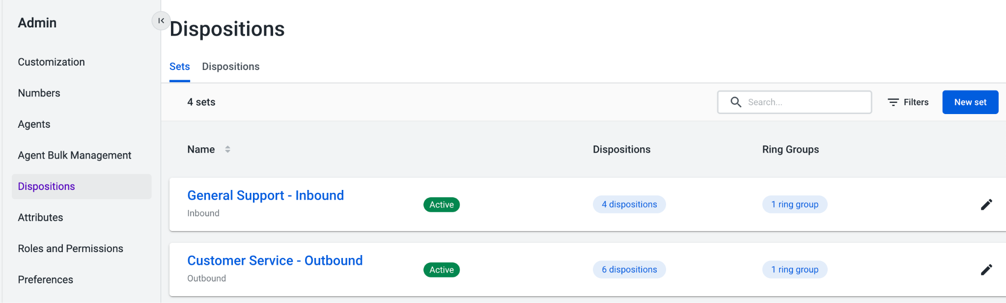
Dispositions
Dispositions can be utilized by your agents to easily label the outcome of any inbound or outbound call. Admins have the ability to create unique disposition codes and assign them to a disposition set(s), as well as dictate on the agent level if they should have access to inbound and/or outbound dispositions.
Create disposition codes within the Dispositions > Dispositions tab. If you no longer need a disposition, you can mark it as ‘Deactivated’. Note there is a 64-character limit.
In the Dispositions > Sets tab, you can create sets of dispositions to apply to specific ring groups for either inbound or outbound calls.

Slide 18
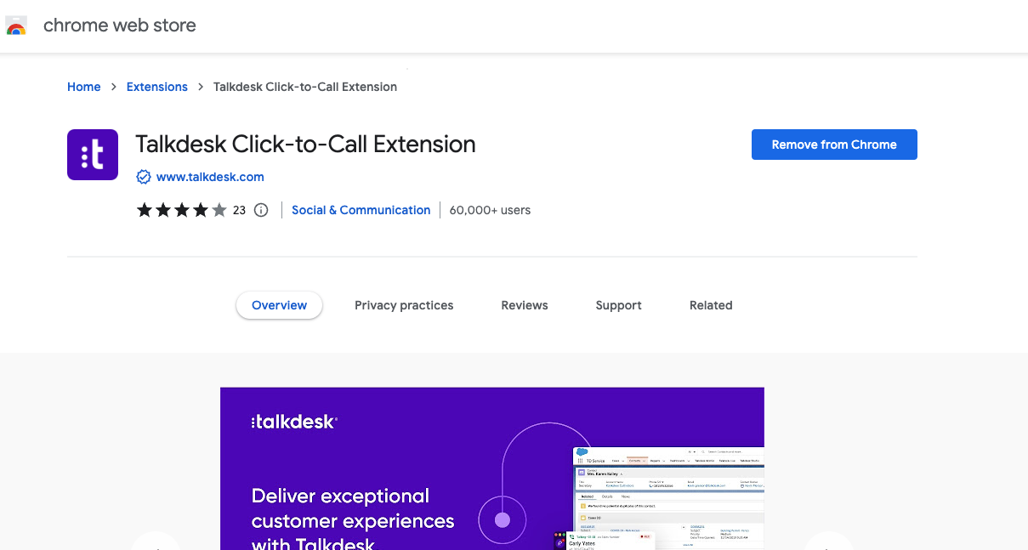
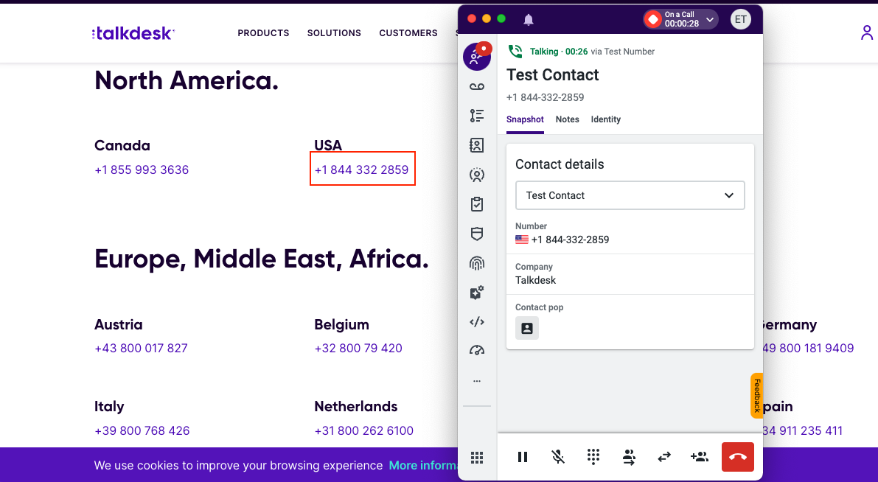
Click to Call
Talkdesk Click-to-Call functionality allows you to call customers directly from your favorite Helpdesk, CRM, sales software or any other website just by clicking on their phone number. Once installed, it will intelligently scan your websites and current systems (i.e. Salesforce, Zendesk, Zoho, etc.) and add a clickable link to each phone number.
1. Install the Talkdesk Chrome extension from the Chrome Web Store. Configure the Click-to-Call extension settings.
2. Once installed, use Click To Call to dial directly from a webpage or your CRM to initiate an outbound call through your Conversations app.

Slide 19
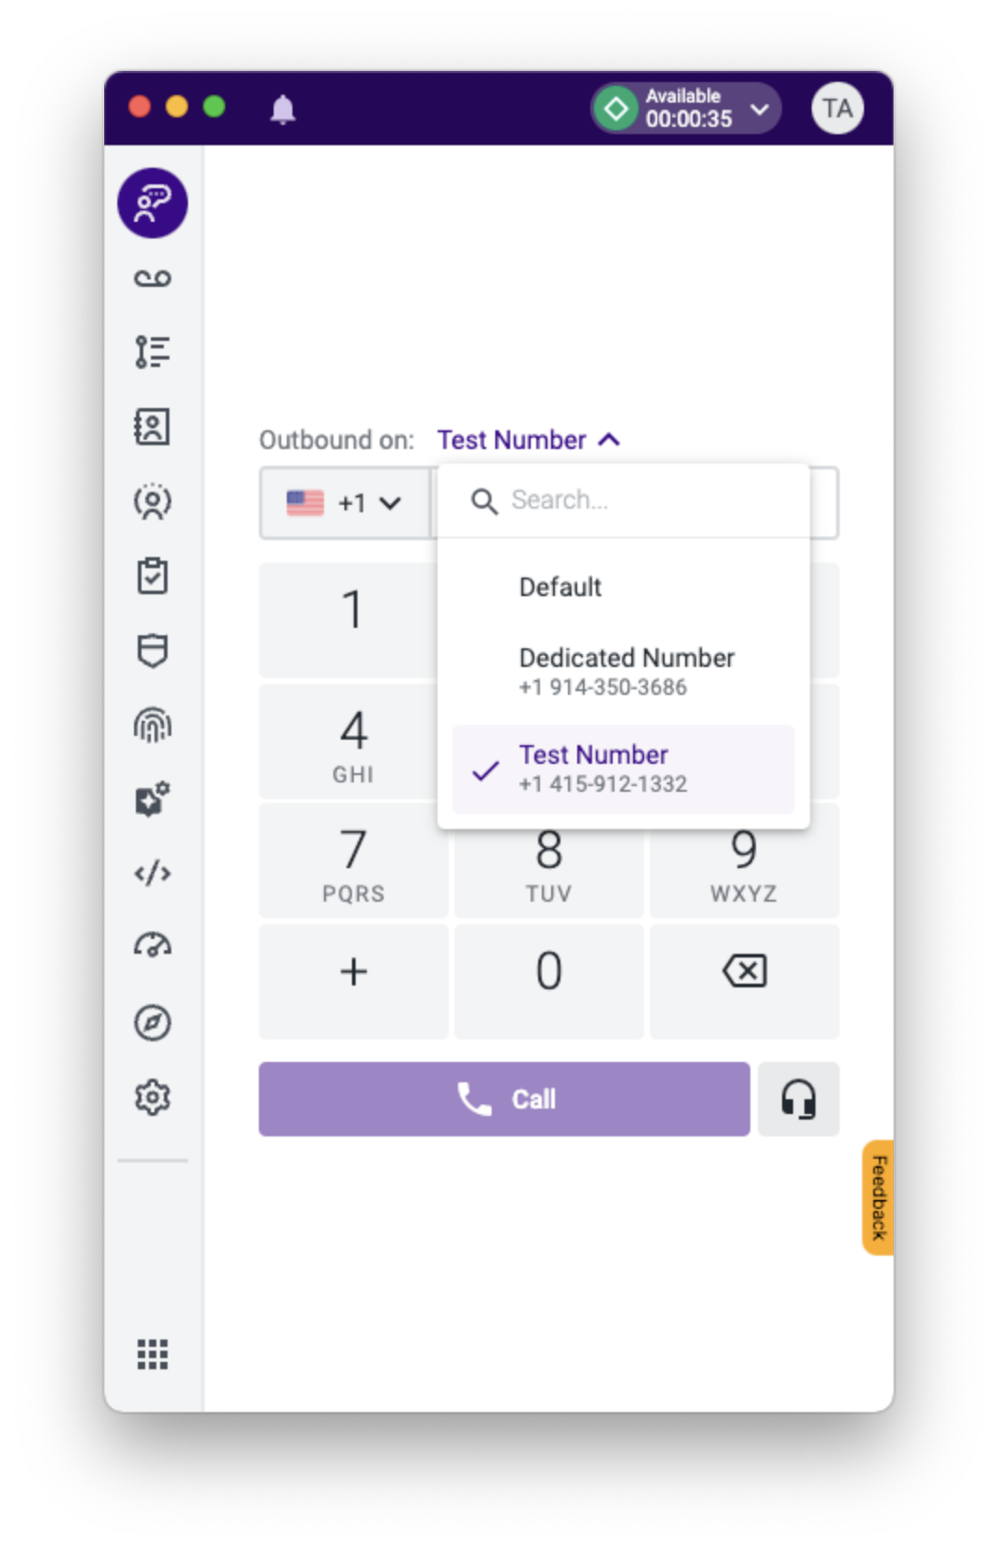
Outbound Caller ID
By default, Talkdesk automatically chooses the best number to display as your outbound caller ID based on comprehensive information. However, it is also possible to manually select the phone number to use when making an outbound call from both the global preferences level as well as within individual agent settings.
Customize Your Caller ID
When this option is enabled either as a global preference or customized per agent, a drop down menu is displayed in users’ Conversation app, allowing them to select the desired outbound caller ID per call.
An agent can choose the ‘Default’ option in this drop down if they would like the system to automatically choose the most appropriate number as the outbound caller ID.
1

Slide 20
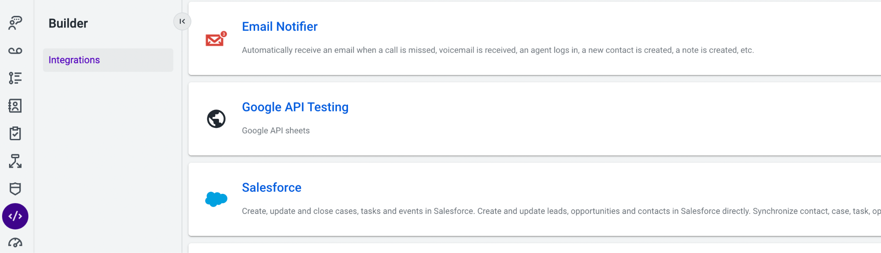
Integrations Manager
Located in the Builder application, here you can add, configure and manage your integrations:
Create automations based on a specific event in Talkdesk
Configure the synchronization between Talkdesk and the 3rd party system
Activate and deactivate all Integrations

Slide 21
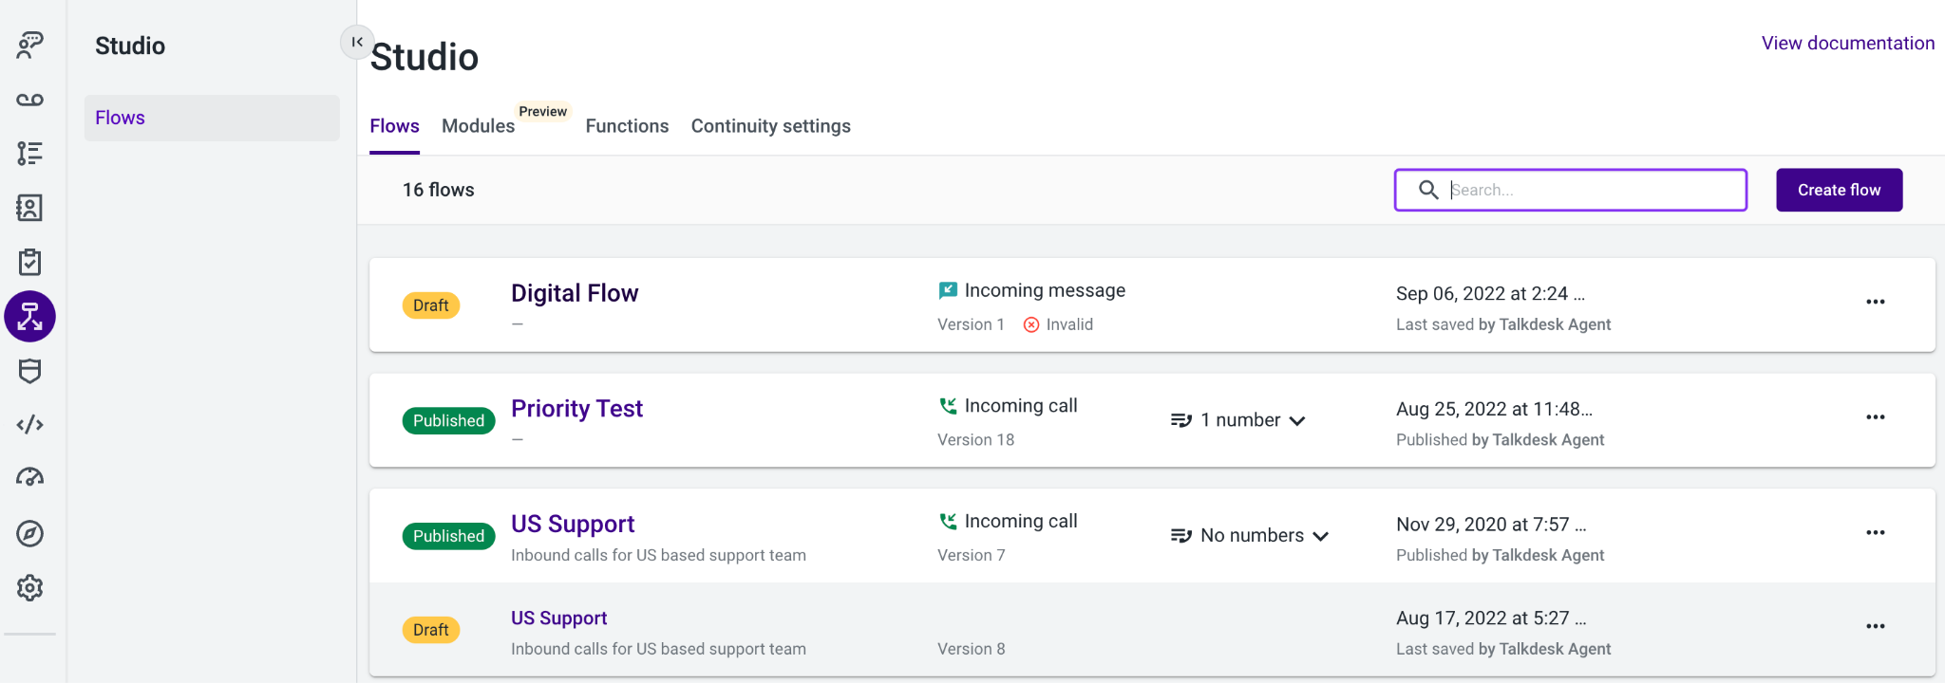
Studio
Navigate to the Studio application in Workspace to access all of your voice, digital and/or API driven call flows. Within the Studio section, you can also access Modules, Functions and the Continuity Settings.

Slide 22

Escalation Support
1
Global team providing 24/7 Support
Bugs or Technical issues: Admins can Submit a Ticket
Create an account for the Talkdesk Support Portal to track your organization’s support tickets
All other questions or suggestions:
Reach out to your CSM and TAM
2
3
4

Slide 23
Resources
Want to stay up-to-date on all the latest and greatest Talkdesk features? Subscribe to our Release Notes and automatically be informed!
Getting started with Talkdesk
Talkdesk Academy
Setting up CX Cloud
Number Porting
Network Tests
Sharpen your skills here!
Installing CX Cloud and Accessing Agent Workspace
Porting process of numbers to Talkdesk
Here’s how you can test
the quality of your network connection
System Requirements
& Network Settings
Set Up Browser
Recommended Headsets
Salesforce Integration
To ensure a smooth experience, see our set of requirements for the use of our web application
See our Talkdesk Installation Instructions for Salesforce
Setting up your Browser
to work with Talkdesk
What headsets are recommended?
Curious about events/issues on our platform? Status.Talkdesk.com

Slide 24

Thank you!

