Slide 1

Talkdesk
Agent Training

Slide 2
Talkdesk Overview
Conversations Functionality
Agent Workspace Apps
Conversations Settings
Resources

Slide 3
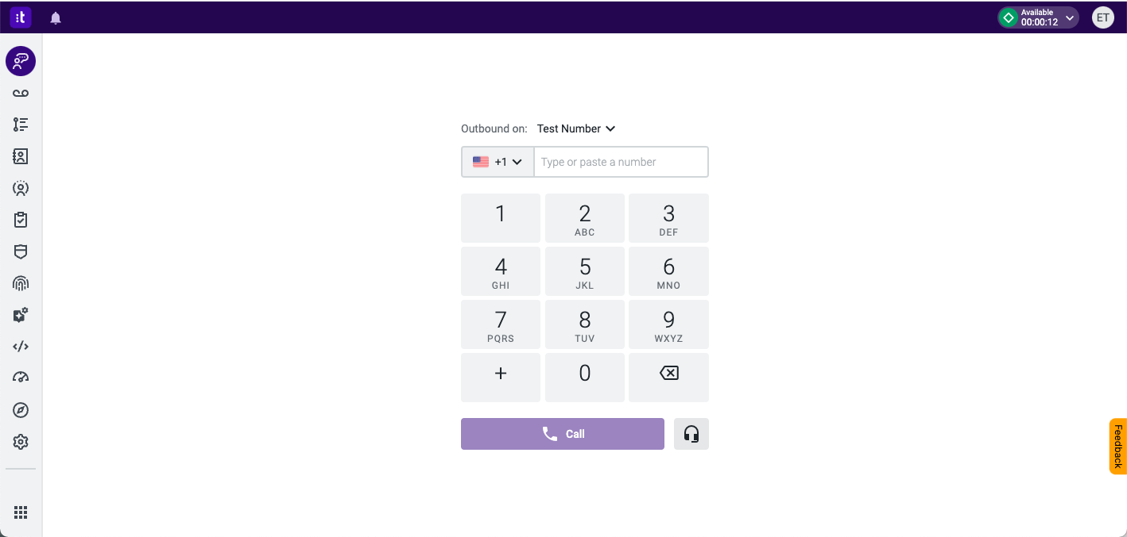
What is Talkdesk?
Talkdesk is a browser-based telephony solution that will allow you to make and receive phone calls directly from your computer.
Talkdesk Components
Perpay.mytalkdesk.com: Browser-based site that is mainly needed for reporting and administration purposes.
Talkdesk Workspace desktop application account: Perpay

Slide 4
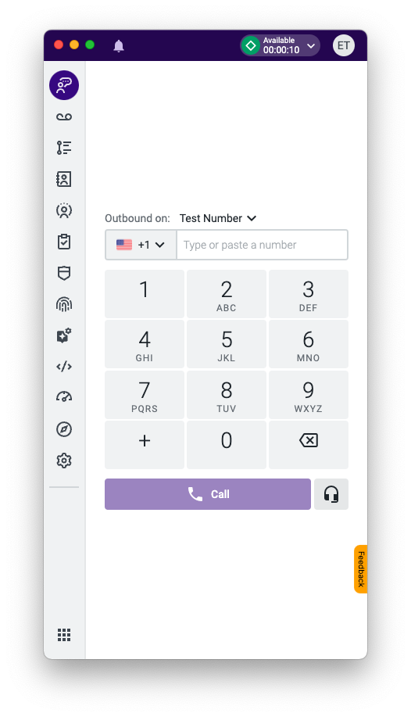
What is Talkdesk Workspace?
The Talkdesk CX Cloud Workspace unifies all CX applications and information agents need on a “single pane of glass”, empowering them to work more efficiently and effectively.
The downloadable desktop application is lightweight and easy to use
Includes Agent Workspace apps for all Talkdesk users:
  Activities - Allows you to see the complete record of agent(s), ring group(s), and/or account activity.
  Conversations - Allows you to handle voice and digital customer interactions. Serves as your desktop phone.
  Contacts - Allows you to access, create and edit contacts.
  Voicemails - Allows you to manage customer voice messages.
Agents can choose to through the desktop app or through the main web browser
  The desktop app is recommended as inbound calls will automatically pop up the application if it is minimized

Slide 5
Best Practices and Recommendations
Use Google Chrome
Always use the most
recent version
Ethernet Connection
Use a wired connection
over wi-fi connection
where possible
Enable Microphone
Allow microphones in your computer settings
Save your CPU
Network-intensive applications can compete with your audio bandwidth

Slide 6
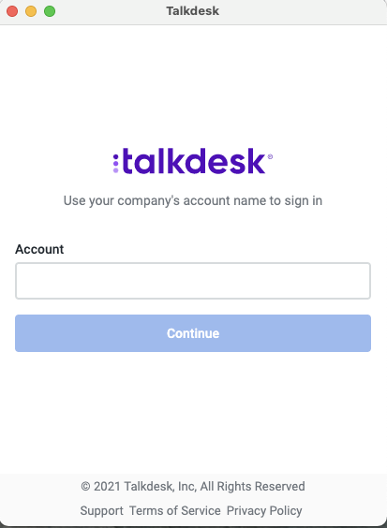
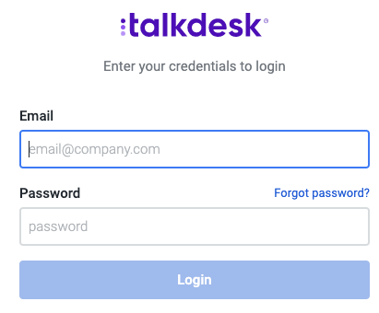
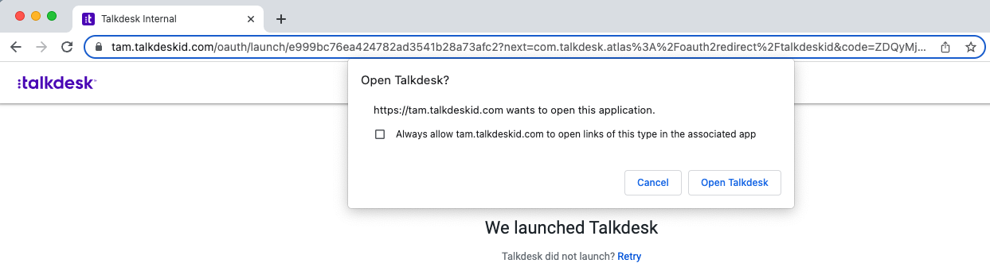
Log In to Talkdesk
1. Open the desktop application and set the domain to “perpay”
**must use all lower case
2. A new browser tab opens. Type in your email and password for Talkdesk. This will be the only step needed if using the web browser.
3. After clicking login, a new web browser page will open and prompt you to Open Talkdesk
**check off the ‘Always allow’ box on the first time logging into the desktop app so you don’t receive this prompt again in the future
1
2
3

Slide 7
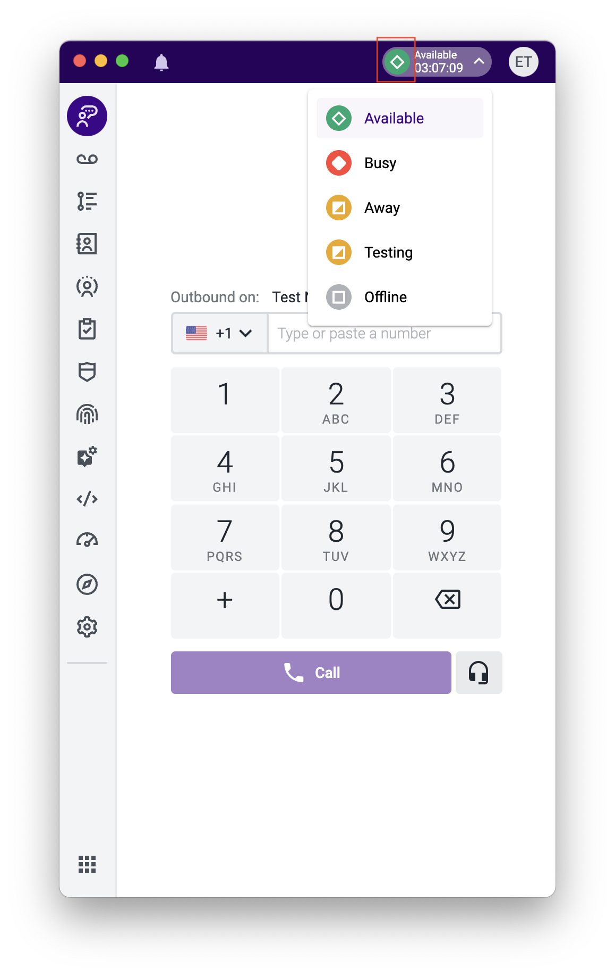
Agent Status
1
Status is how you control whether or not you can receive phone calls. Make sure you are set to ‘Available’ when you are ready to receive phone calls.
You can change your status at any time from the toolbar, by clicking on the symbol next to your initials in the upper right corner of either the desktop app or Talkdesk web page[1]. Simply click on the list of statuses defined by your company’s leaders [2].
Talkdesk will also change your status automatically when you are on a call or handling Dispositions in Talkdesk.
Agent Status Types
GREEN: The agent is signed into Talkdesk and is available to take calls. There can only be one green status in the environment, and the default value is ‘Available’.
RED: The agent is signed into Talkdesk but is busy performing other tasks. If no other agents are available, any new call will wait in queue until an agent in red status becomes available. Two default red statuses:
On a Call: The agent is signed into Talkdesk and is on a call. This status is automatically changed when agents receive/make a call, and they are unable to receive calls.
After Call Work: When a call ends, the agent’s status can be configured to automatically change to “After Call Work” for a fixed period of time. The agent cannot receive calls.
YELLOW: The agent is signed into Talkdesk but may be away from the computer and not eligible to take calls. It will still allow agents to receive call transfers though, should they wish to accept these.
GRAY: This status indicates that the agent is not signed into Talkdesk and is unable to receive calls. There can only be one gray status in the environment, and the default value is ‘Offline’.
2

Slide 8
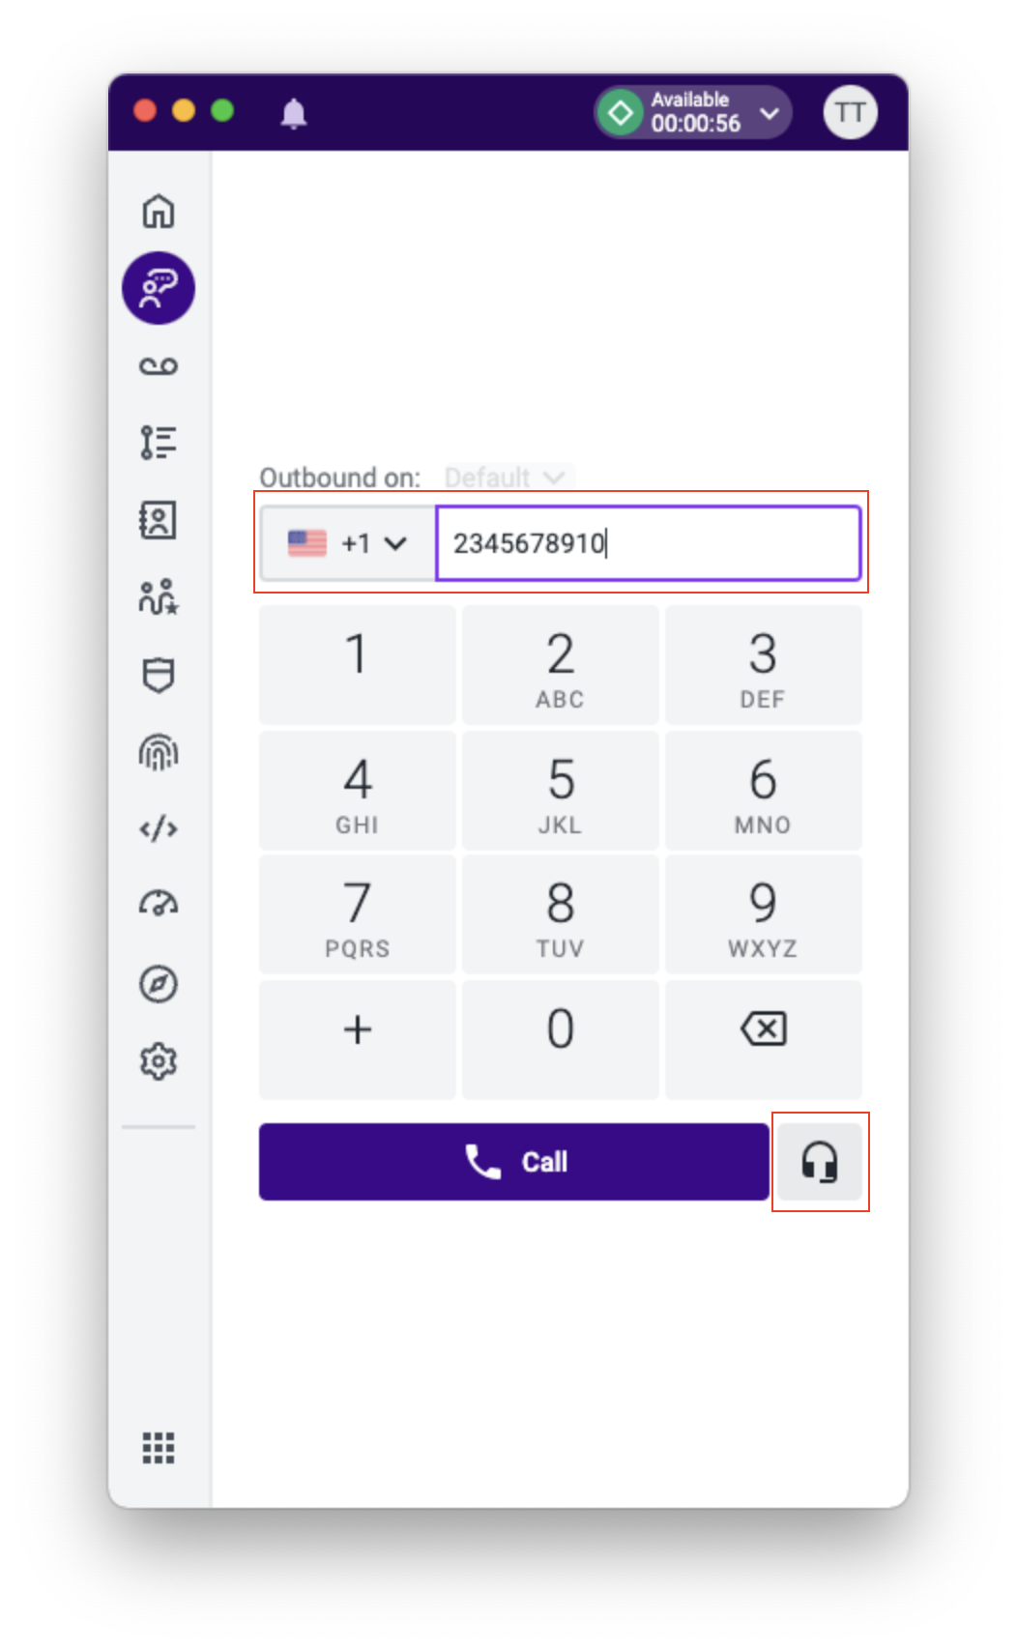
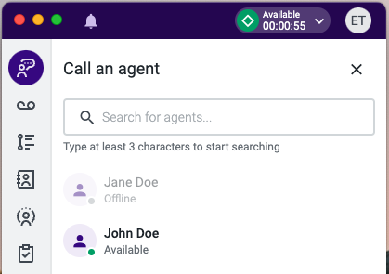
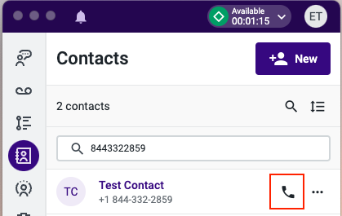
Making Outbound Phone Calls
Type in or copy / paste a phone number into the dialer pad [1].
Once you have entered the number, click the 'Call' button [2] to initiate a call.
You can initiate an internal call to another agent by clicking the headset button [3] next to the Call button.
  This will bring up a list of all agents and their current status that you can browse through or begin typing the name of the target agent.
  Simply click a name [4] to initiate an internal call.
    Note, you are only able to call agents who are in a GREEN or YELLOW status
Contacts can also be dialed by navigating to the Contacts or Activities App and selecting the phone icon [5] next to their name
1
4
3
2
5

Slide 9
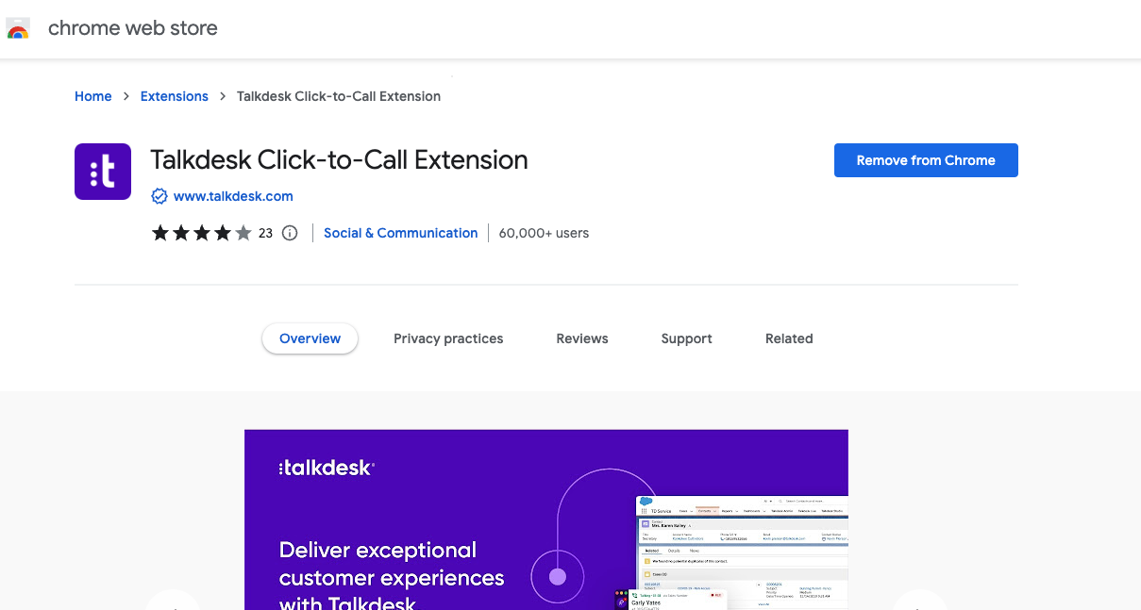
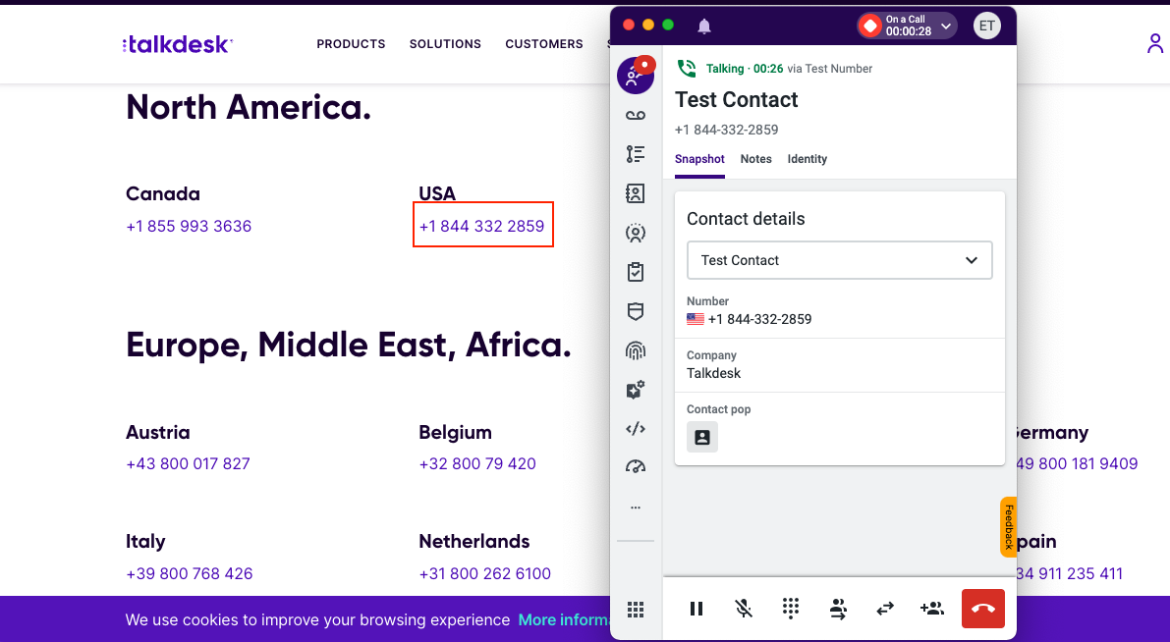
Click to Call
Talkdesk Click-to-Call functionality allows you to call customers directly from your favorite Helpdesk, CRM, sales software or any other website just by clicking on their phone number. Once installed, it will intelligently scan your websites and current systems (i.e. Salesforce, Zendesk, Zoho, etc.) and add a clickable link to each phone number.
1. Install the Talkdesk Chrome extension from the Chrome Web Store. Configure the Click-to-Call extension settings.
2. Once installed, use Click To Call to dial directly from a webpage or your CRM to initiate an outbound call through your Conversations app.

Slide 10
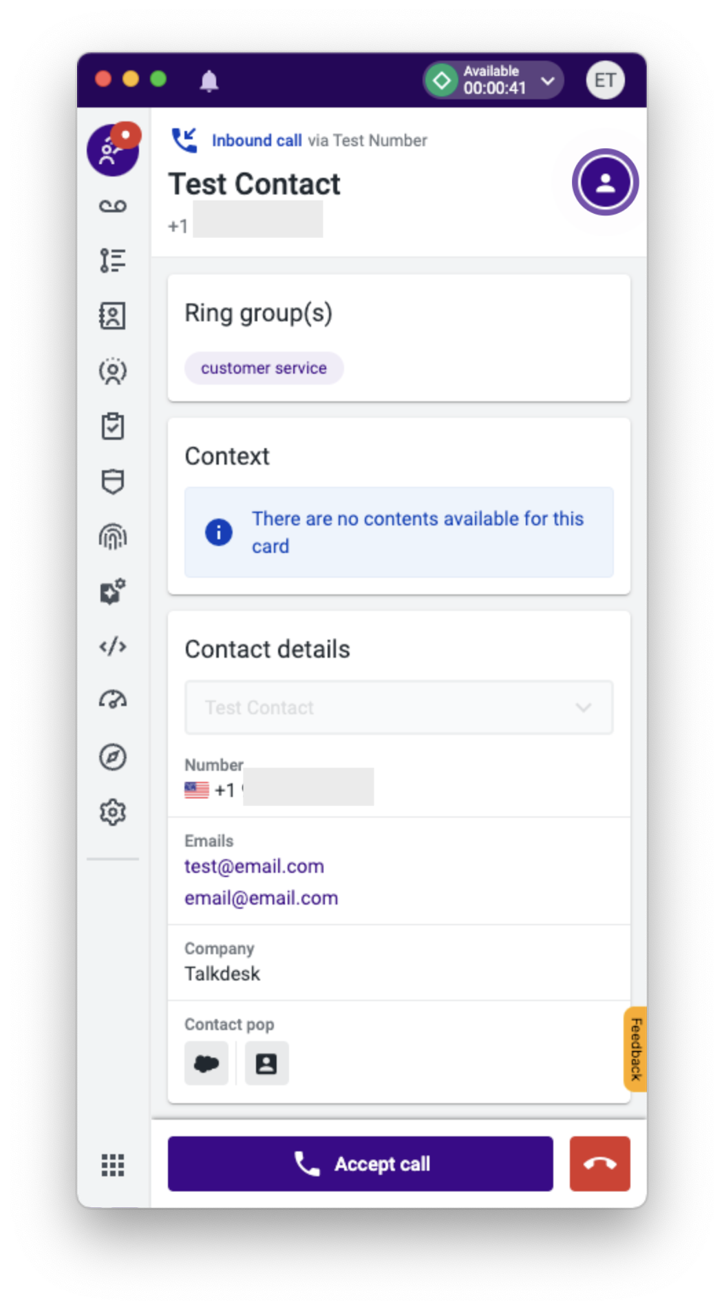
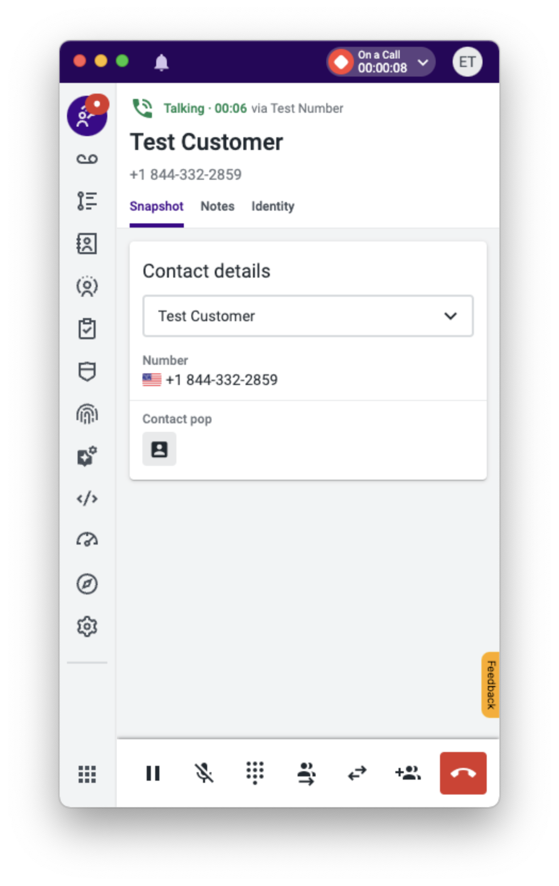
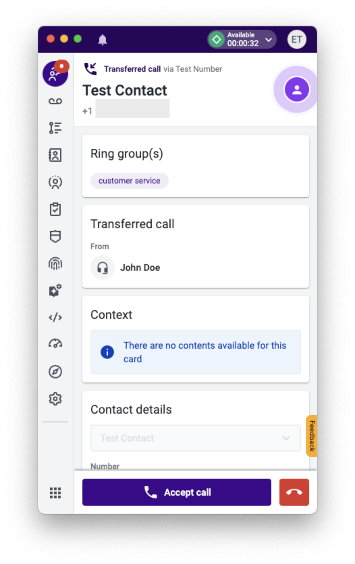
Receiving Inbound Phone Calls
Whether receiving an inbound call or making an outbound call through Conversations, you will see as much information on the Contact that Talkdesk was able to capture
  Ex. Test Contact vs. Test Customer
  Pulling data from CRM
  Existing contacts vs. new contacts
When receiving an inbound call:
  If using the web browser, you will see a toast notification on your Talkdesk tab
  If using the desktop app, the application will popup even if minimized
  Ring group and other context data will be displayed in Conversations prior to accepting the call, and while on the call
If receiving a transferred call from another agent, Conversations will display from who the transfer originated and the type of transfer that was initiated
  Transferred Call (blind transfer)
  Incoming Consultation
  Incoming Conference

Slide 11
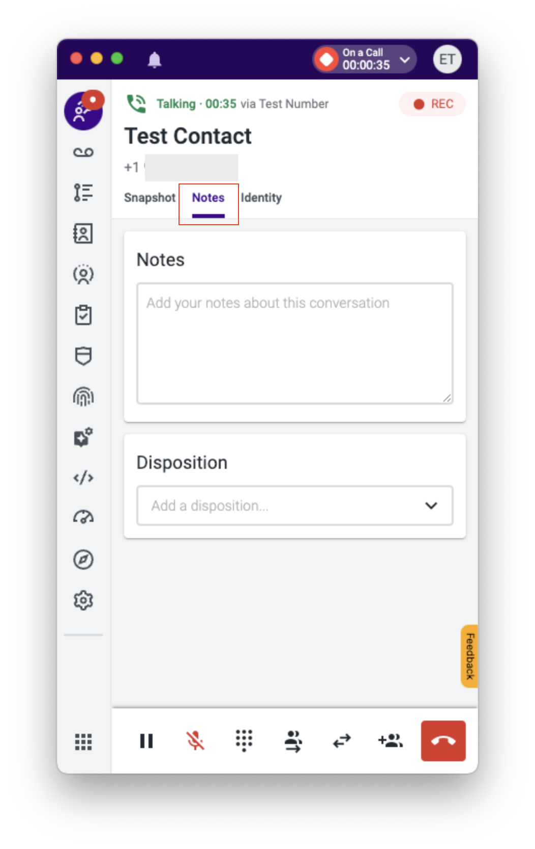
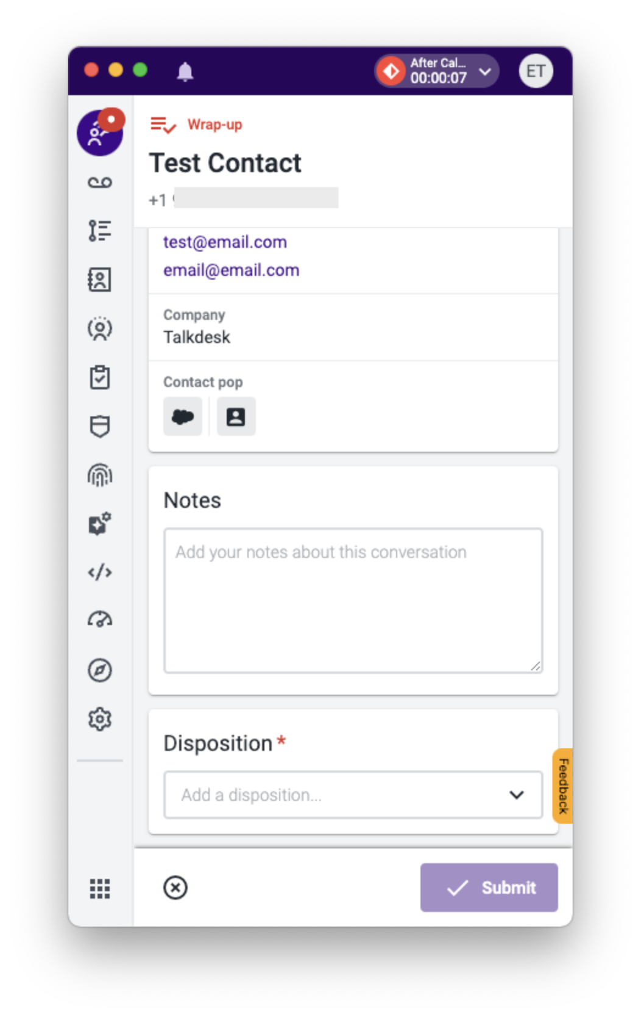
Disposition Codes and Notes
The ability to take notes while on a call can be done by hitting the Notes tab within Conversations
  It will pop open the disposition and notes that will be saved upon ending the call
  If you choose not to use notes or dispositions while on call, you will be presented with the same screen once a call ends if your agent profile has been enabled to do so
  Notes are not mandatory
Dispositions allow for a quick overview of the call and also can be used to trigger automations downstream or used for reporting
  Keep in mind that notes will not save unless dispositions are enabled - the Submit button that is presented with dispositions is what triggers notes and dispositions to be saved to a call

Slide 12
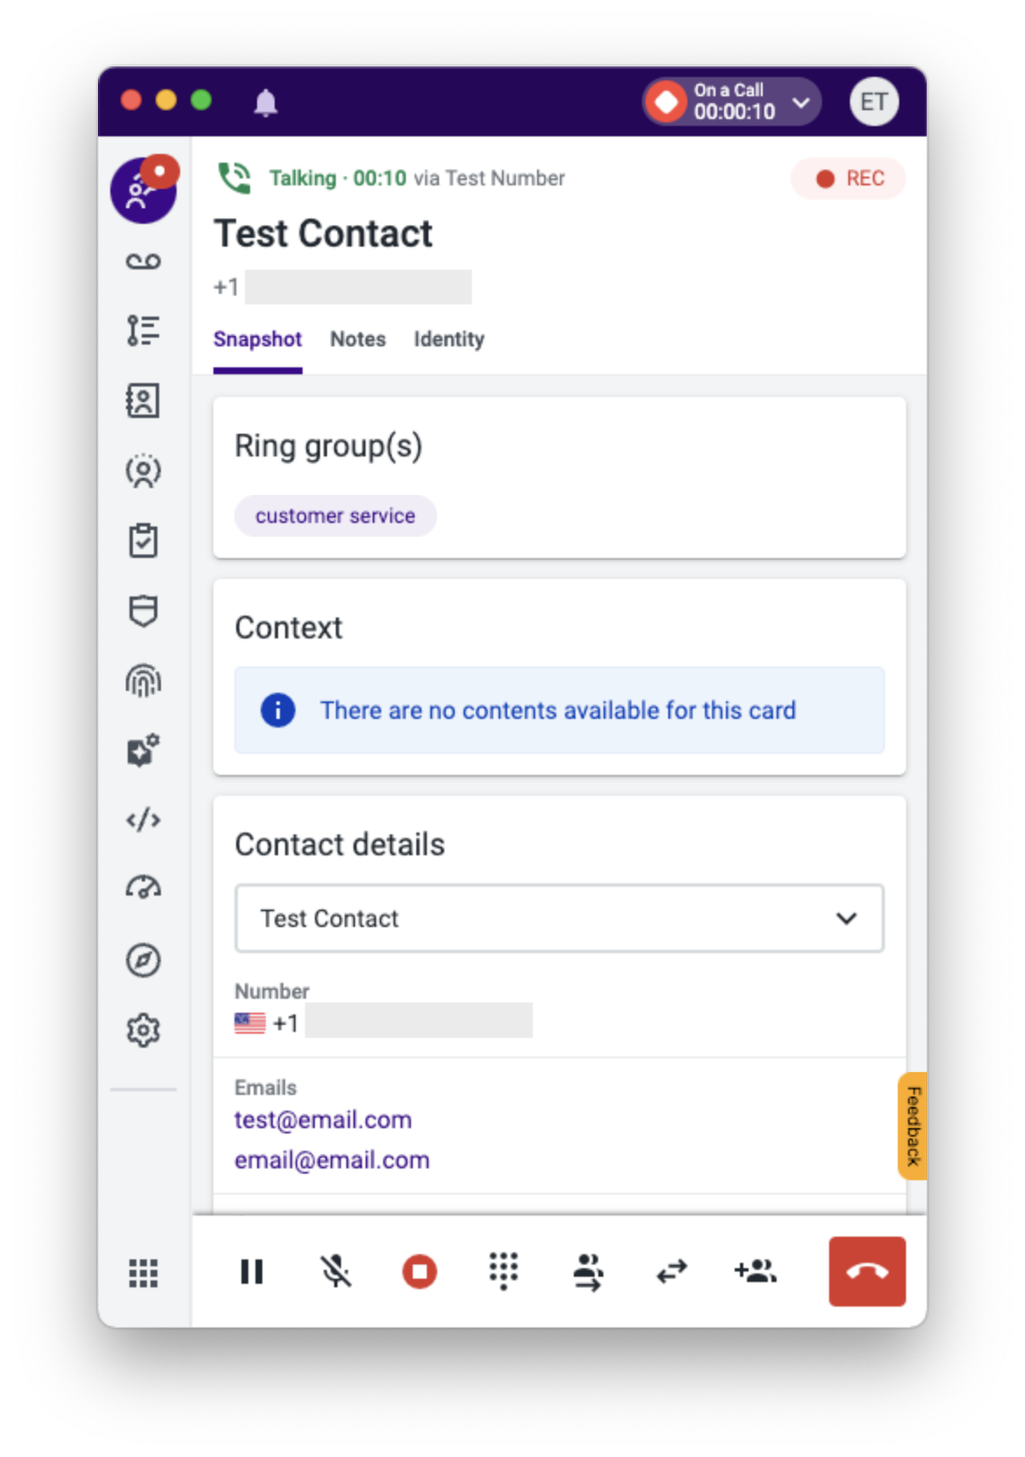
Mute, Hold a Call
4
To place a call on hold simply click the “Hold” button [1]. When a call is on hold, the caller cannot hear you and you cannot hear the caller.
  Note when you place a caller on hold, you will not be able to initiate a conference or warm transfer.
  You will be able to initiate a blind transfer if needed.
To mute a caller click the “Mute” button [2]. When a call is on mute, you can still hear your caller but the caller or other agents on the call cannot hear you
1
2
3

Slide 13

Call Transfers - Consult (Warm)
The warm transfer option, Consult, allows you to talk to the receiving agent/external contact about the caller’s issue, give any background information that might be helpful and prepare him or her for the interaction.
To initiate a warm transfer, press the Consult button
  You can also warm transfer to other ring groups, agents, favorites or external numbers
    If you initiate a warm transfer to a ring group where no agents are in GREEN status, the transfer will be cancelled and you will be returned to the call with the caller
    If you initiate a warm transfer to an agent, only agents who are in a GREEN or YELLOW status will be able to receive the transfer
You can choose to switch between the two legs of the call by clicking on “Switch to this call”, or create a conference with the caller and receiving party by clicking on “Add to consultation”
  When you have spoken with the receiving agent and you are ready to complete the transfer, select the “Transfer” button
The "End Consultation" button allows you to cancel the transfer and go back to the original call with the customer
  If you created a conference, you can remove the receiving agent by click the X next to their name in the conference section

Slide 14
Adding Guests
If you want to conference in one or more guests to the call, click the “Add guest” button
You can only add in other agents, favorites or external numbers to a conference
  Note, only agents who are in a GREEN status can be added to a conference
The limit of guests on a call is 10 participants. The original customer's name is always displayed at the top of Conversations
  You will see the count of additional participants next to the contact’s name (ie. Contact Name (+1) )
  The agent name or external number that have joined the conference will be displayed under the original customer’s name
You can remove any guest (except the original customer) by simply clicking the “x” button next to the number/name
You can end the call for all participants by clicking on the “End conference” button

Slide 15
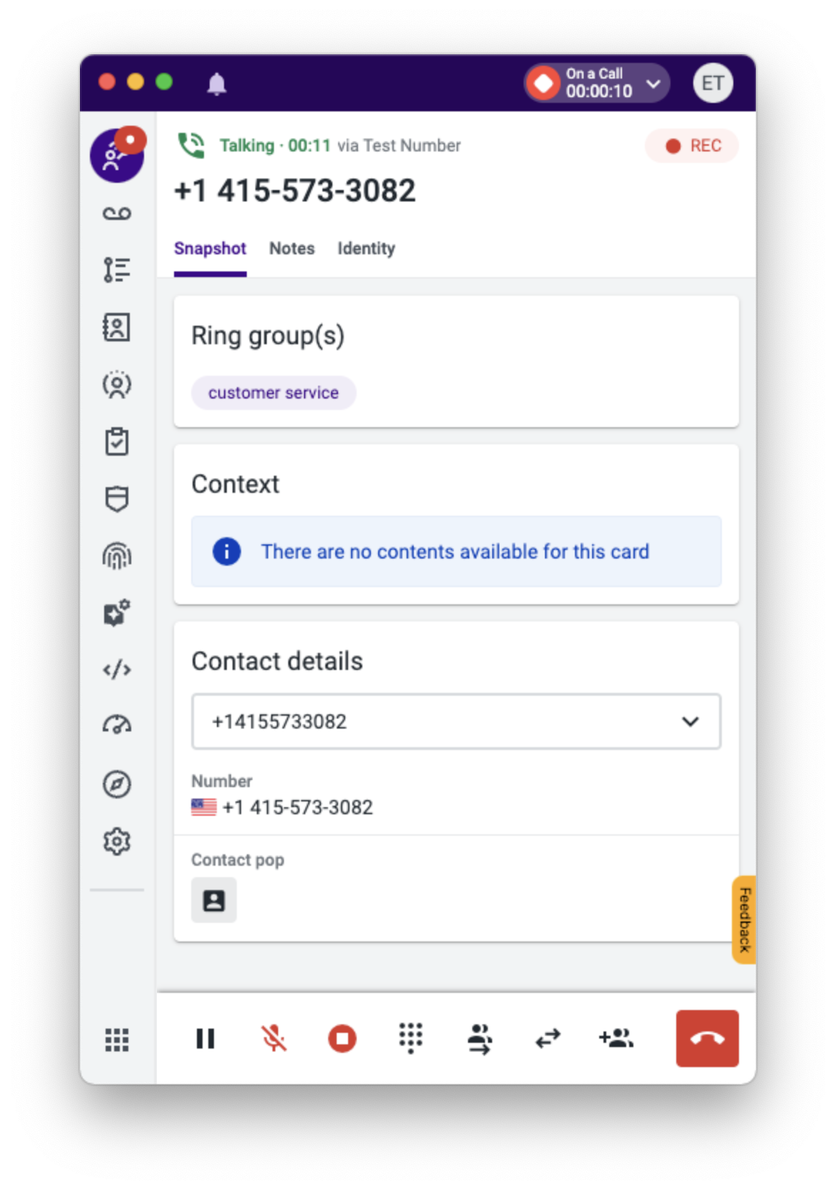
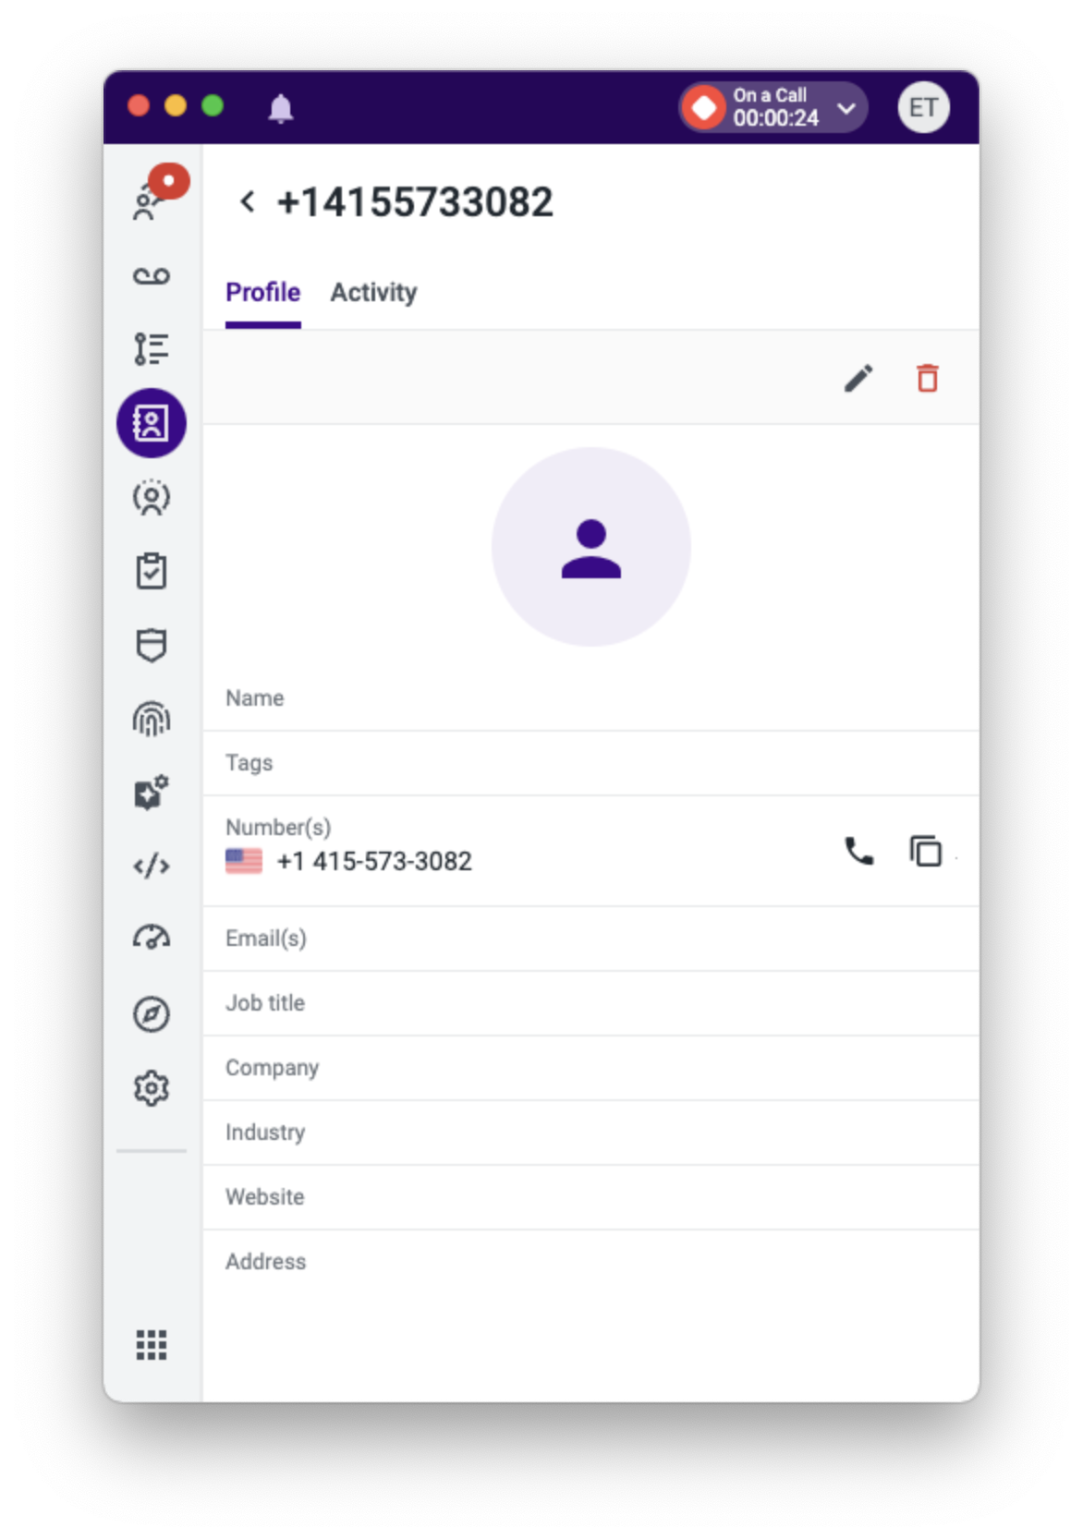
Contact Selection - New
For agents using Intercom, it is recommended to create any new contacts in Intercom.
  A contact sync will run periodically between Intercom and Talkdesk to push the new contact’s information into Talkdesk - this information can then be displayed the next time the customer calls into the business
  Contacts that are created in Talkdesk do not get pushed into Intercom
  Your admins can create automations to create a case / task / activity in Intercom from the inbound call in Talkdesk where you can create the new contact record
For agents not using Intercom, while on the call with the new customer you can click on the Talkdesk contact pop icon [1] in the lower left of Conversations
  This will open the Profile page within the Contacts app where you can edit by clicking the pencil icon [2] and save the information of the new contact
2
1

Slide 16
Contact Selection - Existing
When multiple contacts in Talkdesk share the same phone number, you will see “Multiple Contacts exist for this number” in the contact dropdown below Contact details. Select this dropdown to display the list of available contacts.
Select the correct contact from the dropdown menu and your call will be logged to that contact
If a single contact matches the caller’s phone number, that contact will automatically be assigned to the call
If the contact exists in Intercom, the Intercom logo will be available in the ‘Contact pop’ section
  Agents can click the Intercom logo to open the contact in Intercom

Slide 17
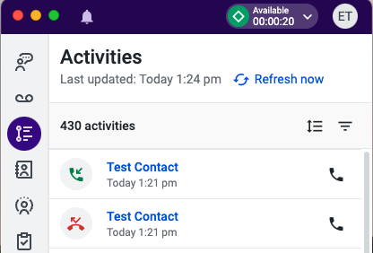
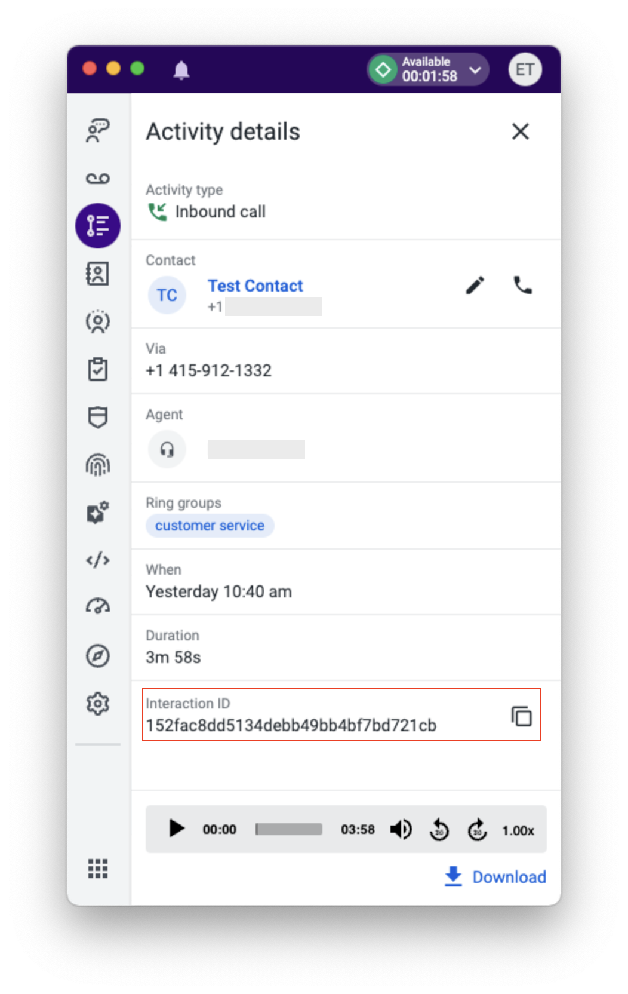
Activities
The Activities app will show your personal call history or call history for your applicable ring groups, depending on what has been permissioned by your admins
Here you can see at what time you had received or made a call to a specific contact
  You are able to sort activities by newest / oldest, as well as filter on different criteria
  You can initiate a call to a contact by clicking on the phone icon for the record you wish to call
  By clicking on the name of a contact within Activities, you will be brought to the contact’s profile page where you can see information about the contact as well as their personal call history
  Clicking on the activity itself (ie. in the white space of the record) you will see a drill down of details for the selected call
    IMPORTANT - if you experienced any issue, whether call quality or customer related, that you want to raise to your supervisor, copy and send the Interaction ID listed on the applicable activity

Slide 18
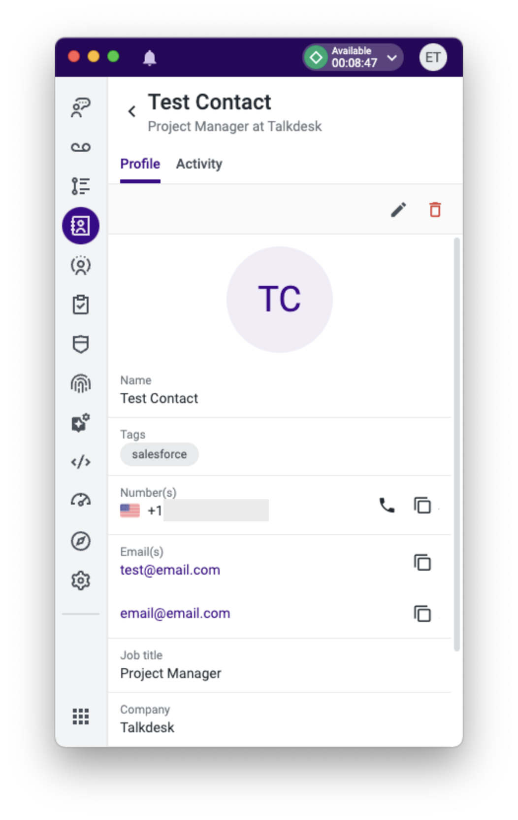
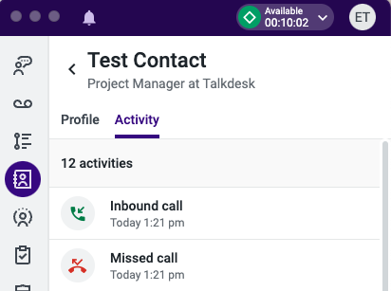
Contacts
The Contacts app will show information for contacts that have been loaded / synced into Talkdesk
The Contacts app also includes the list of external Favorites, where users can navigate to initiate an outbound call to the saved Favorite
For new or unknown contacts, Talkdesk will capture and store the caller’s phone number as a new contact record
  Agents can update any contact record with additional information - contact name, email, company, etc. - to better help identify the caller the next time they call
The Activity tab within a contact record will show the call history for that specific contact
  Clicking on a specific activity under the contact will show the snapshot details along with any saved notes or dispositions from the agent who handled the interaction
You can initiate an outbound call to any number saved within a contact record
The contacts tab can be sorted by alphabetical or reverse alphabetical order
You are able to search for contacts based on the below fields:
  Name
  Phone Number
  Email
  Company

Slide 19
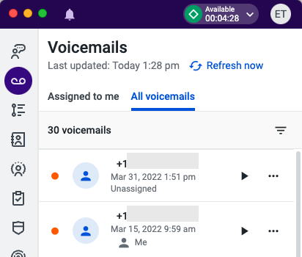
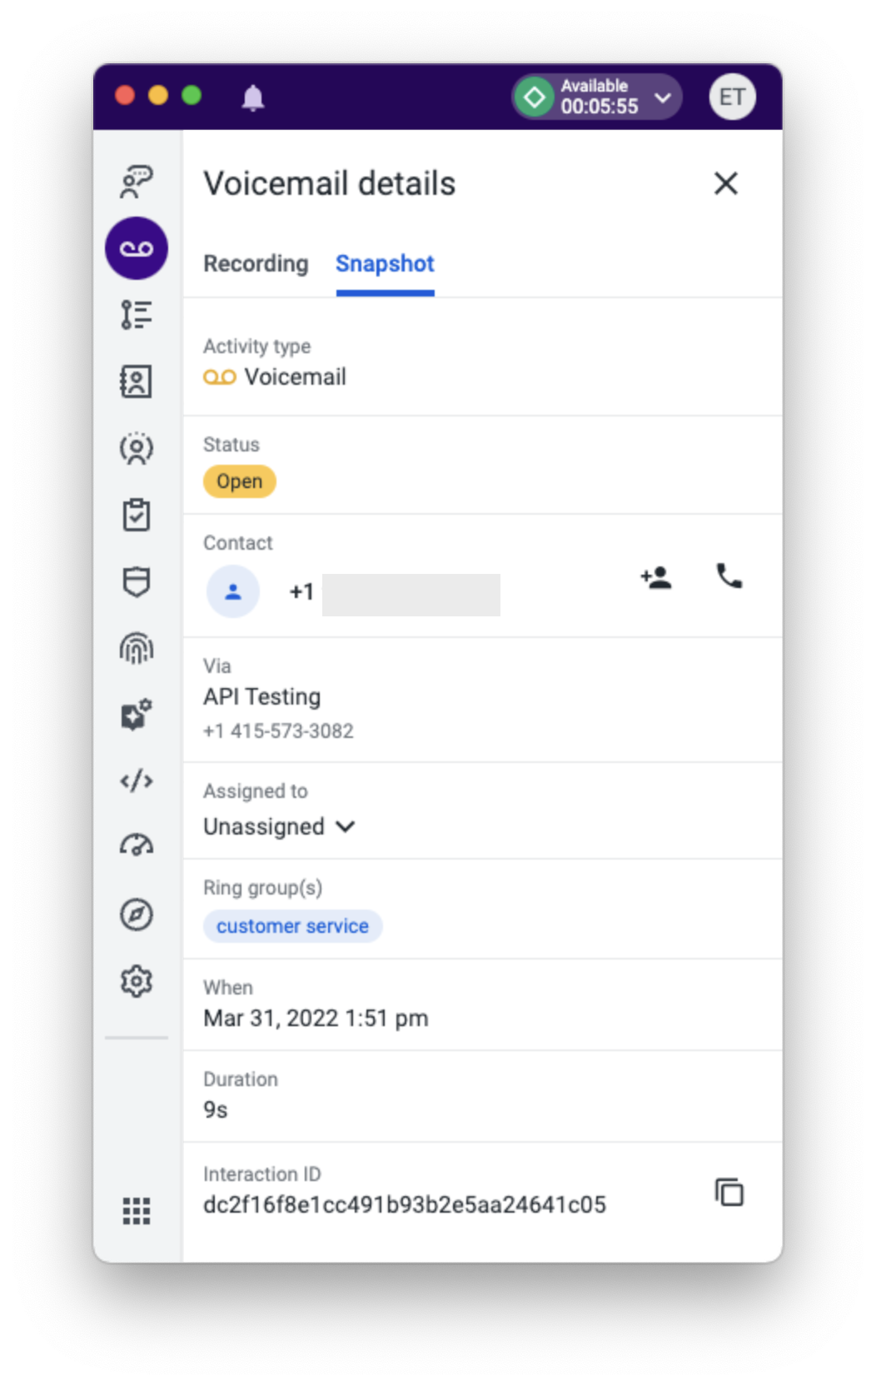
Voicemails
The Voicemails app will show any voicemails that have been left for your applicable ring group(s) as well as any voicemails that have been assigned to you
Here you can see at what time you / the ring group had received a voicemail from a specific contact
  You can filter your view on different criteria
  You can listen to the voicemail by clicking on the play button
  Clicking on the ellipses will present a menu where you can:
    Resolve the voicemail
    Assign the voicemail to a specific agent
    Call the customer back
  By clicking on the name of a contact within Voicemails, you will be brought to the contacts profile page where you can see information about the contact as well as their personal call history
  Clicking on the voicemail itself (ie. in the white space of the record) you will see a drill down of details for the selected call in the Snapshot tab

Slide 20
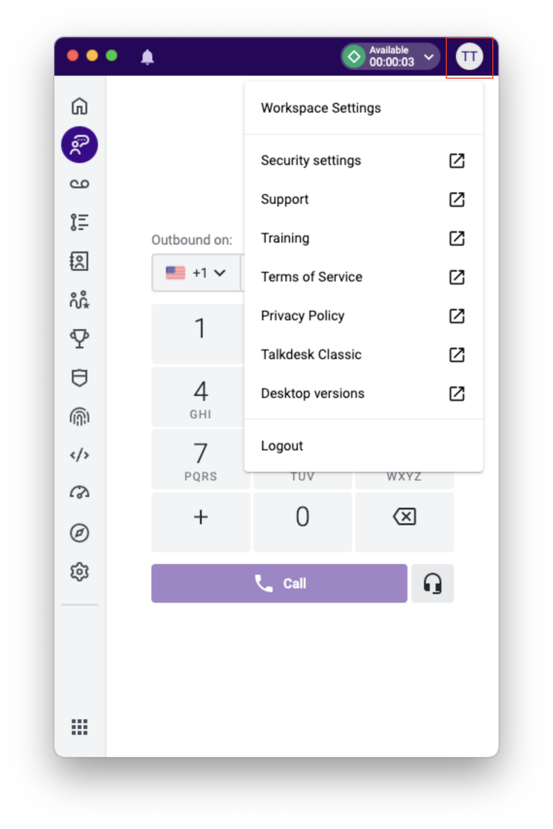
Talkdesk Workspace Settings
Agents can navigate to various settings and additional resources by clicking on their initials in the upper right corner of the CX Cloud app or web browser
Notable features:
  Workspace settings
    Language - choose the desired language to display throughout Talkdesk Workspace
    Keep on top - only applies to the desktop app, enabling this setting (recommended) will allow the application to always stay on top of other apps or web pages
  Security settings
    Ability to change your password
  Support
    Talkdesk support portal where Admins can submit a ticket to our support team should issues arise
  Training
    Link to Talkdesk Academy if you need to take a refresher course
  Logout
    We strongly recommend logging out of Talkdesk when you are done using the system for the day, and starting a fresh new session the following day

Slide 21
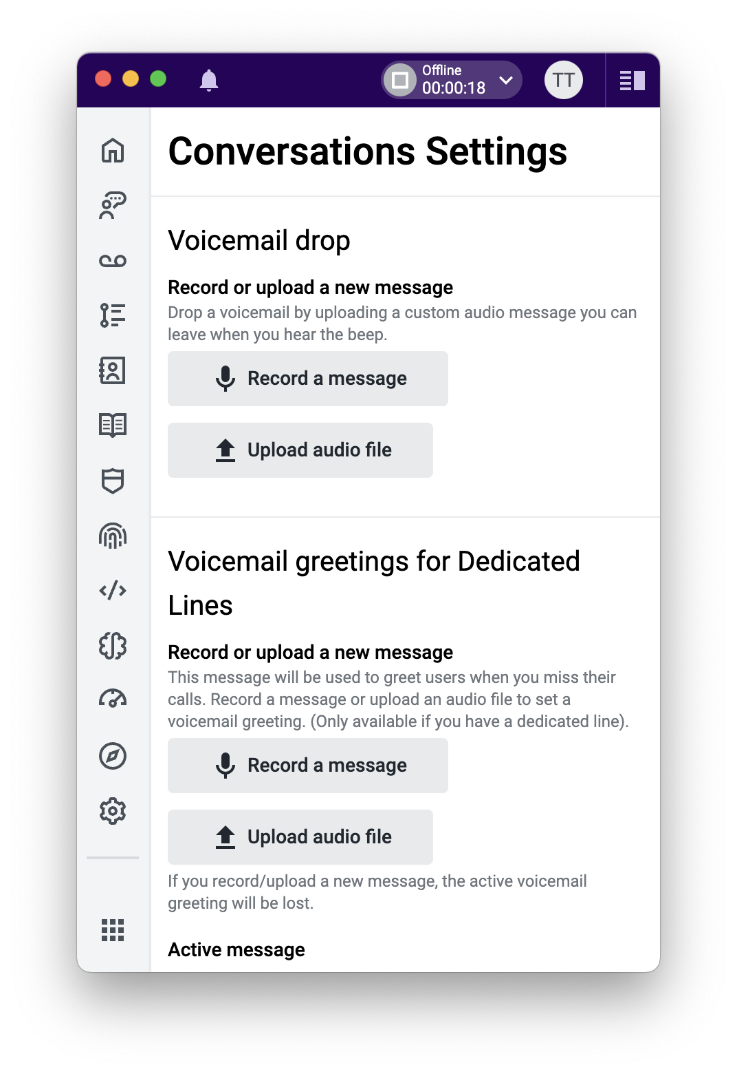
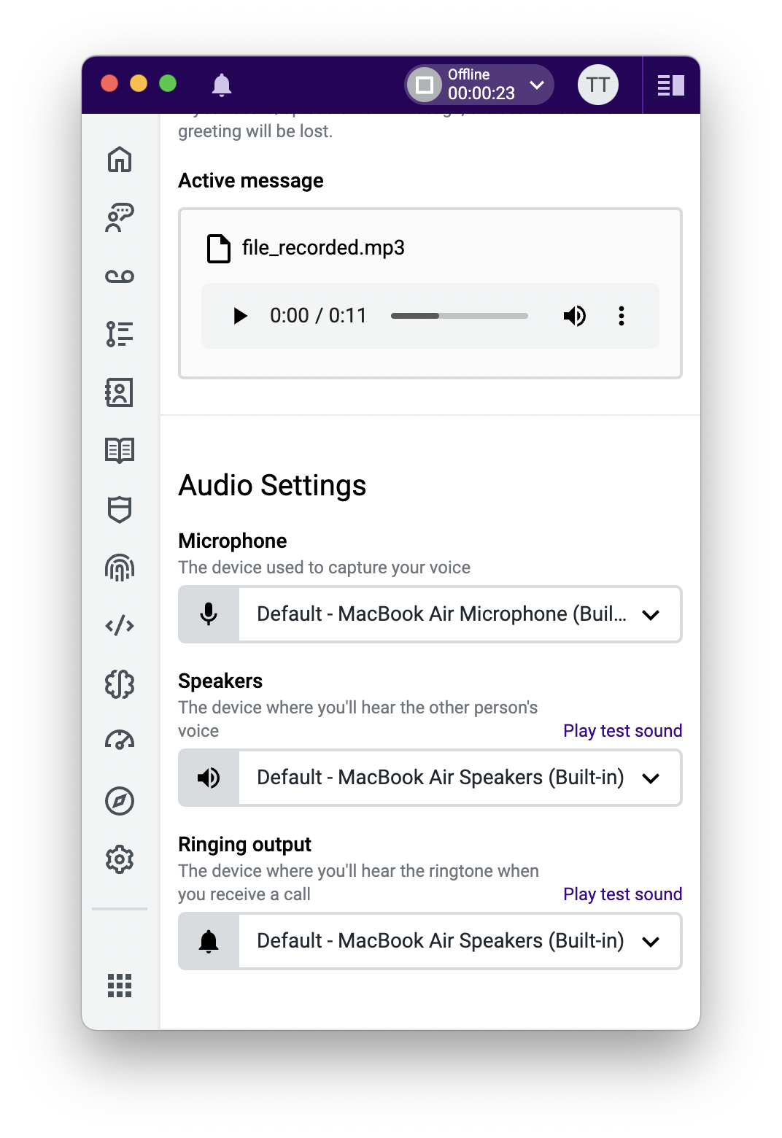
Conversations Settings
Conversation Settings
  Voicemail Drop
    This feature allows Agents to record or upload a personal message, as well as to drop this message during a call if they reach a customers’ voicemail
  Voicemail Greetings for Dedicated Lines
    Record or upload a personal message that your admins can configure to play when a customer reaches your direct voicemail
  Audio Settings - review which audio devices are being used by Talkdesk, and test the sound output
    Microphone
      The device used to capture your voice
    Speakers
      The device through which you will hear the caller
    Ringing Output
      The device through which you will hear the ringtone when you receive a call

Slide 22
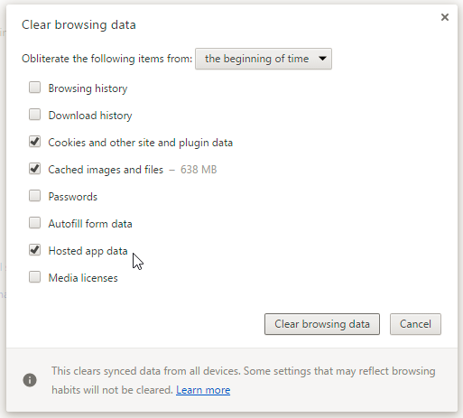
Troubleshooting
Please make sure you are using the latest version of Chrome (no other browser please)
Clear your cache/cookies/hosted app data and restart Chrome
Ensure no plugin/extension is blocking Talkdesk functionalities
Ensure that you did not block any Talkdesk permissions when first logging into Talkdesk
If the desktop application does not work, see if the native Talkdesk web page works by logging in via Perpay.mytalkdesk.com
If you still have issues, go into incognito mode and try making a call from the Talkdesk web page
If none of the above steps resolve the issue, please work with your Talkdesk Admins to contact support
Visit the Talkdesk System Status page at status.talkdesk.com

Slide 23
Resources
  Using Conversations
https://support.talkdesk.com/hc/en-us/articles/4407169235739-Conversations-Voice-Channel-
Conversations Features Guide
https://support.talkdesk.com/hc/en-us/articles/8344986700315-Conversations-Voice-Channel-Features-Guide-
Agent Workspace
https://support.talkdesk.com/hc/en-us/sections/4406872051227-Talkdesk-Agent-Workspace
Talkdesk Academy
https://academy.talkdesk.com/agent-workspace
Homework
Try several outbound calls to your cell phone from Conversations
  Put a call on hold / take off hold, mute / unmute
  Transfer a call (Warm or blind) to another agent
  Update dispositions and call notes
  Create a conference call with another agent; remove the other agent from the call
Initiate an internal call to another agent
Have a manager/supervisor place an inbound call to a Ring Group you have assigned and handle the call as if it were a live caller
Find the Interaction ID for any of your test calls

Slide 24

Thank you!

