Slide 1
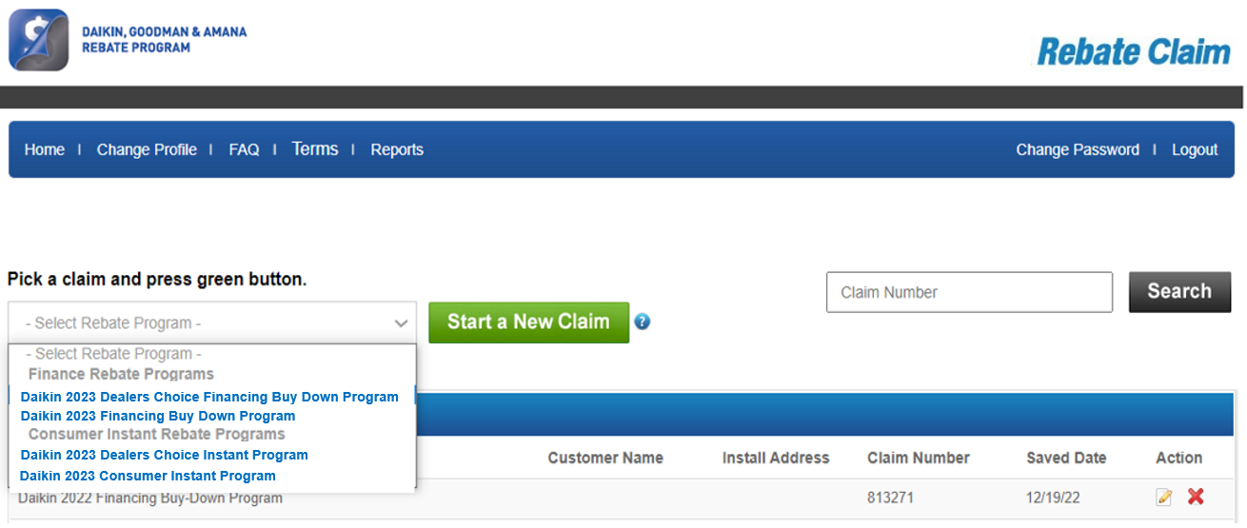

Processing Dealers Choice Rebate – Claims Due Quarterly!
Claim Website: www.egia.org/dealerrebates
TSM DEMO LOGIN:
Username: tsm@egia.org
Password: rebates123
680+ FICO, Prime customer
Near Prime
STEP 1: Click drop down, select claim type
For Dealer’s Choice / Upgrade to FIT Promo:
Only ONE Claim needs to be submitted. BUT Dealer MUST select the option with “Dealers Choice” in the name to get the additional $550 incentive.
600-679 FICO, Sub-Prime
Sub-Prime
STEP 2: Click Start New Claim
<600 FICO, Lease to own
Notes:
Step 1: Go to egia.org/dealerrebates (create account if you don’t have one or login)
Step 2: Click the drop down box and select the type of claim you are entering, then click start new claim
(we have a TSM Demo login here for TSM’s looking to get in and demo the process for their dealers)

Slide 2
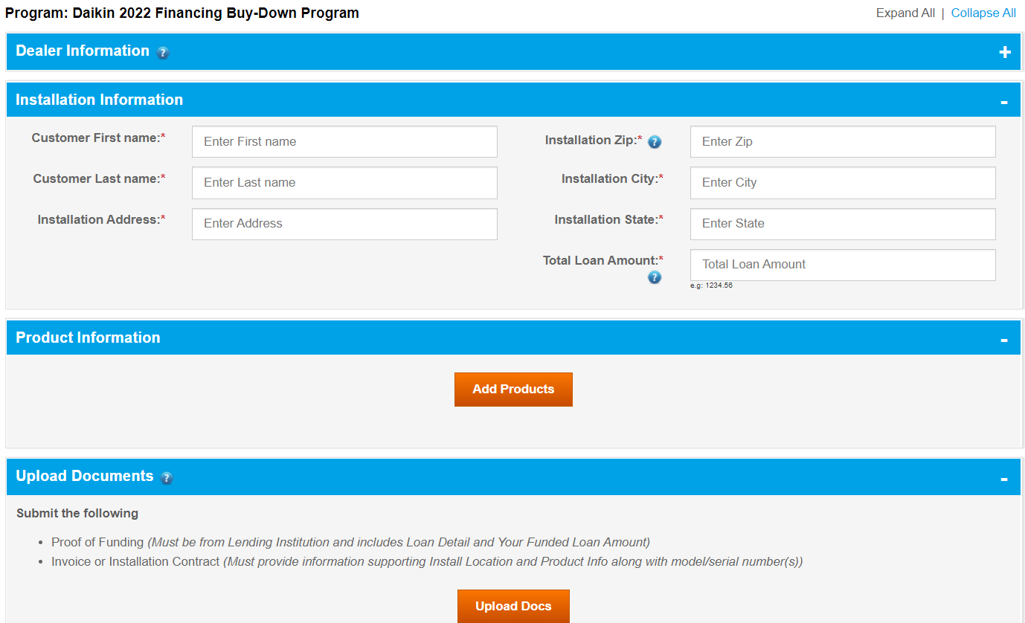
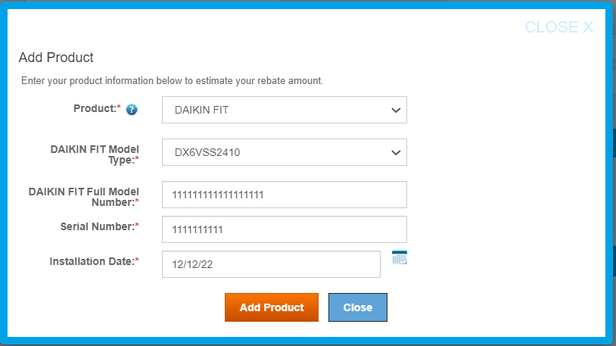
Step 3: Enter Customer & Product Info, Upload Required Docs
1: Enter Basic Customer Info
2: Enter Product Model and Serial
3: Upload copy of Invoice OR Product Registration Cert w/
Model and Serial #’s, and Proof of Funding
(Proof of Funding only required on Finance Buy Down)
Notes:
Next, enter basic customer info (name address)
Enter Product Model and Serial Numbers, and Install Date
Lastly Upload a copy of the Funding Proof from the Finance company (comes at funding via email or in the finance company portal). Also need a copy of Invoice / work order OR copy of Product Registration Certificate with Model and Serial numbers.
(Funding Proof is only required on Finance Buy Down Claims)

Slide 3
Dealer Training On Demand: www.optimusfinancing.com/resources
US / CANADA REBATE TEAM: 888-691-0387 | dealerrebates@egia.org
DAIKIN STRATEGIC PARTNERSHIP MGR: JEREMY CHANDLER 916-759-0515 | jchandler@egia.org
Donna DeCoster
Western Regional Manager
Phone: (323) 312-7579
Email: ddecoster@egia.org
Eric Gude
Sales Manager (Central / Canada RM)
Phone: (515) 499-2849
Email: egude@egia.org
Kimberley Satterwhite
Western Account Manager
Phone: (916) 480-7379
Email: ksatterwhite@egia.org
Leslie Lewis
Central & Canada Regional Manager
Phone: (888) 523-2144
Email: llewis@egia.org
Wright Kimbro
East Regional Manager
Phone: (229) 364-2888
Email: wkimbro@egia.org
Paris White
Central & Canada Account Manager
Phone: (844) 327-3352
Email: pwhite@egia.org
Jen Morris
Eastern Regional Manager
Phone: (843) 327-7887
Email: jmorris@egia.org
Anna Robinson
Eastern Account Manager
Phone: (916) 265-0978
Email: arobinson@egia.org

Slide 4
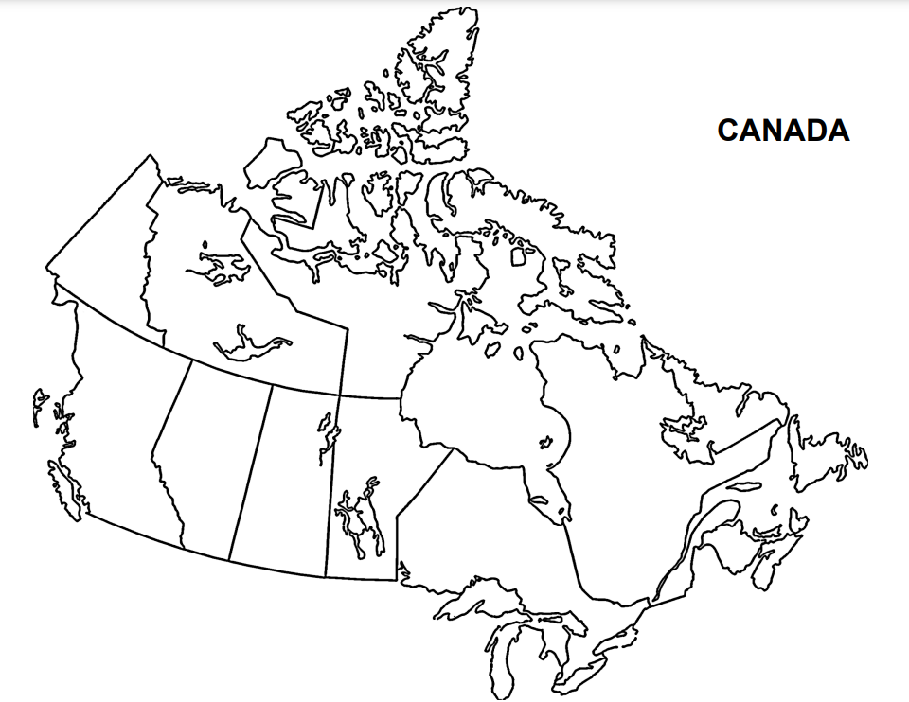
Dealer Training On Demand: www.optimusfinancing.com/resources
US / CANADA REBATE TEAM: 888-691-0387 | dealerrebates@egia.org
DAIKIN STRATEGIC PARTNERSHIP MGR: JEREMY CHANDLER 916-759-0515 | jchandler@egia.org
Jillian Gaskins
Canada Regional Manager
Phone: (843) 814-0513
Email: jgaskins@egia.org
Eric Gude
Sales Manager (Central / Canada RM)
Phone: (515) 499-2849
Email: egude@egia.org

Slide 5
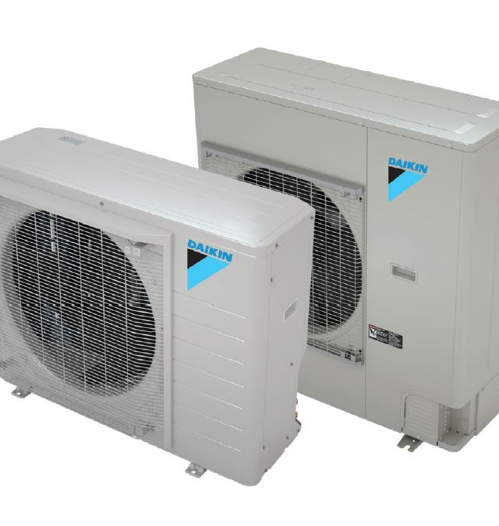
EGIA Rebate Team
(888) 691-0387 dealerrebates@egia.org
Jeremy Chandler
Sr. Manager National Strategic Partnerships
(916) 759-0515 jchandler@egia.org
Questions?

