Slide 1
Funding Files
Step by Step

Slide 2
PART ONE
The Share Drive

Slide 3
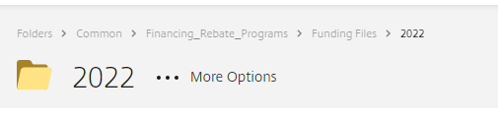
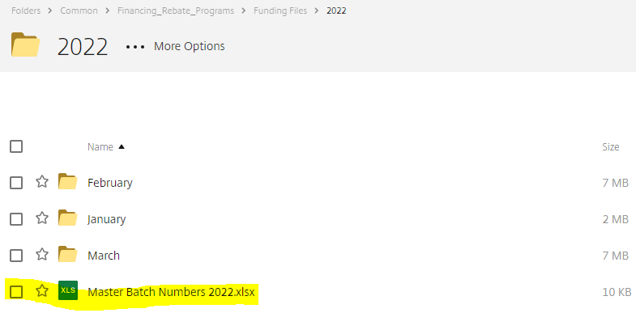
Step One: Share Drive
Path to funding file folder:
Open Master Batch 2022:

Slide 4
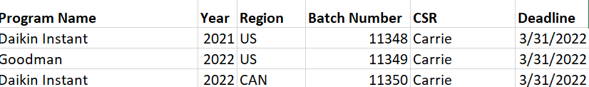
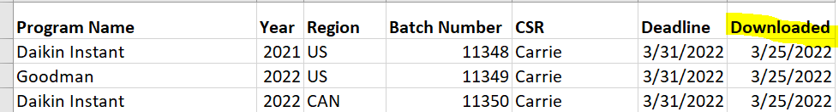
Step Two: Master Batch
See which batches have been assigned to you, and the deadline:
Type in the date downloaded, by you:

Slide 5
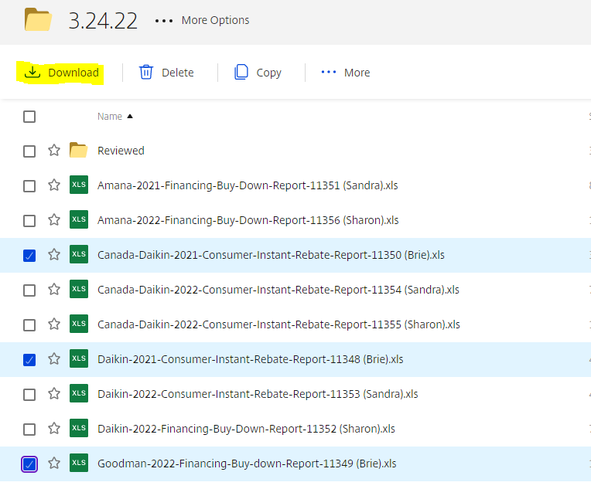
Step Three: Download
Select your assigned batches and then click download:

Slide 6

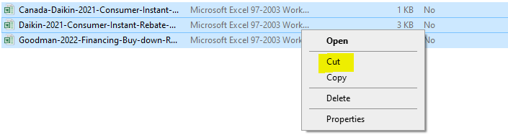
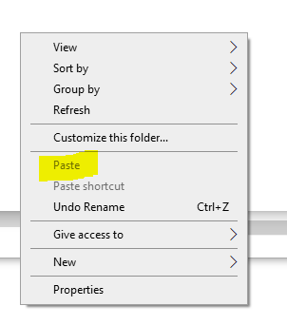
Step Three: Download Continued
Click on the folder that shows on the lower left after clicking download:
Select all folders, right click and select cut:
Paste where you save your files:

Slide 7
PART TWO
Reviewing Instant Files

Slide 8
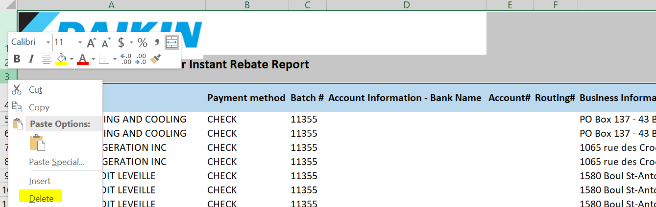
Step One: Formatting File
Click Enable Editing:
Delete the first 3 rows:
Delete the branding: Left click “DAIKIN” and backspace.

Slide 9
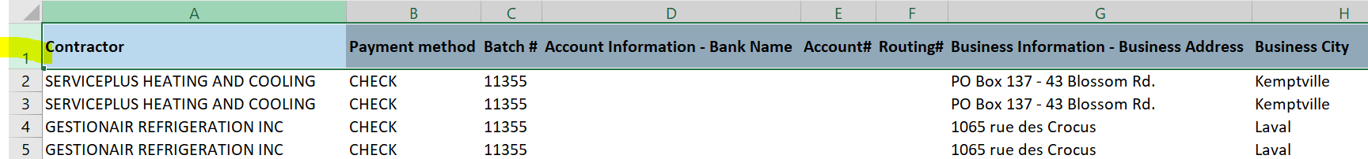
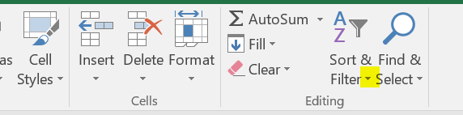
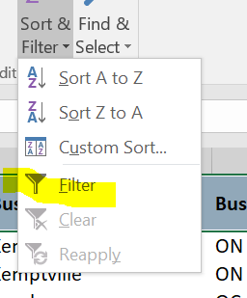
Step Two: Add Filter to Sheet
Select the first row:
Select Sort & Filter:
Select Filter:

Slide 10
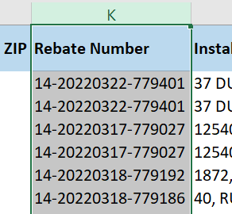
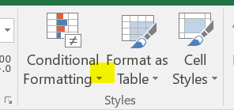
Step Three: Check For Duplicates
Duplicates need to be checked for the following:
  Rebate number
  Installation Address
  All Serial Numbers
Highlight Column:
Select Conditional Formatting:

Slide 11
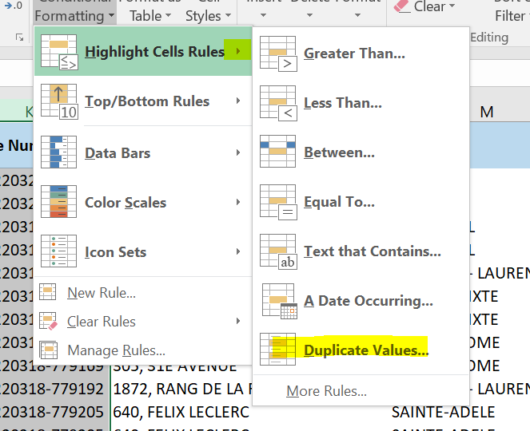
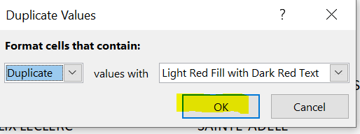
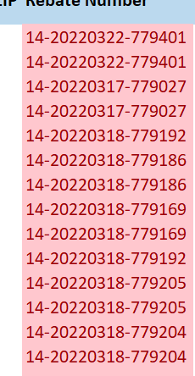
Step Three: Check For Duplicates
Select Highlight Cell Rules and Click Duplicate Values:
Click OK on pop up:
All duplicates will be highlighted:
Ensure that none of the duplicates are due to being applied for twice.
Check that there are no true duplicate serial numbers.

Slide 12
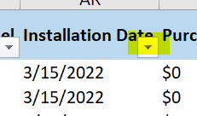
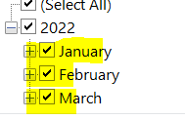
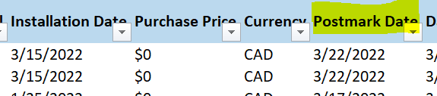
Step Four: Filter by Installation Date
Click Installation Date arrow:
Select Dates by Quarter:
Check Postmark Date for Late Submissions:
Ensure that the claims submitted late are getting paid at 50% or 0% depending on the submission date as laid out in the terms and conditions.
Does the dealer have an exception? Check the claim, share folder, SF and email.

Slide 13
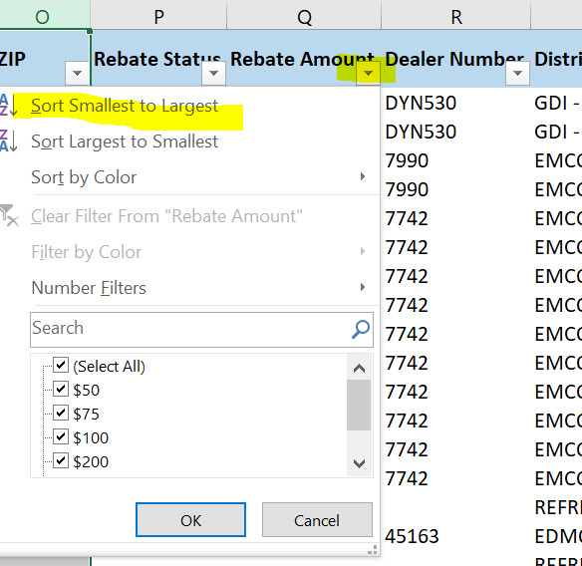
Step Five: Sort by Rebate Amount
Sort smallest to largest:
Compare Equipment to the Programs Excel to ensure it is being paid correctly for each rebate amount
  Now is the time to also ensure all equipment qualifies
    Verify all equipment matches the manufacturer. For example if reviewing Daikin, then only Daikin equipment should be listed, same with Amana, Goodman and Liberty
  NOTE – Ductless: This is a good time to double-check the indoor seer level matches the outdoor seer level. If not we need to pull up the rebate claim number and verify

Slide 14
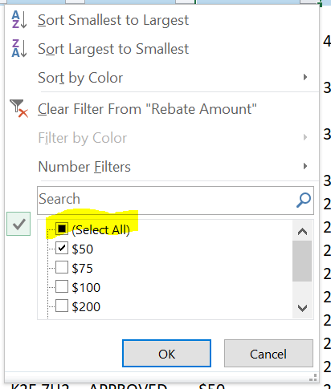
Step Six: Review Serial Numbers
Clear out all of the filters:
Check that all serial numbers look to be 10 digits long
  If a serial number looks short, pull it up in RPS and confirm it with the Goodman Warranty Look Up Tool

Slide 15
Step Six: Verify DCP
Verify dealer is DCP by utilizing the dealer locator tool, SalesForce, the dealerrebates inbox, or RPS
  You may reach out to the processor for help if you cannot find DCP – they may have more information
Important Notes:
Do research: You may need to pull up claims, search the inbox, or look into SalesForce to figure out if something is right or wrong
Some regions in Canada get paid in USD. The locations are New Brunswick, Nova Scotia, Prince Edward Island & New Foundland.

Slide 16

Step Seven: Your Findings
On the second tab of the funding file:
  List the rebates that need updates
  Be clear and concise – What needs to be updated? Why?
  Use this format:
Note: Once you have verified a rebate to be correct, color it green. If it needs updates, color it red. This way you are certain all rebates have been reviewed.

Slide 17
PART THREE
Reviewing FBD Files

Slide 18
Steps 1-4
Same as for instant – see above slides for steps 1-4

Slide 19
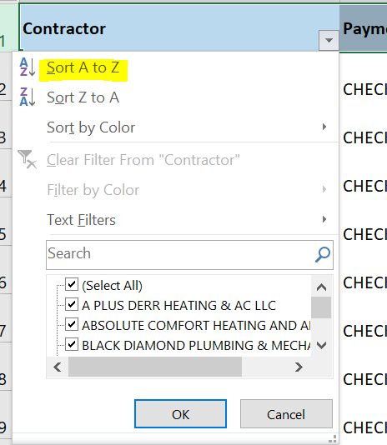
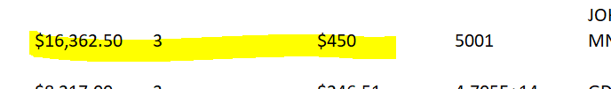
Step 5: PAP, Incentive, Loan Caps
Filter by contractor and cross-reference with SalesForce to ensure that the incentive is correct based on PAP or lack thereof:
Ensure that rebate amounts don’t exceed the loan cap for that program based on terms and conditions
Verify that equipment for each claim qualifies based on that program’s terms and conditions
  Verify all equipment matches the manufacturer. For example if reviewing Daikin, then only Daikin equipment should be listed, same with Amana, Goodman and Liberty.

Slide 20
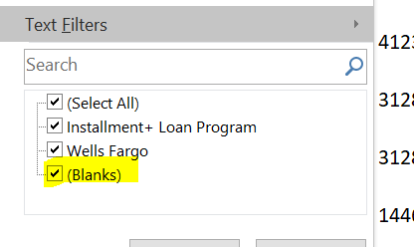
Step Six: Check Financing Info
Filter each financing column by “blank”:
Mark as update needed, note that financing information is incomplete on the 2nd tab

Slide 21
Step Seven: Dealer Fees
Ensure that the dealer fee does not exceed the rebate amount:
  Compare the dealer fee shown on the funding proof to the rebate amount
  List it as update needed if rebate amount is any more than dealer fee

Slide 22
Step Eight: Review Serial Numbers
Clear out all of the filters:
Check that all serial numbers look to be 10 digits long
  If a serial number looks short, pull it up in RPS and confirm it with the Goodman Warranty Look Up Tool

Slide 23
Step Nine: Your Findings
On the second tab of the funding file:
  List the rebates that need updates
  Be clear and concise – What needs to be updated? Why?
  Use this format:
Note: Once you have verified a rebate to be correct, color it green. If it needs updates, color it red. This way you are certain all rebates have been reviewed.

Slide 24
PART FOUR
The Share Drive Continued

Slide 25


Step One: Uploading Files
Return to the share drive where the Funding Files were downloaded from:
Upload your files to the folder named, “Reviewed”:
Name each file:
  Batch Number-Year-Program-U or NU
  12345-2022-US-Daikin-Instant-U or NU
U: Updates required
NU: No Updates required

Slide 26
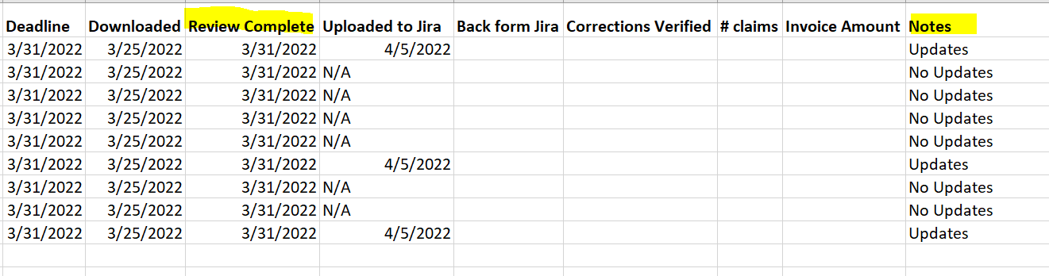
Step Two: Updating Master Batch
Put the date that you uploaded the reviewed file to the Share Drive, and add in the notes if updates are or are not needed:

Slide 27
PART FIVE
Verify Corrections

Slide 28
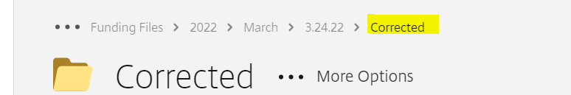
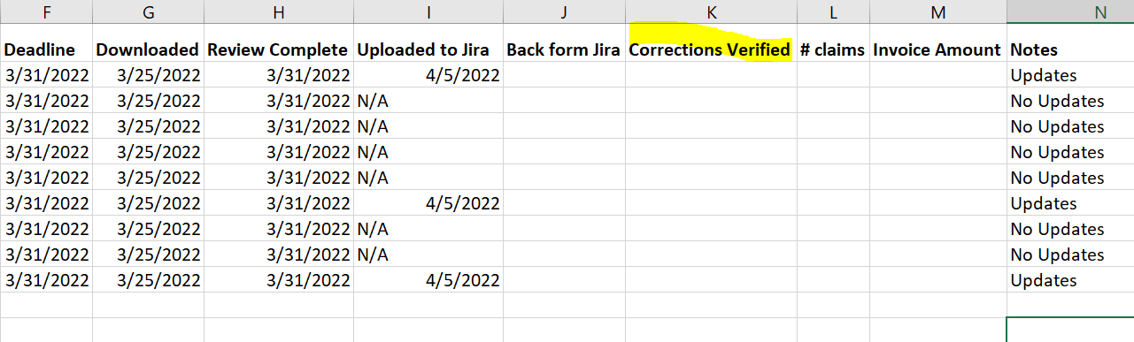
Step One: Share Drive
Check the Corrected folder for any of your batches:
Ensure that all of the changes you notated on your file were made on this new file, and on the claim in RPS
  If not, create a second tab and list what still needs an update
  Update the Master Batch the date you verified the corrections were made:

Slide 29
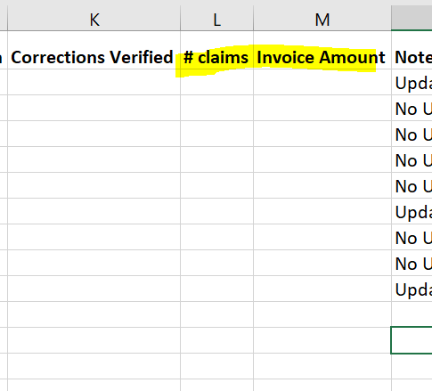
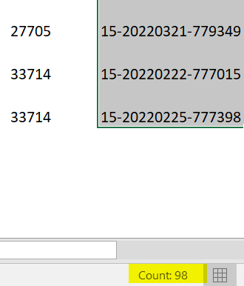
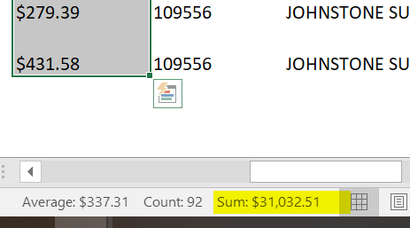
Step Two: # of Claims / Invoice Amount
Fill out the number of total claims and invoice amount on Master Batch:
Find this information at the bottom:

