Slide 1
Energize CT
Processing Guide 12.15.21

Slide 2
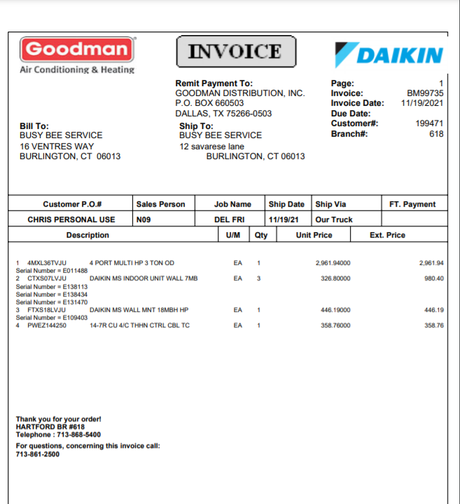
What are you verifying?
The purchase order reflect Goodman, Amana, or Daikin logo or reflect remit payment to Goodman Distribution ( See orange rectangle)
The invoice number on the application matches the invoice number/ document number on the purchase order. ( See orange arrow)
The purchase order document date matches what is listed on the application. ( See orange arrow on the right side.)
The equipment model and serial number on the purchase order matches the model and serial number on the application. ( See orange arrow on the left side)
The company name and address on the purchase order matches what is listed on the application. ( See orange oval)

Slide 3
You are not verifying
The customer name
The install address
The incentive amount

Slide 4

How to process video

Slide 5
Program Reject Codes
If for some reason you are unable to approve a claim the first time please add the applicable reject code:
R_AUTOMATIC_MANUAL | R_REVIEWSTATUS | R_CUSTDESC
A | D | The product must be purchased during the program term.
A | D | The serial number has been previously used. If this claim was submitted incorrectly please reapply.
M | D | This claim is a duplicate. If it was submitted incorrectly please reapply.
A | D | The installation address has previously received an incentive. If this claim was submitted incorrectly please reapply.
M | D | The supporting documents were not submitted by the deadline date.
M | D | The submission deadline for the program has passed.
M | D | This claim does not meet the program requirements. If this claim was submitted incorrectly please reapply.
M | D | This application has been marked as deleted.
A | D | This is a test application.
A | D | At your request your application has been canceled.
M | R | The model number is missing from the purchase order. Please update and resubmit.
M | R | The model number on the purchase order does not match the model number on the incentive application. Please update and resubmit.
M | R | The serial number is missing from purchase order. Please update and resubmit.
M | R | The serial number on the purchase order does not match the serial number on the incentive application Please update and resubmit.
M | R | The purchase order uploaded is illegible. Please update and resubmit.
M | R | The purchase order was not submitted. Please upload a copy of the purchase order and resubmit.
M | W | HOLD PER CSR. DO NOT PROCESS.

Slide 6
Thanks for processing!
Questions: Contact Donica Wilson at 916-480-7388 or dwilson@egia.org

