Slide 1




All in One Financing Solution
Presented By: Presenter Name Goes Here
Created For:
Notes:
MUST Edit
Add contractor/distributor logo in place of white OPTIMUS logo

Slide 2

Notes:
Welcome to OPTIMUS
Which challenges in Finance do you face?
95% of All Finance is done through Prime Lending; Imagine the growth by unlocking Near Prime and Sub Prime
Multiple Applications; Overcoming a “No”
Multiple Websites and Portals
Denials with no where to go
Why OPTIMUS solves them
OPTIMUS origin story: how it makes the customer experience better

Slide 3
The Right Solution for Every Customer
Prime
680+ FICO, Prime customer
Consumer Application
Mobile App
Website
Direct Consumer Marketing
Soft Credit Pull
Near Prime
600-679 FICO, Sub-Prime
Subprime
<600 FICO, Lease to own
Notes:
No waterfalls!
90%+ Approvals
A program for every customer
Fastest way to get to a YES
Best pricing in the Industry, with the absolute easiest process
Its about the Customer Experience
New image: funnel to marketing

Slide 4

OPTIMUS Prime Leasing Program
Subscription… Just Like Netflix!
Notes:
Option to Hide
Subscription like Netflix!
Homeowner benefits:
Maintenance and Repair coverage for 10+ years
Emergency/Priority Service at no additional charge
No Travel/Trip/Diagnostic changes
No Money Down and Fixed monthly payments
100% Transferability and Opt-Out at any time
Dealer Benefits
Customer Retention opportunities for 10+ years
Increased Average Tickets and Add-on Sales
Increased Profitability over other transaction types
Predictable Recurring Revenue over 10+ years
Industry Leading Sales Training and Dedicated Support

Slide 5
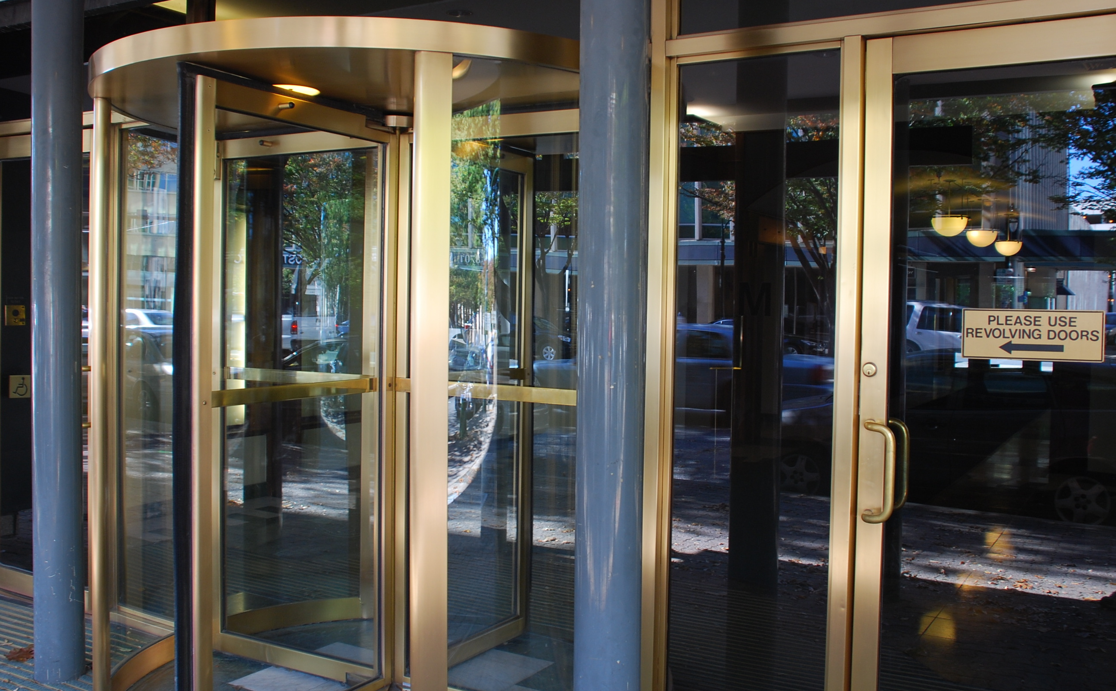
OPTIMUS Revolving
Future purchases with the same line of credit
Notes:
Option to Hide
Revolving line of credit allows future purchases with same line of credit
Well known, trusted name in banking
Revolving line of credit allows future purchases with same line of credit
No money down, affordable fixed payments
Industry leading no interest with equal monthly payment loans
Improved electronic funding process
Unsecured, no pre-payment penalties

Slide 6
OPTIMUS Application Process Demo: https://app.optimusfinancing.com/
Notes:
Picture of Website?

Slide 7
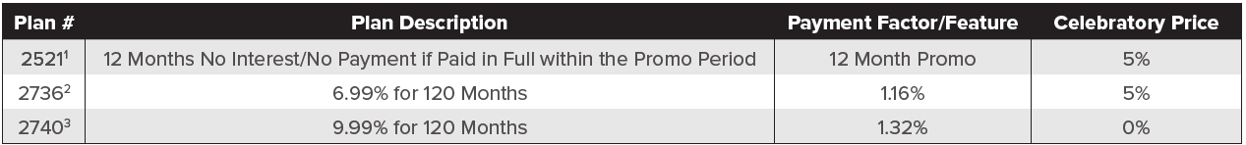
OPTIMUS Promotions (Valid Through 12/31/2021)
How to Sign Up: www.optimusfinancing.com/
Notes:
Use this as an example.

Slide 8
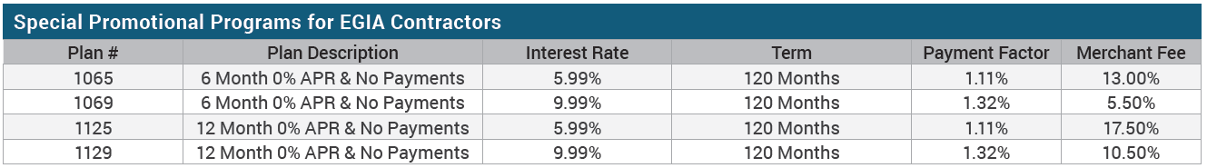
OPTIMUS Hybrid Loans
How to Sign Up: www.optimusfinancing.com/
Notes:
Use this as an example. “SAC” No Payment Loan that rolls to Low APR/Low Payment.
Cash and Payment
12 month ‘no, no’ interest rate deal
https://finportal.egia.org/finance-enrollment/index.php

Slide 9
Click Here To Become An OPTIMUS Dealer

Slide 10

Contact Your OPTIMUS Team
Jen Morris
Phone: (843) 327-7887
Email: jmorris@egia.org
Jeremy Chandler
Phone: (916) 759-0515
Email: jchandler@egia.org
www.optimusfinancing.com
Leslie Lewis
Phone: (916) 821-2205
Email: llewis@egia.org
Notes:
Can Edit
Sales Support: whole team

